Slide 1
Year End Close
FY 2024-2025
Districtwide Training:
Merritt College – April 28, 2025 (1:00 pm – 4:00 pm)
Berkeley City College – April 29, 2025 (9:00 am – 12:00 pm)
District Service Center – April 30, 2025 (9:00 am – 12:00 pm)
Laney College – May 1, 2025 (9:00 am – 12:00 pm)
College of Alameda – May 6, 2025 (1:00pm – 4:00pm)

Slide 2

Welcome
&
Training Overview
Welcome & Introduction
Training Sessions & Resources
Topics: Review of Critical Dates, Requisitions/Purchasing Orders/Receipt of Goods, Prepays and Liabilities, and Accruals
Questions/Conversation
Check-in

Slide 3
Year End Close
Why is fiscal close a big deal?
Public entity – public funds
Compliance – determined by audit review
Fiduciary responsibility
Guided by external timelines – State Chancellor’s Office, Department of Education
Impact on resource projections for next budget year – accuracy in budgeting
Financial Aid: determination of non-compliance could result in fiscal implications in our ability to administer financial aid

Slide 4

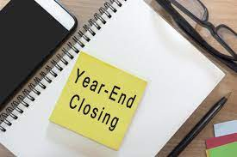
Year End Close

Slide 5
Year End Close
Our goal this year is to close the District’s books no later than August 30, 2025.
Training on fiscal close processes:
Merritt College – April 28, 2025 (1:00 pm – 4:00 pm)
Berkeley City College – April 29, 2025 (9:00 am – 12:00 pm)
District Service Center – April 30, 2025 (9:00 am – 12:00 pm)
Laney College – May 1, 2025 (9:00 am – 12:00 pm)
College of Alameda – May 6, 2025 (1:00pm – 4:00pm)
Year End Close is crucial for accurate financial reporting, a clean external audit, and projecting carryover budgets for the subsequent fiscal year. Anticipating current year (2024-2025) expenditures is key to a successful fiscal close.
To be proactive of year end activities, it is imperative to comply with the deadlines as indicated below. The dates listed in this communication are the last dates for processing various types of transactions. (If multiple steps are required before a transaction can be fully posted, you must consider all steps to ensure that the last step takes place by the date listed.)

Slide 6
Year End Close
Last regular meeting for FY 2025:
Board Docs Deadline - May 20th
Board Meeting - June 10th

Slide 7
Year End Close
*If an accrual is not processed to account for expenses/invoices in the current fiscal year, the invoices will be paid from the next fiscal year’s budget (2025-2026).
Key Notes for Annual Closing Activities
  For this year, there is a single date for both restricted and unrestricted funds
  All purchase Requisitions (and change orders) must be fully approved by June 6, 2025
  Make sure to allow time for all approvers to review and approve the transaction by that date
  Requisitions must have a valid budget check before submission
  After June 9th, requisition access will be restricted
  Payment Requests for Direct Pay transactions must be fully approved by July 11, 2025 and must comply with the approved procedure

Slide 8
Year End Close
Exceptions
  Purchases for commencement-related activities (please adhere to the established purchasing process)
  Purchases made for health and safety emergencies (As soon as these situations are identified, the cost center budget manager should contact the Purchasing Department ASAP)

Slide 9
Year End Close
Purchase Orders
Please review all current POs to ensure that all goods and/or services will be received on time.
  Goods and services received by June 30 and invoiced by July 11 can be paid through the normal Accounts Payable process
  For goods and services received after June 30 and invoiced between July 12 and July 31, invoices must be accrued as liabilities. If the invoice has not been received by the accrual cutoff (August 1), base the accrual on the quote or an estimate from the vendor
  Goods and services received after July 31 must be charged to the FY25-26 budget (not accrued)
  You can check the system for invoices using queries IS_IT_PAID_SIMPLE or VOUCHERS_BY_REQUESTER
  If the invoice is not in the system, contact your AP specialist to confirm

Slide 10
Year End Close
Yearend Accrual
If no invoice has been submitted by June 30, requesters should contact the vendor to either submit an invoice or, if an invoice cannot be submitted in time, to provide an estimate that can be used as the basis for the accrual.
Accruals are submitted as liabilities using 393 as the expense cost center. The process is detailed later in this training.
Personnel Actions
eFORMs requesting payment for any assignments with a start date prior to July 1, 2025, must be approved by the College President (for colleges) or the Vice Chancellors (for district offices) by June 13, 2025. This deadline is necessary for the District to adhere to a timely annual close.
Receipt of eFORMs after this date may delay the processing of payment and delay actual payment to an employee.

Slide 11
Year End Close
Payroll Transactions
Adjustments for pay periods in fiscal year 2024-25 must be received for processing and posting by June 27, 2025.
A Year End announcement will be distributed separately.
Travel Activities
Travel authorizations must be fully approved prior to the start of any trip.
If you need to submit a travel authorization in May or June for a trip in July, enter a dummy TA for one penny and attach a memo listing the actual anticipated total. Remember that you will need to have budget in July to cover all costs.
All expense reports for fiscal year 2024-2025 must be submitted by July 11, 2025.

Slide 12
Year End Close
Receiving Items
If your college/department receives a delivery of goods directly, as opposed to the Warehouse them, please notify the Warehouse in order to record the receipt of goods, and also the Purchasing Department immediately so that the open PO is not inadvertently closed.
Please contact the Finance team if you have any questions or concerns. In order to ensure a smooth and timely Year End close, we all must do our part.

Slide 13
Budget & Finance
Preparation, maintenance, and monitoring of the District's budgets
Maintains district-wide positions control system
Reviews and approves budget journals, budget transfers, and journal entries
Assists in the development of annual tentative and adopted budget
Analyzes a wide variety of bond-related transactions, financial and statistical reports
Laney College
Merritt College
Berkeley City College
College of Alameda
Fareha Bakre
Principal Budget & Finance Analyst
Foziya Musse
Principal Budget & Finance Analyst
Tami Taylor
Principal Budget & Finance Analyst
Andrea Stokes Senior Financial Analyst – Capital Outlay

Slide 14
Questions?

Slide 15
Purchasing
Presenters:
Nicanor Custodio
John Heibert
Myisha Lewis
Seraphine Nzomo

Slide 16
Purchasing
Responsible for all aspects of the procurement process: preparation of quote analysis, source and prequalify suppliers, evaluate material and services, vendor database maintenance, and audit support
Develop and issue competitive bid packages using RFQ/RFP process and monitor changes
Prepares purchase orders for equipment, supplies, and services necessary for the operation of the District
Provides information and assistance to vendors and district personnel
Responsible for change orders and cancellation
#1-9 and A-Ch
Ci-I
J-Pe
Pg-Z
Seraphine Nzomo
Buyer
Nicanor Custodio Jr.
Buyer
Myisha Lewis
Buyer
John Hiebert
Buyer

Slide 17
Requisitions and Purchase Orders
Services and Tangible Goods
Purchasing deadline for approved Requisitions (and Change Orders) for all funds is June 6, 2025.
Buyers MUST review Requisitions for completeness, compliance to the district’s administrative policies and purchasing standards, and ensure that they understand what goods and services are being purchased.
Sometimes these tasks require that Purchasing staff engage with the requesting department or division for clarification and Purchasing may offer suggestions about alternative items or procurement alternatives.
Only after Purchasing has reviewed and dispatched the Purchase Order is the vendor authorized to perform goods or services.

Slide 18
Requisitions and Purchase Orders
What do the Buyers need to dispatch Purchase Orders in PS?
The requisition must be budget-checked and have funds fully encumbered. If there are issues with the budget the Buyer will reach out to the requisitioner by email or via Teams
Requisitions must include quotations, bid recaps, or supporting documentation for purchase where required by district procedure
If the work is under contract, the agreement must be fully executed
Requisitions must include the board item if board approval was required

Slide 19
Requisitions and Purchase Orders
Purchase Orders are initially sourced in “Open” status automatically by the system. After the buyer has reviewed and dispatched the Purchase Order, it will have the status “Dispatched.”
The dispatched Purchase Order is sent to the vendor. End users may request copies of the dispatched Purchase Order.
Note: If a Buyer does NOT have all information necessary to dispatch the PO, the PO cannot be dispatched until all issues are resolved. The buyer will notify the requisitioner of the issue(s). Issues must be resolved urgently in order to complete the order within the fiscal year.

Slide 20
Requisitions and Purchase Orders
FINAL NOTE:
Ensure that all relevant information is entered into PS. This will enable buyers to expedite the processing of Purchase Orders. Utilize the note fields to provide essential details to departmental approvers regarding your requisition. Additionally, be attentive to email and Teams communications from buyers, as they may require prompt responses or additional documentation within the system.

Slide 21
Warehouse
Presenters:
Shawnee Martinez

Slide 22
Warehouse
Receives, marks, stores, issues, tags, picks-up, assembles, and delivers district supplies and equipment to campuses and District Service Center
Unloads incoming trucks at the warehouse and loads trucks for delivery
Delivers district mail
Checks items against purchase orders and packing slips and reports shortages, damages, and other discrepancies
Picks up recycling materials on a weekly basis
Assembles and makes minor repairs to equipment
Shawnee Martinez
Warehouse
Jay Kendrix
Warehouse
Luis Orellano
Warehouse

Slide 23
Warehouse: Delivery, Receiving & Storing
The Cutoff for warehouse staff to receive and receipt goods delivered to the district is June 30, 2025 for FY 2024-2025 purchases.
The Warehouse staff plays a critical role in procurement. They collaborate with departments and divisions to optimize warehouse operations, maintain an organized environment, and ensure efficient distribution of goods and supplies.

Slide 24
Warehouse: Delivery, Receiving & Storing
What happens when goods arrive at the District Warehouse?
Staff interacts with couriers and delivery personnel handling items that can be hand-carried, moved using dollies, or transported by forklift.
Staff must reconcile packing slips, delivery receipts or bills of lading with the associated Purchase Order in the system. They have to reconcile any discrepancies or issues that may arise.
Warehouse staff will reach out to end users if there are potential items for return due to damages.
Warehouse staff will reach out to end users if items appear to be leaking, odorous, or otherwise considered unsafe to move out of warehouse.

Slide 25
Warehouse: Delivery, Receiving & Storing
Key reminders:
DELIVERY HOURS are: 7:00 am-11:15 am and 12:00 pm to 3:15 pm
Advise your suppliers of the warehouse delivery hours
Advise suppliers that Warehouse Staff must sign for all deliveries
Having accurate information on the Purchase Order helps to easily identify the items delivered and allows for quick sorting and distribution

Slide 26
Warehouse: Delivery, Receiving & Storing
Contact the Warehouse in advance if:
  An order requires special handling
  An order needs to be delivered outside of the normal hours
  There is a need to store items for extended periods. This avoids overstocking and wasting valuable warehouse space
The district discourages “drop-offs.” This avoid conflicts and ensure staff is available to receive and process goods delivered.

Slide 27
Questions?

Slide 28
BREAK

Slide 29
Accounts Payable
Reviews and reconciles invoices and purchase orders submitted for payment
Reviews, analyzes and matches invoices and contracts for consistency with purchase order information
Examines travel claims for completeness and accuracy before payment
Works with warehouse, college business office, and district's personnel in finalizing payment
Prepares various accounts payable related reports
Dept. of General Services / M&O
Berkeley City College / Merritt College
College of Alameda / District Service Center
Laney College
Tina Du
Accounts Payable Specialist II
Nick Shere
Accounts Payable Specialist II
John Brown
Accounts Payable Specialist I
Jamila Osman
Accounts Payable Specialist I

Slide 30
Prepays and Liabilities
Presenter:
Nick Shere

Slide 31
The tl;dr:
*
When you are approaching the end of the fiscal year, you want to have a complete picture of all your outstanding invoices.
Tools for identifying invoices:
  Voucher Exceptions Report (VOUCHER_EXCEPTIONS) to find invoices we have that we cannot pay because some issues are preventing it.
  Open Encumbrance Report (PCC_OPEN_ENC_NEW) to find POs with remaining balances that should have already been spent down. Contact your AP Specialist to confirm if they have received the invoices!
  Vendors: Contact your vendors, especially if you have any vendors working on multi-year contracts or if they have delayed billing. If they are working in June, you need to know when that work will be billed. If it will not be billed in time for the AP cutoff, request an estimate.
INVOICES
*
“too long; didn’t read”

Slide 32
The tl;dr:
*
If you need to pay now for something that will happen next fiscal year, email the invoice to your AP Specialist with the budget coding for next fiscal year.
Example: Subscriptions and institutional memberships that are billed in advance every year.
AP will pay it now.
In July, create a requisition in the new fiscal year and notify your AP Specialist.
If the transaction is split across both fiscal years, create two reqs, one now for this year’s portion, one in July for next year’s portion.
PREPAYS
*
“too long; didn’t read”

Slide 33
The tl;dr:
*
If you need to pay in July or later for goods and services received in June or earlier, work with your business office to submit the invoices or estimates as part of your campus’s “liability list.”
Example: Vendor works in June but won’t bill until August, or there is a dispute on the invoice that will take a long time to resolve
Finance will create a journal entry that charges your old year budget for the expense being accrued.
The journal entry will reverse the funds in the new year, creating a negative expense.
AP will process a payment in the new fiscal year which will be offset by the negative expense.
If the transaction crosses between fiscal years, you will need to do a req in July for the new year portion.
LIABIILITIES
*
“too long; didn’t read”

Slide 34
Type of transaction | When we pay for it | When we receive it | When we account for it
Prepay | Old Year | New Year | New Year
Liability | New Year | Old Year | Old Year
Prorated Prepay | Old Year | Both Years | Both Years
Prorated Liability | New Year | Both Years | Both Years
Regular re-encumbrance | New Year | New Year | New Year
Summary of Prepay and Liability Transactions

Slide 35
Okay here’s the too long part
In a normal transaction, funds move from your budget to an AP balance sheet account, and from there to cash
  4304 -> 9940 -> 9110
  In commitment control, you only see the first step in that chain
When we cut a prepay check, the initial transaction starts in a separate balance sheet account
  9220 -> 9940 -> 9110
  The payment is hitting cash (Peralta’s bank account) but it does not yet come out of your budget
  At this stage, you won’t see anything in commitment control (budget overview)

Slide 36
Long part (continued)
Later on, in the new fiscal year, you initiate the requisition to cover this (already paid) expense
AP takes the funds off of that PO and applies them to the prepaid voucher to offset the expense
  4304 -> 9220
The new voucher does show up in commitment control/budgets overview
You can maybe think of a prepay as borrowing from the district when we issue the prepay, and paying the district back when we do the offset requisition and voucher

Slide 37
Normal transaction
In a normal transaction, funds come out of your chartstring (and PO encumbrance) and into 9940 when AP creates a voucher
When AP cuts a check, the funds move from 9940 into 9110
4304
9940
9110
Current fiscal year
(Your req/PO distribution)
(AP suspense: a posted AP voucher)
(Cash: a payment issued and posted)

Slide 38
Prepay Transaction
9220
9940
9110
In a prepay transaction, funds initially move from the 9220 balance sheet account to 9940
Later on, the transaction in 9220 is offset by a voucher which hits the new fiscal year budget
Current
fiscal year
Prepayment balance sheet account
(AP suspense: a posted AP voucher)
(Cash: a payment issued and posted)
Next
fiscal year
4304
(Your req/PO distribution)

Slide 39
Prorated (Split)
Prepay Transaction
100%
100%
100%
In this example, we have a transaction that falls half in this year and half in next year
The actual split can be 60/40, 70/30, etc., depending on the dates in question
In this case you will do two reqs, one in the old fiscal year, one in the new fiscal year
9220
9940
9110
Prepayment balance sheet account
(AP suspense: a posted AP voucher)
(Cash: a payment issued and posted)
Current
fiscal year
50%
4304
(Your June
req/PO distribution)
Next
fiscal year
50%
4304
(Your July req/PO distribution)

Slide 40
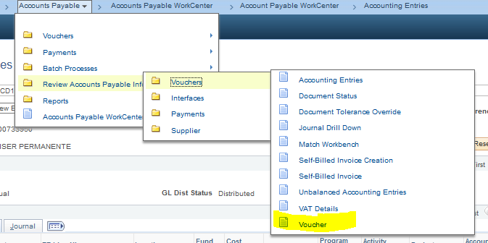
How do I know if my prepay invoice is paid?
You can’t use req doc status or VOUCHERS_BY_REQUESTER to see if your prepay invoice was paid, because the voucher is not associated with a requisition in the system
But you can pull up the voucher directly by using the Voucher Inquiry screen under Review Accounts Payable Information
Search using the invoice number

Slide 41
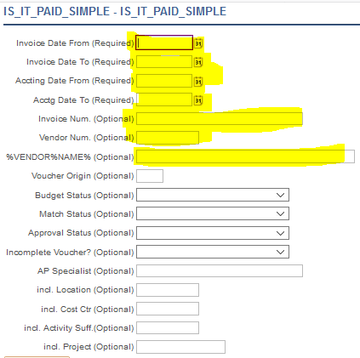
How do I know if my prepay invoice is paid?
You can also use query IS_IT_PAID_SIMPLE to search by invoice number or vendor ID/vendor name

Slide 42
How does this relate to “liability lists”
When we talk about “liability lists” we’re referring the accrual of invoices from the prior fiscal year for payment in the new fiscal year
So, basically the opposite of a prepay
In the liability list process, you make a list of invoices you know are outstanding but which for some reason can’t be paid by the AP cutoff in July
That list of invoices is used to create a journal entry to record the expense in the old year while allowing us to pay it in the new year
For example, a vendor has completed work but they fail to invoice us in a timely manner. We accrue the funds so we can pay them once we do get the invoice

Slide 43
Liability Transaction
4304
9510
In a liability transaction, funds are moved from your original budget chartstring into the liability account.
Then, they are reversed into the new fiscal year to create a negative expense. Like an anti-check!
When AP pays the bill, the AP voucher washes out with the reversed prepay.
Current
fiscal year
Your original budget
Journal entry into the liability balance sheet account
4304
9110
Next
fiscal year
9940
Journal entry reverses into the new fiscal year
(Cash: a payment issued and posted)
AP Suspense Account

Slide 44
Prorated (Split)
Liability Transaction
4304
50%
50%
9510
In a prorated liability transaction, the liability journal accrues the old FY portion.
New near funds are encumbered normally.
So, your requestion will have (at least) two lines, one coded normally and one coded to 393.
Current
fiscal year
Journal entry into the liability balance sheet account
Your original budget
4304
50%
100%
9110
100%
Journal entry reverses to new year
9940
(Cash: a payment issued and posted)
Next
fiscal year
AP Suspense Account
50%
4304
New year budget

Slide 45
What should be accrued?
As long as an invoice and complete documentation can be submitted to AP by the cutoff (July 11 for FY25), you should not need to accrue them.
However, if you have a vendor that you know will not generate an invoice until after July 11, you may need to accrue an estimated amount to cover that final invoice.
Hopefully you will not have any verbal orders or vendors working without contracts, but historically these have also been a source of liability transactions.
Review your open encumbrances in April/May/June and follow up with your vendors to determine what if anything you may need to accrue.

Slide 46
Accounting
Review all billings to ensure compliance with local, state, and federal policies and regulations
Maintains detailed ledger of funds allocated, received, and expended
Organizes billing workflow and ensures that financial schedules and deadline are met
Submit project billings
Collects data and posts entries to appropriate general ledgers
Receives cash and check deposits from the colleges
Herzie Mendoza
Senior District Accountant
Richard (Zhao) Jian
District Accounting Technician
Ofelia Mendoza
District Accounting Technician
Judy Lam
Principal Accounting Technician

Slide 47
Accruals
Presenter:
Herzie Mendoza

Slide 48
How liabilities are processed
Finance will provide an Excel template to the business office.
Work with the business office to list all invoices (or estimates) for prior-year expenses that you will not be able to submit normally.
You must have valid budget for all of them.
Finance will set a deadline to submit the spreadsheet.
The accrual deadline for FY25 is August 1.
It’s important to capture all liabilities to avoid audit findings.

Slide 49
How liabilities are processed
After Finance has posted your campus’s liability journal, you should receive a report showing the budget coding used for the reversal side of the accounting entries.
The liabilities will be set up in cost center 393.
You can review liability journals with query 9510_JOURNALS_A.
You will use this new coding string to set up the Requisitions in July to pay your liability invoices.
Once the liability PO is dispatched by Purchasing, let AP know to process the payment.
Please note that cost center 393 transactions are approved by finance, not the campus. So please make sure to keep finance aware of any liability invoices you do not yet wish to pay – for example, if there is a dispute with the vendor that needs to be resolved. If needed, you can request in advance for Finance to ad hoc route the transaction to the campus manager who should review it.

Slide 50
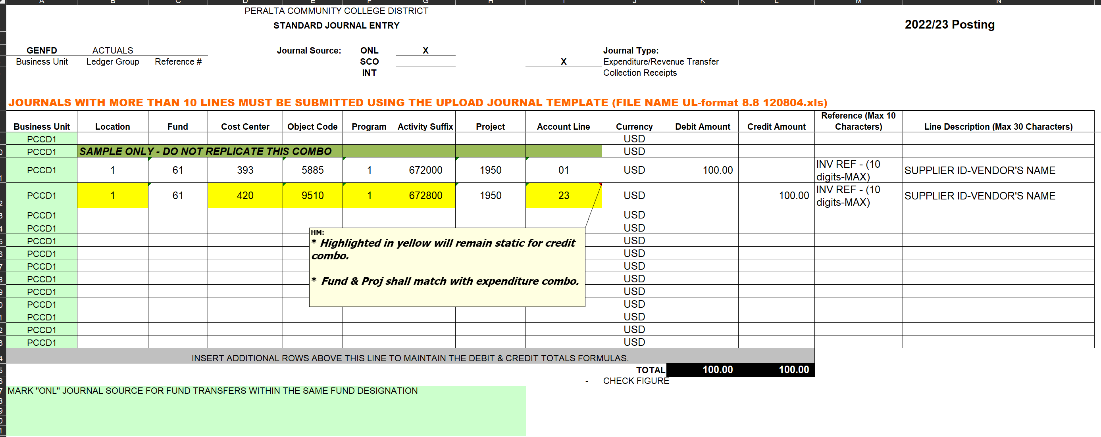
Year End Close
Workbook Template for Yearend Transactions leftover

Slide 51
Year End Close
Debit Line:
During Year End closing, the District will use Cost Center 393 (Liabilities Reversal) combo instead of original Cost Center used.
Credit Line:
The static yearend 23-digits combo are: X-XX-420-9510-1-672800-XXXX-25. Please align your Location, Fund used, Project references from expenditures lines.
Note: Be mindful on splitting cost (i.e.: EBMUD invoices b/w water & sewer costs)

Slide 52
Helpful Queries
Presenter:
Nick Sheres

Slide 53
Some Important Queries for Requesters
Query Name | Function | Frequency to Run
PCC_OPEN_ENC_NEW OR PCC_OPEN_ENC_NEW_REQUESTER | Open Encumbrance Report: review POs with remaining funds encumbered | Once every 1-2 months, more frequently between April and July
VOUCHERS_BY_REQUESTER | Track vouchers for invoice payment against your POs as they are entered | 1-3 times per week or as needed
IS_IT_PAID_SIMPLE | Locate vouchers matching specific criteria | As needed
VOUCHER_EXCEPTIONS | Vouchers that we have in the system but cannot yet pay | Weekly or Monthly
AP_DEPT_EXP_HIST_B | Department expense history: review year-over-year spending | Annually
REQUESTER_REQ_PO_STATUS | Review the status of your reqs and associated POs | Weekly or as needed
PO_LINE_ENCUMBRANCE | Returns the encumbrance amounts on one PO | As needed to verify remaining funds
VENDOR_COMMIT_THRESHOLD_B | Check how much we have spent or intend to spend with the vendor for the fiscal year, broken out by cost center. | Before initiating a direct pay or other threshold-limited transactions.

Slide 54
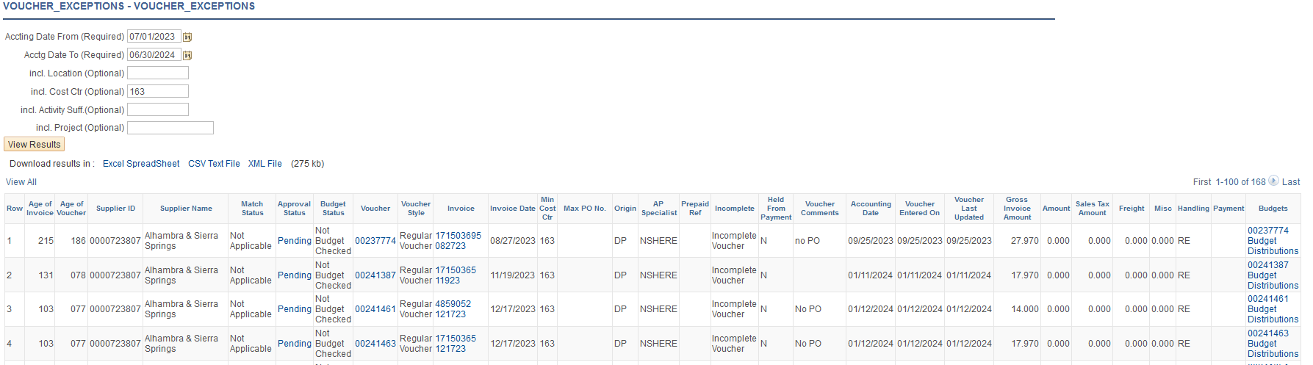
Queries: Voucher Exceptions
Your AP Specialist should provide you with your voucher exceptions on a periodic basis
You can also run them yourself
  Navigate to Reporting Tools->Query->Query Viewer and search for VOUCHER_EXCEPTIONS
  Enter the current year beginning and end dates and your cost center

Slide 55
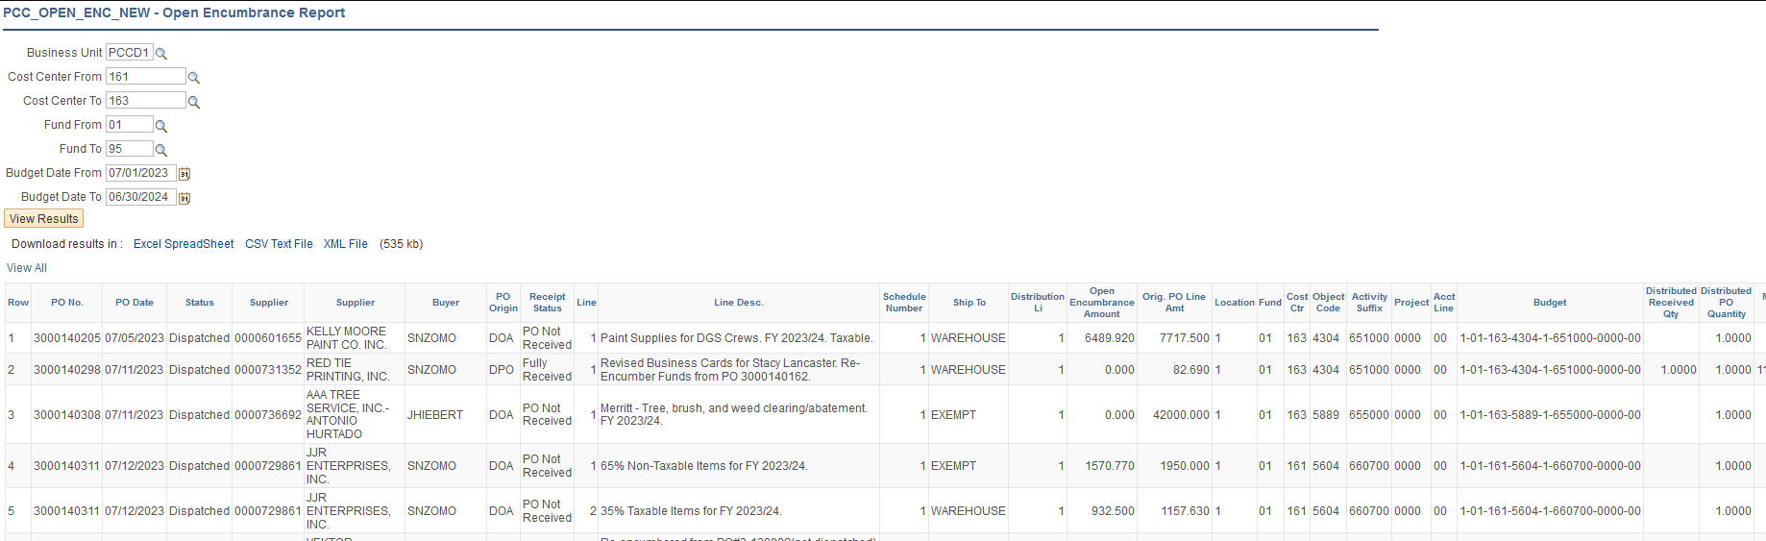
Queries:
Open Encumbrances
You should run your open encumbrances around once a month
In query viewer, search for PCC_OPEN_ENC_NEW to pull encumbrances by cost center range, or PCC_OPEN_ENC_NEW_REQUESTER to pull encumbrances related to Requisitions you entered

Slide 56
Training Resources
https://www.peralta.edu/finance/training-materials
https://www.peralta.edu/finance/forms-documents-presentations
https://www.peralta.edu/it/peoplesoft-upgrade
https://peralta.instructure.com/courses/56014/modules
https://www.peralta.edu/boardoftrustees/bp-ap

Slide 57
Questions?

Slide 58



Thank You!
@PeraltaColleges
@PeraltaColleges
@peraltacolleges

