Slide 1

Peralta Community College District
FLEX Day Presentation
2015 Strategic Plan
January 14, 2015

Slide 2
Background:
The first PCCD Strategic Plan was finalized in 2008.
Developed in response to an accreditation recommendation.
Consultants guided the development of the first plan.

Slide 3

This year we have updated the original Strategic Plan

Slide 4
Strategic Planning
(6 years)
Program Review
(3 years)
Goals, Objectives
PBIM
(operational planning)
(1 year)
Goals, Objectives
Goals, Objectives
PCCD Planning Cycles

Slide 5
Strategic Plan Update Process
Reviewed and revalidated the PCCD Mission Statement (Spring 2014)
Conducted an external scan of our service area (Summer and Fall 2014)
Reviewed and updated the existing Strategic Goals (Fall 2014)
Conducted an internal scan of PCCD data (Fall 2014)
Set new Institutional Objectives (Fall 2014)

Slide 6
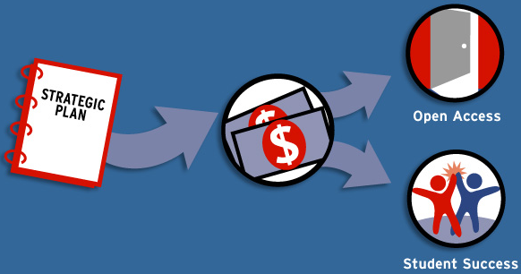
Why do Strategic Planning?

Slide 7
We want to ensure that all planning is aligned with our Mission and integrated with our Strategic Goals

Slide 8
PCCD Strategic Goals
A. Advance Student Access, Equity, and
Success
B. Engage and Leverage Partners
C. Build Programs of Distinction
D. Strengthen Accountability, Innovation and
Collaboration
E. Develop and Manage Resources to
Advance Our Mission

Slide 9
External and Internal Scan Data

Slide 10
Demographic Change
Population Growth in Alameda County
10 year projection is 6% growth overall
% change by age group varies:
15-24 years 0% change
25-34 years 4%
35-49 years (-1%)
60+ years 28%

Slide 11
Demographic Change
Ethnicity
Ethnic Group | 2014-2023 % Change
African American | -2%
American Indian | -5%
Asian | 12%
Hispanic | 10%
Pacific Islander | 9%
White | -1%

Slide 12
Demographic Change
Job Growth Will Outpace Population Growth
Population Growth = 6%
Job Growth = 13.5%
Majority of Projected Job Growth is in Service Related Industries

Slide 13
Demographic Change

Slide 14
Internal Scan Data

Slide 15
Internal Scan Data
To meet the demands of employment, the number of degrees and certificates must increase by 50%.
In the past five years, the number of degrees and certificates has increased by only 10%

Slide 16
Internal Scan Data
Students that Transfer
(past 6 years)
Majority are female

Slide 17
Internal Scan Data
Students that Transfer
Highest % are Asian

Slide 18
Internal Scan Data
Student Success Rates in Basic Skills Classes Vary by Ethnicity

Slide 19
Internal Scan Data
Student Success Rates in Basic Skills Classes Vary by Ethnicity

Slide 20
Internal Scan Data
Distance Education
# of Distance Education/Hybrid Classes has Increased
Student Success Rates for Distance Education Classes has not Increased
 | AY 2010-11 | AY 2011-12 | AY 2012-13 | AY 2013-14
100% Online | 59.7% | 55.9% | 58.6% | 56.2%
Hybrid | 63.7% | 57.9% | 61.3% | 56.5%
Total | 60.4% | 56.6% | 60.0% | 56.3%

Slide 21
Summary of Trends
Alameda County Job Growth Rate (13.5%)
Employment in Service-related Industries
Enrollment in Distance Education Courses

Slide 22
Summary of Trends
FTES/Enrollment
Degrees and Certificates Awarded
Student Success Rates in Distance Education Courses

Slide 23
Summary of Trends
College Age Groups
African-American Student Success Rates in Basic Skills English and Mathematics
Number of Full-time Permanent Faculty

Slide 24

Plan for Student Success

Slide 25
Questions and/or Comments?

