Slide 1

AY 2024-2025
FTEF Allocation Proposal Presentation
Education Committee
Dr. Stephanie Droker, Interim Deputy Chancellor
Dr. Nathaniel Jones III, Acting Vice Chancellor of Finance and Administration
Dr. Diana Bajrami, Acting President COA
Dr. Tina Vasconcellos, Associate Vice Chancellor of Educational Services
October 10 2023

Slide 2

Overview AY 22-23 and AY 23-24 Data (incl. projected Spring 24)
Academic Year 2024 – 2025 FTEF Proposal

Slide 3
F
AY 23-24 Overview & Projection
&
There is an anticipated increase in FTES from AY 22-23
This current and anticipated increase is still short of the residential FTES target
FTEF Actuals have consistently exceeded the FTEF Allocation

Slide 4
FTES Trends

Slide 5

FTEF Actual and FTEF Allocation

Slide 6
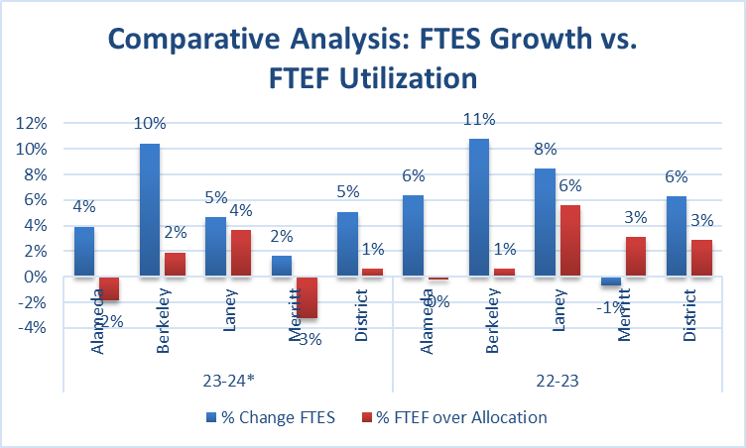
% FTES Growth & FTEF Utilization by College/District

Slide 7

Proposal
Increasing the FTEF Allocation for AY 24-25 from 920 to 925 FTEF.
Increasing the Dual Enrollment Allocation from 40 FTEF to 50 FTEF
These increases in FTEF would cost ~$665K that would need to be made up elsewhere in the budget

Slide 8
Methodology
Project
Project Spring 24 data based on Fall 2023 for both FTEF and FTES
Subtract
Subtract FTES generated from dual enrollment from total FTES
Analyze
Analyze the trends from (Total FTES – Dual Enrollment) and Dual Enrollment FTES

Slide 9

Proposal
Calculate the Funded Total FTES per each academic year (excluding dual enrollment)
Calculate the 3 year average % of Funded Total FTES per Each College (exclude dual enrollment FTEF from Total FTEF)
Allocate 925 FTEF based on the 3 year average % of Total Funded FTES per college
Calculate the 3 year average % of Dual Enrollment FTES
Allocate per college based on average 3 Year Percentage of Dual Enrollment FTES

Slide 10
FY 24- 25 FTEF Allocation Proposal
FY 24-25 FTEF Allocation Proposal | Alameda | Berkeley | Laney | Merritt | District
3 YR AveFunded FTES excl. Dual Enrollment | 2339.93 | 2784.26 | 4463.74 | 2881.88 | 12469.81
3 yr Ave % Funded FTES excl. Dual Enr. | 18.76% | 22.33% | 35.80% | 23.11% | 100.00%
Proposed AY 24-25 FTEF exc Dual Enrollment | 173.57 | 206.53 | 331.12 | 213.78 | 925.00
AY 23-24 FTEF Allocation excl. Dual Enrollment | 167.70 | 201.10 | 329.78 | 222.06 | 920.64
Difference Between AY 24/25 and 23/24 | 5.87 | 5.43 | 1.34 | -8.28 | 4.36
3 YR ave dual enrollment FTES | 161.01 | 474.58 | 727.22 | 471.07 | 1833.89
% 3 year average dual enrollment FTES | 8.78% | 25.88% | 39.65% | 25.69% | 100.00%
Proposed AY 24-25 Dual Enrollment FTEF | 3.51 | 10.35 | 15.86 | 10.27 | 40.00
Additional Proposed Dual Enrollment FTEF | 0.88 | 2.59 | 3.97 | 2.57 | 10.00
Total Proposed Dual Enrollment FTEF | 4.39 | 12.94 | 19.83 | 12.84 | 50.00
AY 23 -24 Dual Enrollment FTEF Allocation | 7.29 | 8.74 | 14.33 | 9.65 | 40.01
Difference Between AY 24/25 and 23/24 | -2.90 | 4.20 | 5.50 | 3.19 | 9.99
Total Proposed 24-25 FTEF | 177.96 | 219.47 | 350.94 | 226.62 | 975.00
Total FTEF 23-24 | 174.99 | 209.84 | 344.10 | 231.70 | 960.63
Difference Between AY 24/25 and 23/24 | 2.97 | 9.63 | 6.84 | -5.08 | 14.37
% Change | 1.70% | 4.59% | 1.99% | -2.19% | 1.50%

Slide 11
Process and Next Steps
The Proposal was shared with Presidents, VPs and District Team on October 9 in two separate meetings.
Present the Proposal and Data to the Education Committee
Present the Proposal to the PGC
Forward a Recommendation to the Chancellor for consideration and final decision

Slide 12

Questions & Discussion

