Slide 1
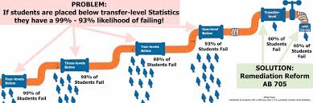
AB 705 District Meeting
November 20, 2018
Office of Academic Affairs

Slide 2
Agenda:
Final Decisions: Math and English
Curriculum Approval Status
Co-requisites vs. Linking: Decision
Noncredit: CDCP
Tutoring Taskforce and Parcel Tax
Counseling Update: Self Guided Placement Example
Scheduling Courses for AB705
Spring Priorities

Slide 3

Math and English Agree to Use the Default Rules:

Slide 4
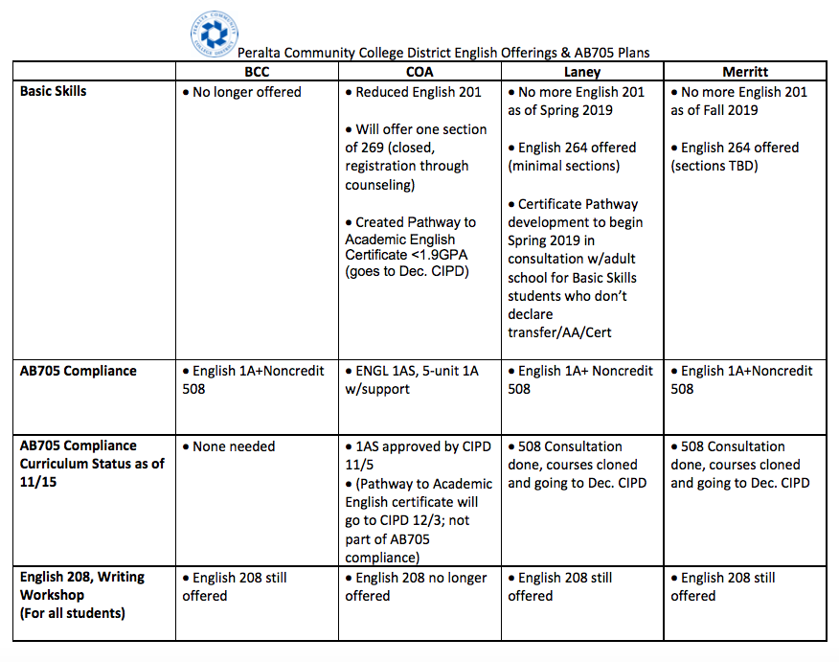
English: Decisions and Status

Slide 5
Math: Decisions and Status
Spring 2019 pilot: Statistics with support next semester at some colleges (some are linked and some are not). Laney offering Noncredit support courses for Math 1 (Pre-calculus) and Math 50 (Trigonometry) that are unattached to specific courses
Fall 2019: All colleges offering…

Slide 6
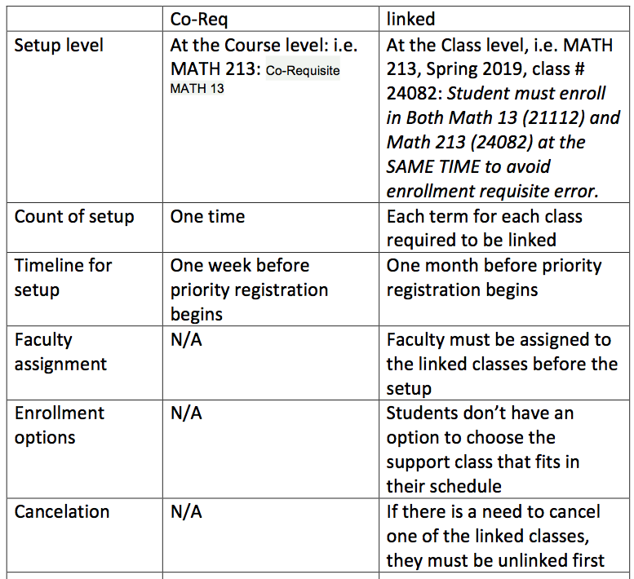
Co-Reqs. vs. Linked Courses:

Slide 7
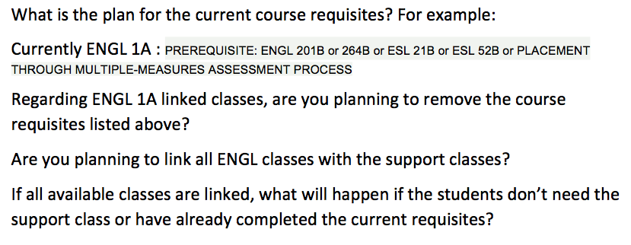
Questions Related to
Co and Pre-Requisites:

Slide 8
Noncredit Co-Requisites:
CDCP Noncredit Courses/Certificate:
  Benefits
    Does not add to the student’s credit load
    Students receive a Certificate of Competency/Completion
    Students CAN reenroll
    The process to go from a credit to noncredit student is now simplified
    SCFF pays the higher rate for CDCP FTES ($5,457)

Slide 9
Tutoring and Parcel Tax:

Slide 10
Counseling Update:
Update: VC Cifra
Example of Self Guided Placement Tool Sierra College https://www.sierracollege.edu/student-services/assessment/placement-tool/index.php

Slide 11
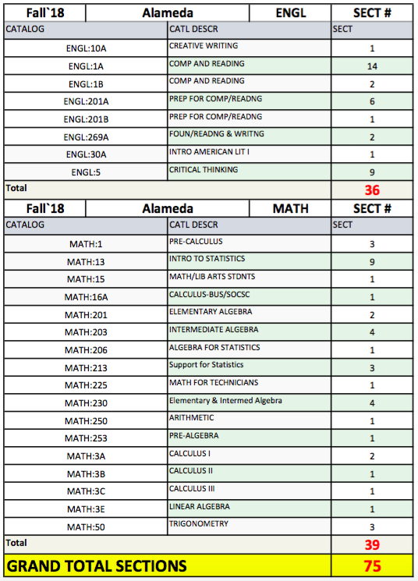
Scheduling for AB705:

Slide 12
Scheduling for AB 705:
How many sections? Fall 2018, Fall 2019
What will the extra hour of instruction do to classroom use?
We need to schedule Math and English first. With the additional instructional hours what will this do to the schedules of other departments?
Demo and Discussion: VP Miller and Nathan Pelligrin

Slide 13
Spring 2019 Priorities:
Pedagogy: Best Practices to maximize the intent of AB 705
ESOL: Bringing ESOL faculty to the table
Student Communication: Current and New
Other Priorities?

