Slide 1

Noncredit Guide for Deans
Fall 2019

Slide 2
Credit vs Noncredit: The Basics
Credit Classes | Noncredit Classes
Carries Units. You are paid by the unit. | Have no units. You are paid by the lecture/lab hour.
If students pass, they can not repeat the course. | All noncredit classes are repeatable, even if the students receives a Pass (P).
For most credit classes, you assign a grade of A, B, C, D or F. | For noncredit classes, you assign a grade of: P (Pass) for demonstrating the competency NP (No Pass) for not demonstrating the competency, or SP(Satisfactory Progress) for showing progress, yet not achieving the competency. SP is a non-passing grade.
Students are expected to do 2 hours of work outside of class for each lecture hour. | Students are expected to do little to no work outside of class.
 | Faculty must take attendance and report every hour that students are in class. This is crucial and is how the college is paid. It’s called Positive Daily Attendance (PDA).

Slide 3
What do we need to know?
1. Faculty assignments are assigned the same as credit. (Lecture unit credit=lecture hour noncredit)
2. Curriculum is made through the same process as credit. (Laney Curriculum Committee-CIPD-State Chancellor’s Office)
3. Grades and attendance are managed differently.

Slide 4
Grades
Faculty submit student grades ALONG WITH total hours in their faculty center.
There are three (3) grade options:
    P (Pass)
    NP (No Pass)
    SP(Satisfactory Progress)
    The definition for each should be clearly outlined in the course outline. SP is intended for students who came to class and learned something, but didn’t gain the competencies of that class. SP is a non-passing grade.

Slide 5
Positive Daily Attendance
All noncredit classes are Positive Daily Attendance (PDA). This means:
Faculty are required to track and keep clear records of each hour that students are in class.
Faculty submit the total number of attended hours in a separate column next to the grades column on the grade roster at the end of the term. This number is as important as the grade.

Slide 6
Census and Attendance Rosters
1. Noncredit classes must submit a Census Roster. This is a way to drop No Shows. Faculty should only drop No Shows. If a student has attended a single hour of class, we do not drop them. The college will lose that funding for that hour if the student is dropped.
2. Noncredit classes do not need to submit Attendance Rosters.

Slide 7
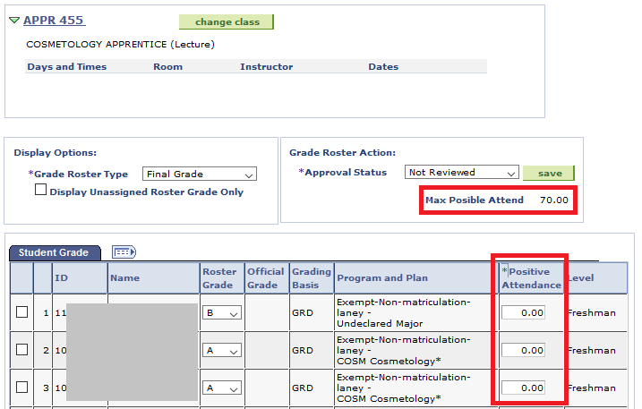
Screen Shot of Grade Roster
See Max Possible Attend: This is the total possible number of hours a student COULD attend your class. You enter the actual number attended in the *Positive Attendance column. (By the way, these grades are not the for noncredit grades of P, NP and SP.)

Slide 8
Questions?
Beth Maher
emaher@peralta.edu
510-464-3225

