Slide 1

Noncredit Teacher’s Guide
For Faculty Who are Teaching Noncredit Courses
Fall 2019
Questions? Email Beth Maher, Noncredit Coordinator, at emaher@peralta.edu

Slide 2
Table of Contents
Overview: Credit vs Noncredit | 3
Enrollment | 4
Grades | 5
Positive Daily Attendance | 6-8
Mirrored Classes | 9-11
Adding Students | 12
Dropping Students | 13
Waitlists | 14
Census and Attendance Rosters | 15-16
Certificates and Graduation | 17-18
Noncredit Student Services | 19

Slide 3
Credit vs Noncredit: The Basics
Credit Classes | Noncredit Classes
Carries Units. You are paid by the unit. | Have no units. You are paid by the lecture/lab hour.
If students pass, they can not repeat the course. | All noncredit classes are repeatable, even if the students receives a Pass (P).
For most credit classes, you assign a grade of A, B, C, D or F. | For noncredit classes, you assign a grade of: P (Pass) for demonstrating the competency NP (No Pass) for not demonstrating the competency, or SP(Satisfactory Progress) for showing progress, yet not achieving the competency. SP is a non-passing grade.
Students are expected to do 2 hours of work outside of class for each lecture hour. | Students are expected to do little to no work outside of class (except in Mirrored classes. Here students are expected to do exactly what the credits students do).
 | Faculty must take attendance and report every hour that students are in class. This is crucial and is how the college is paid. It’s called Positive Daily Attendance (PDA).

Slide 4
Enrollment
Students must apply to the college via CCCApply*
Once they have a student ID number, students can enroll in noncredit courses.
To enroll, students enroll online just as they do for credit classes. If they only completed the Noncredit Application, the system will only allow them to enroll in noncredit courses. If they completed the CCCApply, they can enroll in credit or noncredit. However, to enroll in noncredit classes, students must select for NONCREDIT CLASSES in their search or they will not see these classes listed.
*For some students, enrolling online is a barrier. These students can complete the paper Noncredit Enrollment Form and turn it into their campus Admissions and Records office.

Slide 5
Grades
Faculty submit student grades AND total hours in their faculty center.
There are three (3) grade options:
    P (Pass)
    NP (No Pass)
    SP(Satisfactory Progress)
    The definition for each should be clearly outlined in the course outline. SP is intended for students who came to class and learned something, but didn’t gain the competencies of that class. SP is a non-passing grade.

Slide 6
Positive Daily Attendance
All noncredit classes are Positive Daily Attendance (PDA). This means:
Faculty are required to track and keep clear records of each hour that students are in class.
Faculty submit the total number of attended hours in a separate column next to the grades column on the grade roster at the end of the term. This number is as important as the grade.
After you submit your grades and total hours, send your tracking form to Rollbooks@peralta.edu

Slide 7
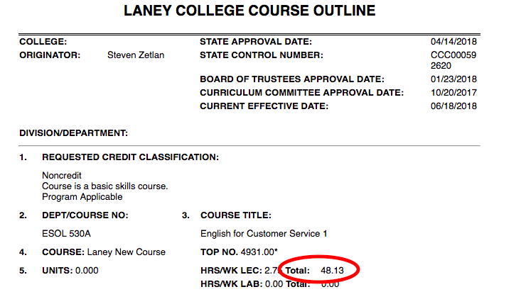
TOTAL HOURS possible are found on your COR (Course Outline of Record)

Slide 8
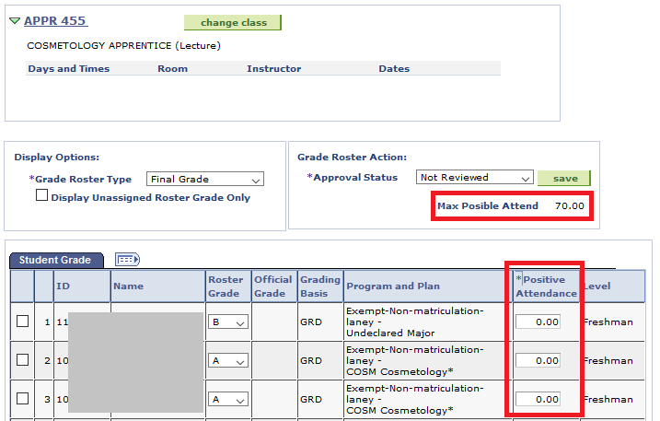
After your class finishes, you’ll get your Grade Roster
See Max Possible Attend: This is the total possible number of hours a student COULD attend your class. You enter the actual number attended in the *Positive Attendance column. (By the way, these grades are not the for noncredit grades of P, NP and SP.)

Slide 9
Mirrored Classes
Mirrored classes are exact replicas of credit classes, only they are noncredit. The students attend class with credit students and are expected to do all the same work.
Credit rosters will list under the credit course number and noncredit rosters will show as a separate course under their course number. Follow all the same procedures for grading and taking attendance for noncredit students in mirrored classes as you do in regular noncredit classes.

Slide 10
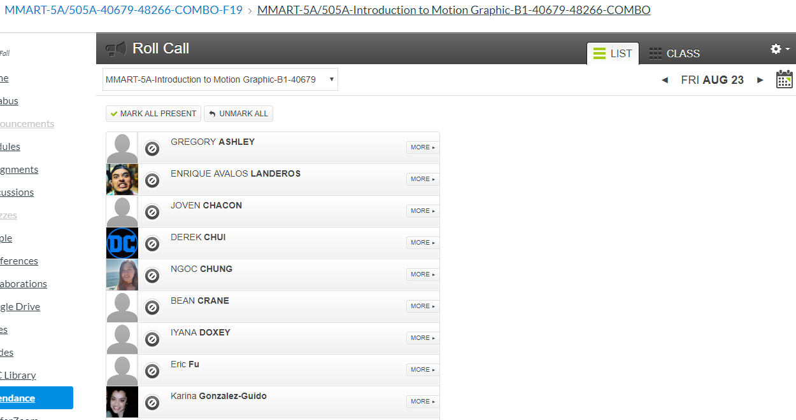
Mirrored Classes and Canvas
Your mirrored class and your credit class will show up on the same canvas shell.

Slide 11
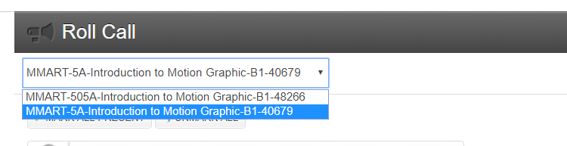
Mirrored Classes and Canvas
To see the attendance roster for both your credit and mirrored noncredit classes in your one shared Canvas Shell, use the drop down menu on the Attendance screen.

Slide 12
Adding Students
Deadlines for noncredit classes are the same as credit classes. The deadline to add is the last day the Census Roster is due. If the class is on the regular 17.5 week semester, the deadline will be widely publicized.
Dynamically dated classes have different deadlines. To know the deadline for your class, go to your Faculty Center and look under the Class Roster for the class. To the right of the roster is a blue box called “To Do” in this box you will see the dates for Census. The due date for the census roster is the deadline for adding your class. (See sample screen shot next page. In this sample, the deadline for adding the class is 12/22/2015)
There is no deadline to add a noncredit class if the class is Open Entry/Open Exit, if space is available.

Slide 13
Dropping Students
Do not drop a student who has attended even a single hour of class.
The college will receive apportionment for any hours the student came. (If they are dropped, the college loses those hours.)
Only drop No Shows. This can be done through the Census Roster. (See previous slide for information on when Census Rosters are due for dynamically dated classes.)

Slide 14
Waitlists
Waitlists are kept for Noncredit classes. But they do not automatically fill in as space becomes available.
No permission numbers are issued for noncredit students. Simply use an Add card to add any students until the last day to add.

Slide 15
Census and Attendance Rosters
1. The college receives apportionment for noncredit students through the total Positive Daily Attendance, not through the census count.
2. However, you still submit the Census Roster. This is a way to drop No Shows. Only drop No Shows. If a student has attended a single hour of class, do not drop them. The college will lose that funding for that hour if the student is dropped.
3. Noncredit classes do not need to submit Attendance Rosters. If you receive notices about Attendance Rosters, you can ignore them.

Slide 16
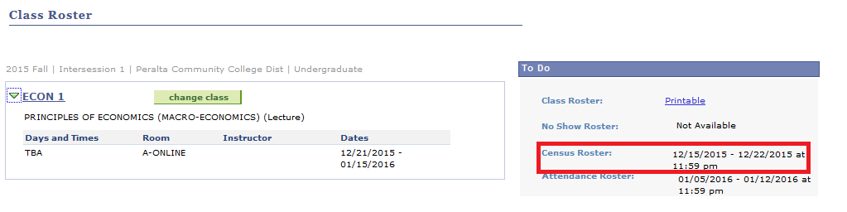

Slide 17
Certificates
For now, instructors/departments send a list of names of students who should receive certificates to BCC counselor, Hue Huynh at noncredit@peralta.edu.
In the future, noncredit students will “petition” at their campus to receive their certificates the same as credit students do currently.

Slide 18
Graduation
Noncredit students who complete a certificate are allowed and encouraged to participate in College graduation ceremonies. Information on graduation dates can be found on each college’s website.
To apply or “petition” for graduation, students must see a counselor and complete the petition paperwork before the deadline posted on the college website.

Slide 19
Student Services
Noncredit-only students do not receive the AC Transit or have access to Health or Financial Aid Services.
All other student services are available to noncredit students, including access to:
  A Student ID Card
  Peralta email address
  All libraries
  Employment Services Center/Career Center
  Writing Center
  Tutoring services
  Computer rooms
  Student centers and campus clubs
  Food pantry

Slide 20
Noncredit Coordinator
Beth Maher
emaher@peralta.edu
510-464-3225

