Slide 1
Understanding the New Duration of Status Rule
91 FR 44976 | Effective September 15, 2026
Office of International Education, PCCD

Slide 2
Agenda
D/S vs Period of Stay, AUD
Rule Overview – What Changed
Two Student Populations
Extension of Stay (EOS) and Alternatives
Academic Restrictions – Transferring and Educational Objectives
Travel Protocols
Scenarios
Resources & Q&A

Slide 3

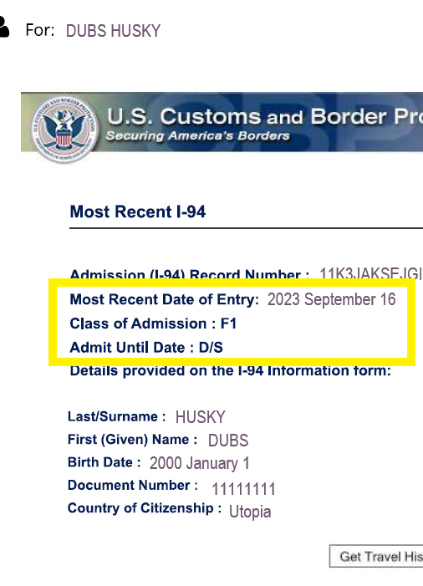
D/S vs Period of Stay
D/S, Duration of Status. Prior Definition:
  D/S is the current length of permitted stay for most F-1 students who enter the U.S. with a valid F-1 visa and I-20. According to Study in the States, “When you arrive at a U.S. port of entry, a U.S. Customs and Border Protection officer will provide you with an admission stamp that will list the date in which you must depart the United States. As an F-1 student, you will most likely have duration of status (D/S) listed on your admission stamp. D/S means you may remain in the United States so long as you maintain your nonimmigrant student status.” (https://studyinthestates.dhs.gov/2015/03/what-my-duration-status)
“Period of Stay” will now replace “Duration of Status”
  = Fixed Admission Period
Fixed Admission Period = Program Length given on I-20 + 30-day grace period
Admit Until Date (AUD) = Date Period of Stay expires
Form I-94, Arrival/Departure Record = Program Length given on I-20 + 30-day grace period

Slide 4
Rule Overview: What Changed
Old Rule (Pre-Sept 15)
✗ I-94 shows "D/S" —no fixed end date
✗ DSO extends programs internally in SEVIS
✗ 60-day post-completion grace period
✗ Lateral academic progression allowed – AA to AA
✗ No restriction on major changes or transfers
New Rule (Sept 15 and after)
✓ Fixed I-94 Admit Until Date (AUD) —I-20 end date or max 4 years, whichever is shorter; ESOL capped at 24 months
✓ Extensions filed by student directly with USCIS (I-539)
✓ 30-day post-completion grace period
✓ Upward academic progression only —no AA to AA
✓ First-year major change & transfer lock for undergrads

Slide 5
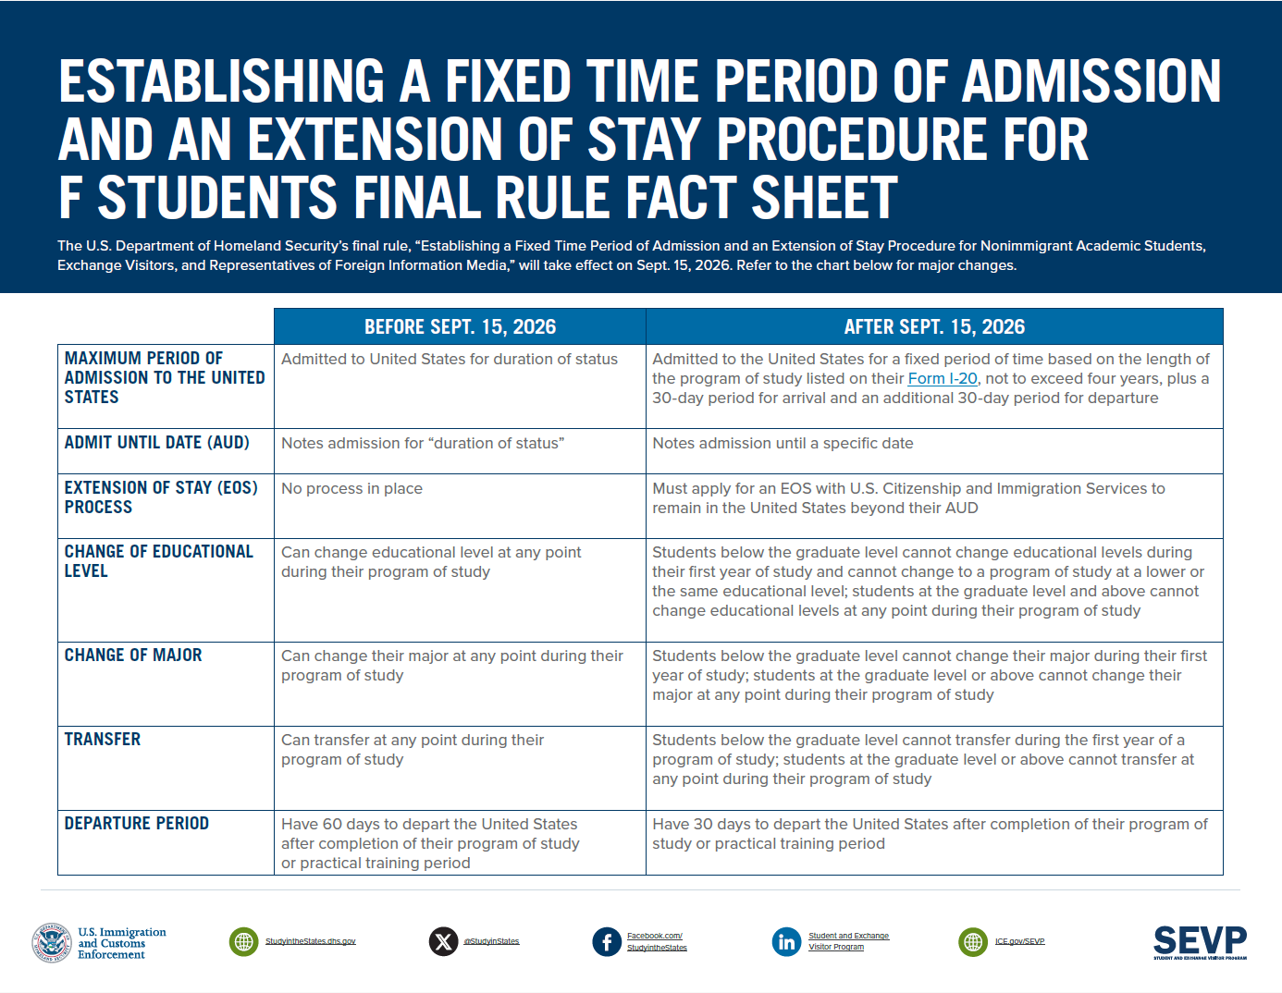

Slide 6
Two Student Populations
Group A – D/S Students
Group B – New Rule Students
Definition: Present in the U.S. with valid D/S on I-94 on Sept. 15, 2026.
Admitted for duration of status (D/S), are permitted to remain in the U.S. without filing a Form I-539 with USCIS, but only until the program end date (or OPT end date) of I-20 (or OPT EAD) for a maximum of four years from the final rule effective date, whichever is shorter, plus a 60-day grace period for F nonimmigrants
What they retain:
  60- day grace period. Do not need to file Extension of Stay (EOS) if within their current I-20 period.
  If OPT filed before March 17, no EOS required
When EOS is required: New I-20 or New Program
Travelling home and back after Sept. 14 will put you in Group B
Definition: New admits on Sept. 15, 2026, or any D/S student who travels and re-enters after Sept. 14.
I-94: Fixed Admission period – Program End Date on I-20 + 30-day grace period
Grace Period: 30 days
Max Period of Study = 3 years at PCCD
Extensions: Must file I-539 for Extension of Stay (EOS)
Academic Rules: All new restrictions apply: No changes in major or ed level or transferring in first year. No lateral or downward changes after completing program - Upward mobility only.

Slide 7
What situations could require filing EOS
Program Extensions – need more time to complete degree or certificate program
Eligible Transfers - Revised 8 CFR 214.2(f)(8)(iv)
Reinstatement
Change in Ed Level – ESOL to Associate or Associate to Bachelor
OPT – March 17, 2027

Slide 8
EOS Filing Reasons: What Qualifies and What Does Not (What is USCIS looking for?)
Revised 8 CFR 214.2(f)(7)(i) eligibility conditions
Qualifying Bases
Not Acceptable
Compelling Academic Reason
• Change of major or research topic
• Unexpected research problems or delays
• Accepted to a new/higher-level program —awaiting start term
• Loss of advisor or thesis committee member
• Departmental restructuring affecting degree completion
Documented Illness or Medical Condition
• Serious illness requiring time off from studies
• Medical documentation from licensed provider required
• Must show condition affected ability to complete program on time
• Treatment plan and expected recovery timeline required
Circumstances Beyond Student’s Control
• Natural disaster or national health crisis
• Closure of institution or major disruption
• Government action outside the student's control
• Must demonstrate direct causal link between event and program delay
Academic Probation or Suspension
Repeated Inability or Unwillingness to Complete
A pattern of incomplete courses, repeated withdrawals, or chronic inability to finish coursework is expressly excluded.
Program Delays Due to Student Choice
Voluntarily taking lighter loads, personal travel, or elective deferrals do not constitute circumstances beyond the student's control. USCIS will scrutinize enrollment patterns.

Slide 9
EOS Filing: Two-Step Process
Step 1: Student requests Program Extension with School’s P/DSO
  Students requests Extension of Program
  P/DSO reviews student’s eligibility and issues updated I-20 reflecting new PED if eligible
    Student must have a compelling academic reason, documented illness, or circumstances beyond control. Academic probation/suspension/repeated failure = not acceptable.
Step 2: Student timely files form I-539 with USCIS to obtain an extended AUD on I-94
  Extension of Stay
  Must file before I-94 AUD expires
  After filing, will continue to have legal presence up to 240 days while application pending with USCIS
    If denied, must depart immediately if AUD expired (no grace period)
  File Form I-539 with fee, $420/$470 up to 180 days in advance. No premium processing.
  Biometrics and/or possible interview may be required

Slide 10
Alternative to EOS: Travel & Re-entry
How Travel & Re-Entry Option works
1. Student Departs w/ New I-20
  DSO issues new I-20 reflecting new program or continuation
  Student must pay SEVIS I-901 fee for new SEVIS ID
  Current I-94 AUD ends upon departure
2. Students Requests Re-Entry & New AUD from CBP
  CBP has discretion to admit or refuse entry
  If admitted, will receive new fixed date I-94.
  If previously in Transition Group, will lose that status and benefits.
3. Student Resumes Study
  Student returns in valid F-1 status with new AUD.
EOS vs/ Travel & Re-entry: Two Valid pathways
 | EOS – File I-539 with USCIS | Travel & Re-entry
Cost: | $420/$70 | $350 SEVIS I-901 fee, travel costs, and if F-1 Visa is expired, costs associated with the renewal
Decider: | USCIS adjudicates | CBP discretion
Approved/Denied | Student remains in US and continues to study while app pending If denied, and AUD has passed, depart immediately | If denied, student will not be readmitted to the U.S.

Slide 11
Academic Restrictions: What the Rule Prohibits & What it Requires
Revised 8 CFR 214.2(f)(5)(ii)(A)
No Major Change – First Year
Upward Mobility Only
Undergrads may NOT change their declared major during first academic year at issuing institution.
SEVP may authorize exceptions for extenuating circumstances (ie school closures, disaster, etc…)
Students who complete a program after Sept 15, 2026 may NOT enroll in/transfer out to another at the same or lower level
Graduate-Level Students: No Changes Allowed.
Exceptions can be granted by SEVP for “extenuating circumstances”

Slide 12
Restrictions on Transferring
8 CFR 214.2(f)(5)(ii)(A)
First Academic Year lock
Students may not Transfer to another institution in their first academic year
  Academic year clock begins on the Program Start date on your I-20, not the Sept 15 effective date
Transfers within PCCD colleges should be acceptable and do not fall under changes of new rule
  No EOS would be required if no changes to Program End Date (PED)

Slide 13
Travel Protocols
Should I travel if I have a EOS application pending with USCIS?
General Protocols:
Always travel with your most current I-20 and I-94 (esp if you have an updated I-94 due to COS or other USCIS approval)
Check your F-1 Visa expiration date – if expired, plan to renew in your country before returning to U.S.
Passport Validity as possible AUD limiting factor
OK to travel after filing EOS if current AUD is not expired
Travel after filing EOS with expired AUD will likely result in denial of I-539 application for “abandonment”.

Slide 14
What Has NOT Changed
CPT
OPT
  EOS (I-539) may be required in conjunction of OPT (I-765)
On-Campus Employment
  Can continue to work if EOS is pending with USCIS as long as timely filed
RCL
Reinstatement

Slide 15
Scenarios - OPT
Student’s Grad term: | Example 1: SP2027, May 29, 2027 | Example 2: FA2027, December 18, 2027
I-94 | D/S | D/S
Applies for OPT (Earliest date is 90 days in advance) | Can apply as early as March 1, 2027. Must file before 3/17 to avoid EOS. | Can apply as early as September 19, 2027.
EOS required? | No, if submits I-765 before March 17 | Yes, after March 17

Slide 16
Scenarios - Transferring
 | Example 1: 1st year student at Peralta | Example 2: FA2027, December 18, 2027 AUD: January 18, 2028 | Example 3: FA2027, December 18, 2027 AUD: December 18, 2028 Transferring to a university
I-94 | AUD: July 31, 2029 | AUD: January 18, 2028 | AUD: December 18, 2028
Applying for Transfer | You cannot transfer in your first year | Can apply as early as 180 days before program end date. | Can apply as early as 180 days before program end date.
EOS required? |  | EOS needed while at Peralta | EOS needed at new school if time needed beyond December 18, 2028

Slide 17
Resources
SEVP: Elimination of Duration of Status Quick Facts
SEVP: Elimination of Duration of Status Frequently Asked Questions
Federal Register, Final Rule

Slide 18
Seeking Answers for Unanswered Questions
Pathway Programs – Single I-20 or Separate Programs
Double Majors
RCL/Leave period terms not counted towards first year clock
Which school helps to file EOS for Transfer Students?
How does F-2 (dependent) travel without F-1 affect AUD?

Slide 19
Questions?

