Slide 1

Noncredit Program Development
Fall 2019

Slide 2
CDCP Noncredit: The Deal for the College
1. Full apportionment (just like credit) from State.
Must be a sequence of at least 2 courses leading to a certificate
  1. Certificate of Competency: Basic Skills areas, including ESOL
  Certificate of Completion: Career Preparation areas
3. No minimum # of hours.
4. Focus is competency, not grades or units.
5. Curriculum development = same as credit.

Slide 3
CDCP Noncredit: The Deal for the Students
CDCP Noncredit: The Deal for the S
Free
Can re-enroll in the class multiple times
Doesn’t use up FA on basic skills or non-Transfer bound coursework. (Can not receive FA for NC)
Little homework.
Low stakes. Can give college a try.
No residency requirement.
Application: Use CCCApply (for students with very low English a simple 2 page Noncredit Application is available.)

Slide 4
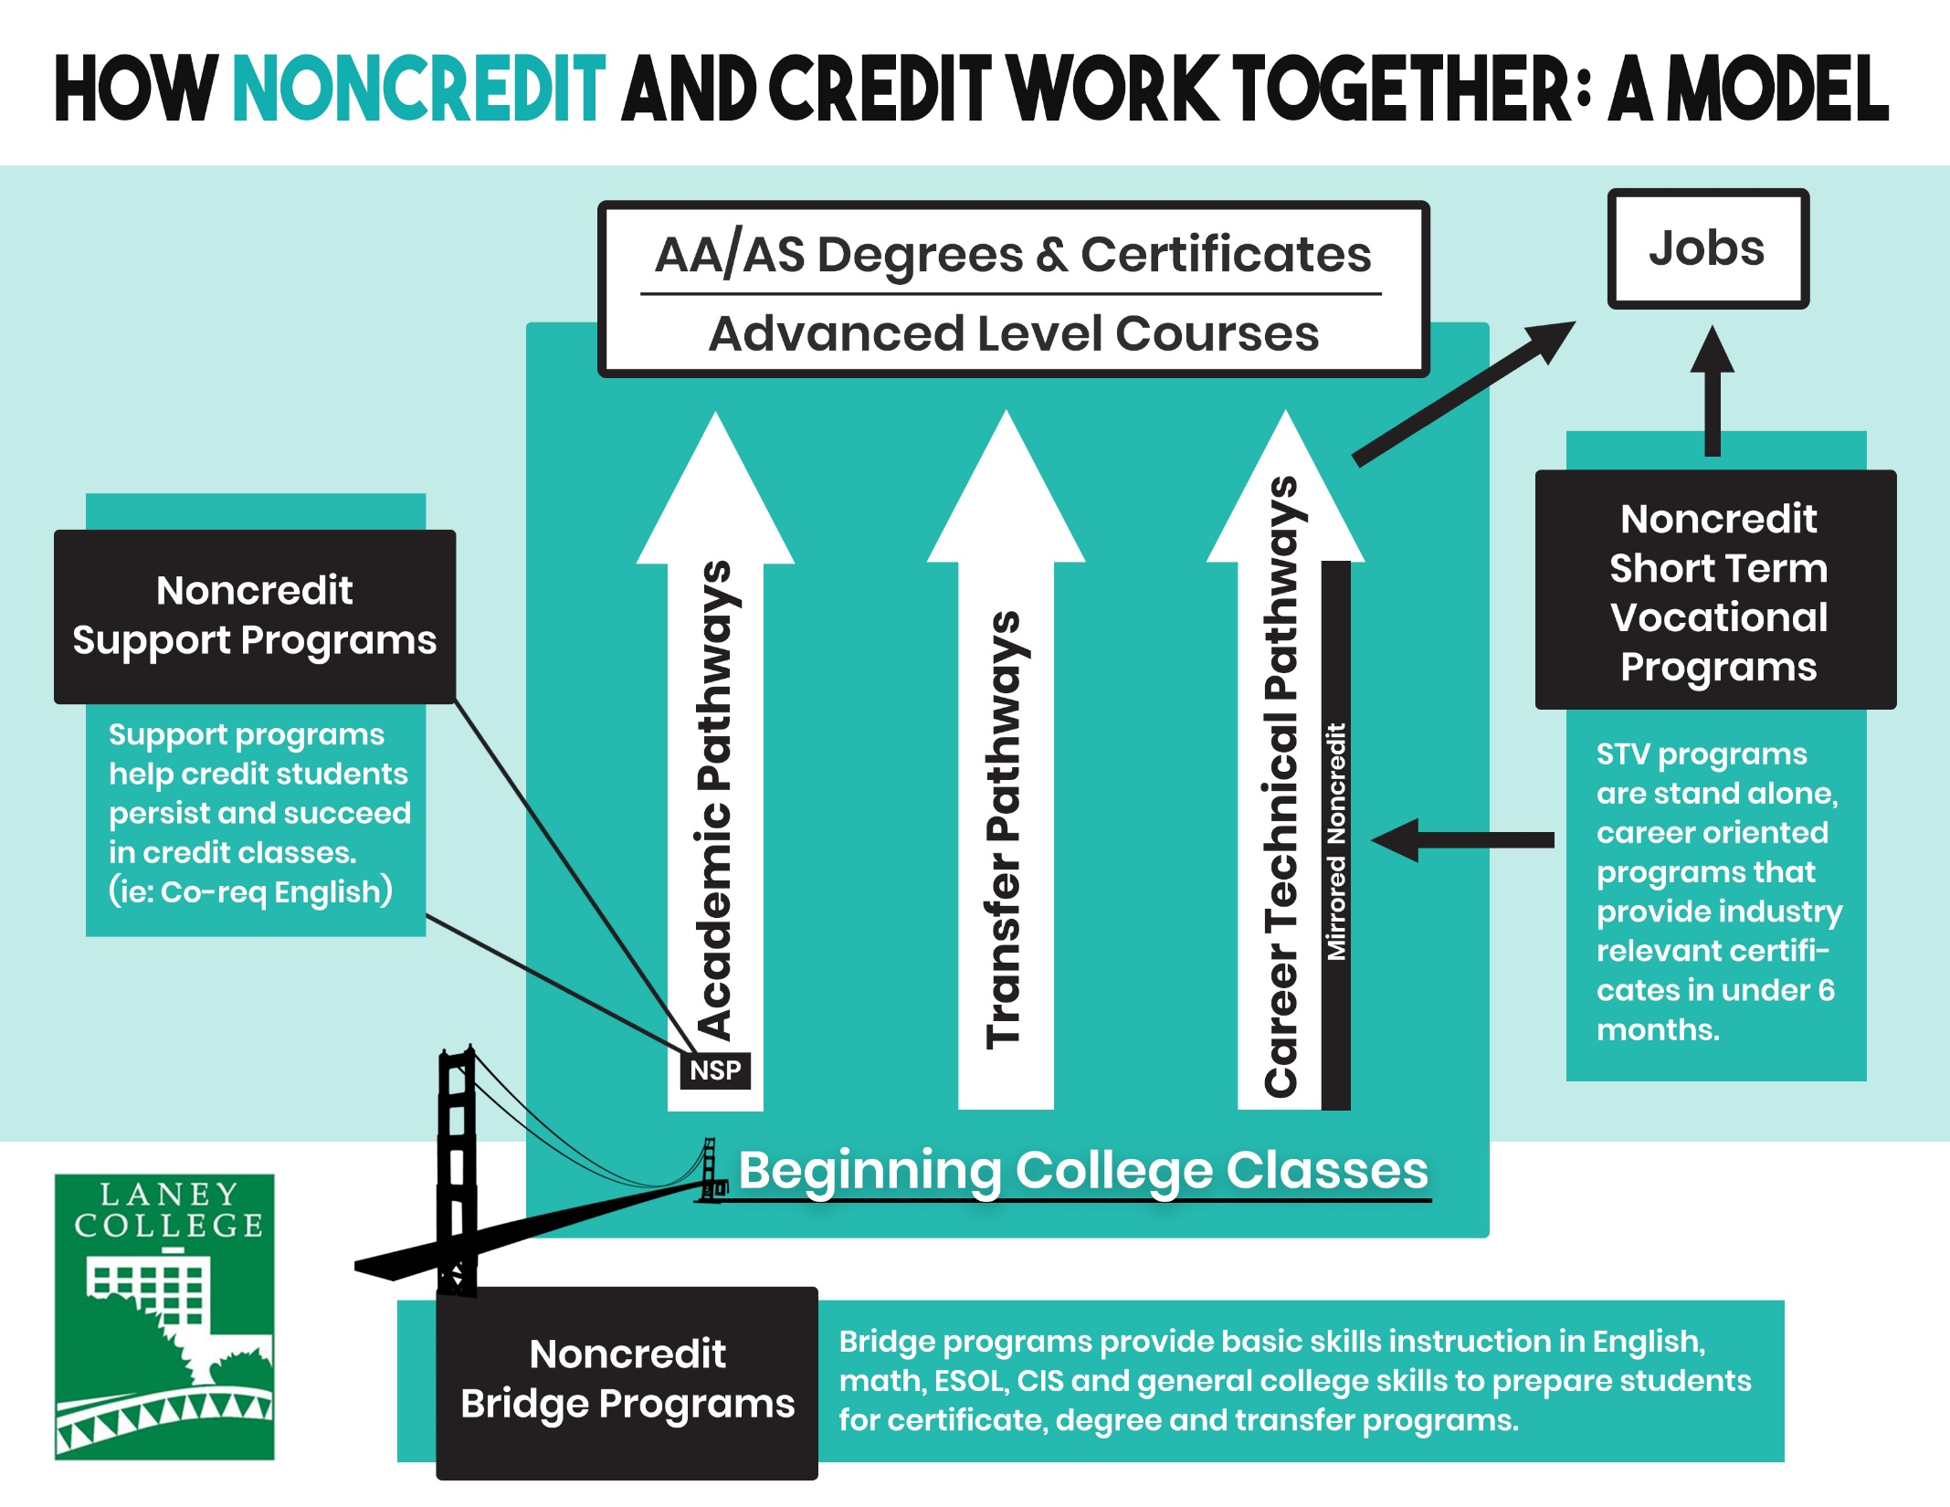

Slide 5
Noncredit Bridge Program
Certificate of Competency:
ESOL Bridge to Credit
(4 sequenced classes)
For students with English levels too low for credit program
8 week classes means more points of entry for students
Not open entry/exit; managed enrollment
Courses on Campus & at Community Based Organizations

Slide 6
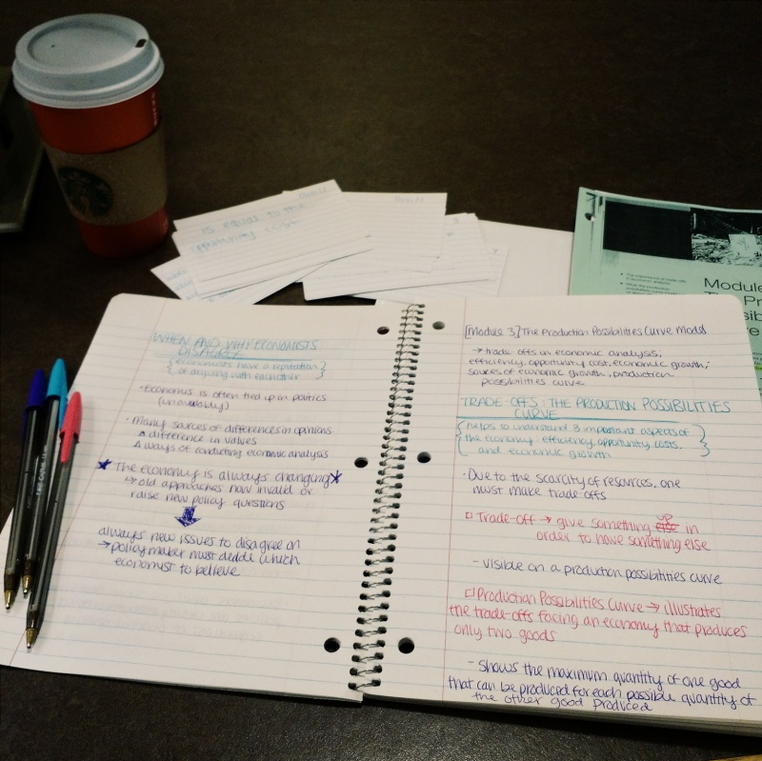
Noncredit Support Program

Slide 7
Noncredit Support Program
Certificate of Competency:
Academic Composition Skills
1. Pre-writing and Organization
2. Paragraph Development, Analysis and Research
3. Sentence Structure and Proofreading
To support credit students
in transfer level classes (AB705)
Skills-based
Co-requisite; linked with English 1A
Same instructor

Slide 8
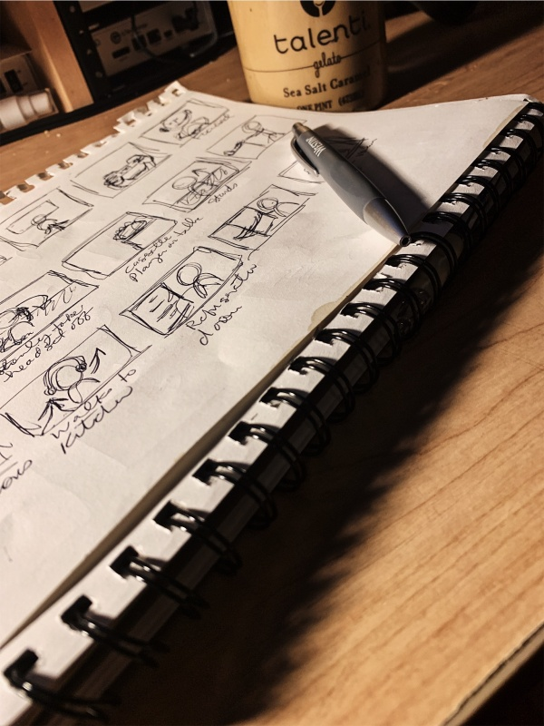
Noncredit Mirrored Programs
Certificate of Completion: Introduction to Animation and Game Design
(4 sequenced classes)
Exactly same content as the credit courses/programs
For students: A way to repeat or “try out” a class
For Departments: a way to boost enrollment of a credit class

Slide 9
BCC’s Multi-Media Arts:
Fall ’19 enrollment boost with mirrored classes
Class | Credit | Noncredit | Total Enrollment
Introduction to 3D modeling | 18 | 8 | 26
Introduction to Digital Illustration | 11 | 7 | 18
Introduction to Motion Graphic | 25 | 5 | 30

Slide 10
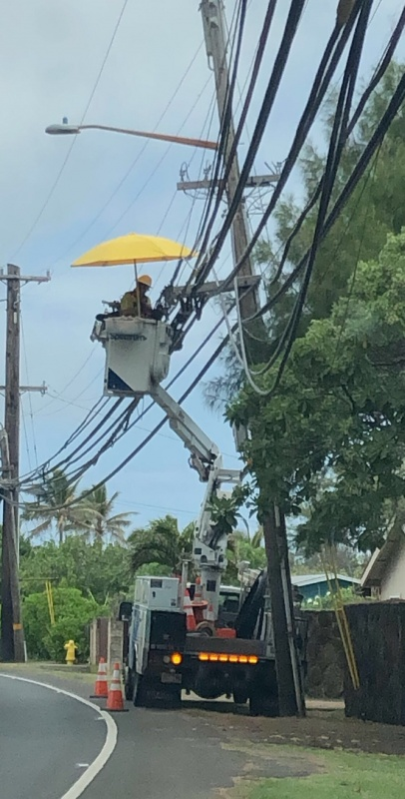
Noncredit Short Term Vocational
Certificate of Completion:
Electric Systems Technology Certificate
1. Electrical Fundamentals
2. Cable and wiring
3. Home Electronic Systems
For working students who need skills (not units) quickly
Taught Fridays and Saturdays 8am-3:45
All three classes can be completed in one semester.
(Mt. San Antonio College)

Slide 12
Questions?
Beth Maher
emaher@peralta.edu
Iolani Sodhy-Gereben
Isodhygereben@peralta.edu
Melissa Mcelvane
mmcelvane@peralta.edu

