Slide 1
Benefits Fringe Committee
September 25, 2014

Slide 2
Agenda
10:00 – 10:10
Announcements and Introductions, New Faces Around the District Focus of the Committee, PCCD Benefits Office
10:10- 10:40
Benefits Bridge-demonstration- online enrollment for active employees
New hires, life event changes, then open enrollments, Keenan & Associates
10:45-10:50
Affordable Care Act: Pay or Play Cadillac Tax, Default Enrollment, PSW Benefits Resources
10:50 – 11:00
Progress Report, Since We Last Met…, PCCD Benefits Office
Response to Employee/Retiree Spring 2014 Survey-October Events – Please remind your groups of upcoming empowerment workshops
Results of the Dependent Audit (review of other upcoming audits)
Healthy Community, Fit Fun, Fab Summer Challenge
Who’s Who?
    ING is now VOYA
    Pre-paid Legal is LegalShied
    CVS Caremark is CVS Health
Minute Clinics
Mental Health Parity
Account Balance to retirees on the self funded plan first quarter 2015
Retiree List Serve Update
          ,
11:00-11:10
State of the District, Finance
11:10 –11:20
State of the YTD Benefits Spending, Benefits Office
11:20-11:30
Agenda items for next meeting

Slide 3
Handouts
September 2014 Newsletter
Finance Office Presentation

Slide 4
New faces to the committee
Human Resources Director Nikki Washington
Employee Relations Director Channel Washington
Selwyn Montgomery, Local 39

Slide 5
Focus of the Committee
Language reflected in spirit of all three Collective Bargaining Agreements:
The parties agree that a study committee shall be established to study manners and mechanisms which will reduce the impact of health and welfare costs to the District. The study committee shall consist of representatives from PFT, SEIU Local 1021, IUOE Local 39, Management and Retirees to review potential changes and/or modifications to health and welfare plans. The role of the Committee shall be limited to making recommendations to the unions and the District.

Slide 6

Progress Takes Time
Together we:
Implemented an enhanced dental plan-Delta Dental PPO plus premier; offering an increased plan limit (Local 1021)
Developed audience specific communication tools to promote the new benefit (Local 39)
Significantly reduced our costs by increasing Medicare Coordination campaigns (Peralta Retiree’s Organization)
Used feedback from our constituents to develop our collective agenda
Incorporated the use of e-communications with our constituents (PFT & PCCD Business Managers)
Re-engaged employee-centered workshops on long-term care
(Local1021)

Slide 7
Online Electronic Enrollment
Already exists for Section 125 & 132 Plans (since 2012)
Possible for the 403(b) & 457(b) Plans
In transition for medical, dental, plan enrollment
New employees expect it; we are migrating towards it
  First for new hires (October)
  Then for life events (November)
  Deferred for part time hourly faculty and retirees for now

Slide 8

Integration of Technology
<2005
2006
2010
2012
2014
4 vendors
4 forms,
sent via fax to 4 destinations
to four destinations
125 Open Enrollment goes “e”
4 vendors
1 forms
sent via fax to 4 destiantions
4 vendors;
1 form;
4 electronic data entry steps
4 vendors
No form
1 data entry point
4 vendors
Kaiser, CoreSource, Delta Dental, United Health Care Dental
ADA Compliance-default enrolment
Reduce processing time
Business partners expect it
New hires expect it
E-application,E-paf,Paper forms???
Benefits Bridge

Slide 9
Benefits Bridge
A Keenan product
Improve our business processes
Ensure continuity exchange of information
Between the District and
  the employees (new and those who experience a life-event)
  Its business partners
Reduction in paper use
Align ourselves for more automated compliance and recordkeeping
Testing in October for active; no impact to retirees

Slide 10
Benefit Bridge
Electronic enrollment interface
Ralph Gowen, Program Developer
Vice President, Product Management

Slide 11
Affordable Care Act
Review of progress and accomplishments since 2010
    Default enrollment – unknown effective date
Pay or Play 2015
  Who pays?
  Who plays?
  Penalties?
  Periods
    Look-back measurement period
    Monthly Measurement period
Cadillac Tax 2018 – final regulations are not released at this time
  What is the tax as passed in the regulation? Possible 40% excise tax.
  What is the practical application for Peralta? Unknown at this time.
  Who pays? Unknown at this time
  What is considered a Cadillac Plan? Unknown at this time.

Slide 12

Refer to the September 2014 Peralta Benefits Everyone

Slide 13
Pay or Play –PSW Benefit Resources
This legislation applies to groups with 100 or more employees January 1, 2015. For groups of 50 – 99 employees, this legislation is effective on January 1, 2016.
Applies to employers who did not offer coverage to SUBSTANTIALLY all full time employees (and dependents) working 30+ hours per week.
$2,000 penalty multiplied by number of full time employees minus 30.
Substantially all full time employees is phased in over a 2 year period. 2015 the employer must offer coverage to 70% of full time employees; 2016 and beyond employer must offer coverage to 95% of full time employees
Employees’ contribution for employee only coverage cannot exceed 9.5% of household income.
Plan must cover at least 60% of costs on average

Slide 14
Pay or Play –PSW Benefit Resources
Full time employee is an employee who is employed on average of at least 30 hours of service per week.
Full time equivalent employee – add hours of service in a month for part time employees (up to 120 hours per person); divide total hours by 120 = number of full time employees for the month.
Must offer coverage to employees within 90 days of employment (60 days in California)
Filing of proof of participation can be done on Form 1094-C (transmittal) and 1095-C (employee statement) – forms are available in draft format only at this time.
2 methods for determining full time status
  Monthly measurement method –employees are identified based on the hours of service for each calendar month; employer must offer coverage within 90 days of employment (60 days in California); must be treated as returning employee unless there is a 13 week break in service or 4 week break in service that is longer than the prior period of employment
  Look-back measurement method (Measurement Period; Administrative Period; and Stability Period) –
  Measurement period – counting hours of service (3 – 12 months);
  Administrative period – time for enrollment / disenrollment (up to 90 days / 60 days in California);
  Stability period – Coverage provided (or not) – length depends on type of employee and whether full time or not

Slide 15
Default Enrollment
Applies to groups with 200 or more employees.
Employer must automatically enroll new full time employees in health plan (subject to waiting periods)
Employee must opt out of coverage.
Timeline has been pushed back – was due to be effective in 2014. Unknown effective date at this time

Slide 16

Since we last met.
Progress Report, Since we last met…, PCCD Benefits Office
Response to Employee/Retiree Spring 2014 survey-October Events
Results of the Dependent Audit (review of other upcoming audits)
Who’s Who?
    ING is now VOYA
    Pre-paid Legal is LegalShied
    CVS Caremark is CVS Health
Minute Clinics
Mental Health Parity
Account Balance to reach retirees on the self funded plan.
Retiree List Serve Update

Slide 17
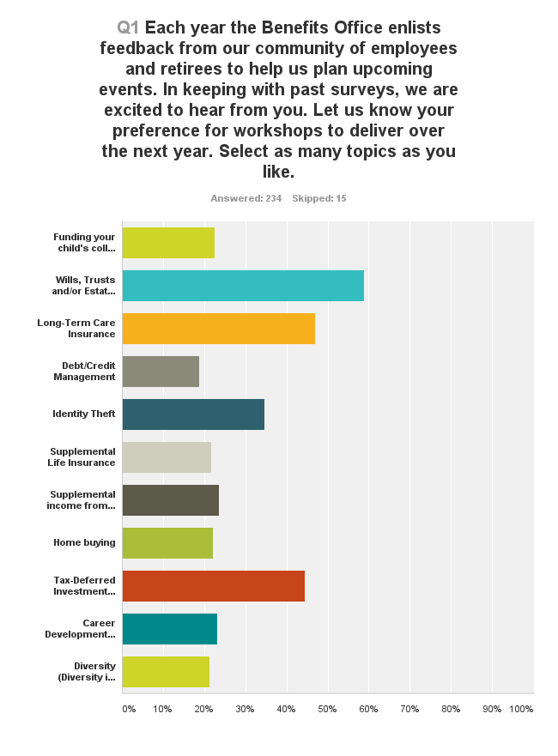
Response to the Spring 2014 Survey

Slide 18
October Workshops
Postcard Side 1
Postcard Side 2

Slide 19
Since we last met
Dependent Audit Savings
  (refer to the September 2014 Newsletter)
  Yielded approximately $344k savings
Open enrollment Glide Path
Column1 | Column2 | Admin | Confidential | Local 39 | 1021 | PFT
From | To
United Health | Delta | 1 |  |  | 2 | 2
CST | Kaiser | 1 |  | 1
CST | CSL | 2 |  |  |  | 3
Kaiser | CST | 1 |  |  | 2
Delta | UHC |  | 1 |  | 1 | 2
CSL | CST |  |  |  |  | 1
CSL | Kaiser |  |  |  | 1 | 1
kAISER | CSL

Slide 20
Since we last met

Slide 21
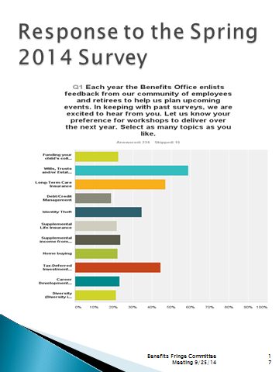
Since we last met
Open Enrollment for voluntary Life insurance through CIGNA
As referenced earlier in this presentation
16 enrolled under the guarantee issue

Slide 22
Since we last met
Part time Faculty Open Enrollment ended Tuesday, September 23
Plan | Dec-13 | Sep-14
CSL | 10 | 4
CST | 12 | 4
Delta Dental | 24 | 48
UHC Dental | 18 | 10
Kaiser | 37 | 60

Slide 23
ING/Reliastar became VOYA Financial
VOYA is our carrier for
  Long-term Disability and
  Life Insurance Business Partner
  Stop Loss
Rebranding
The process has been taking place in stages across the company and as result, you may see both ING U.S. and Voya throughout the end of the year

Slide 24
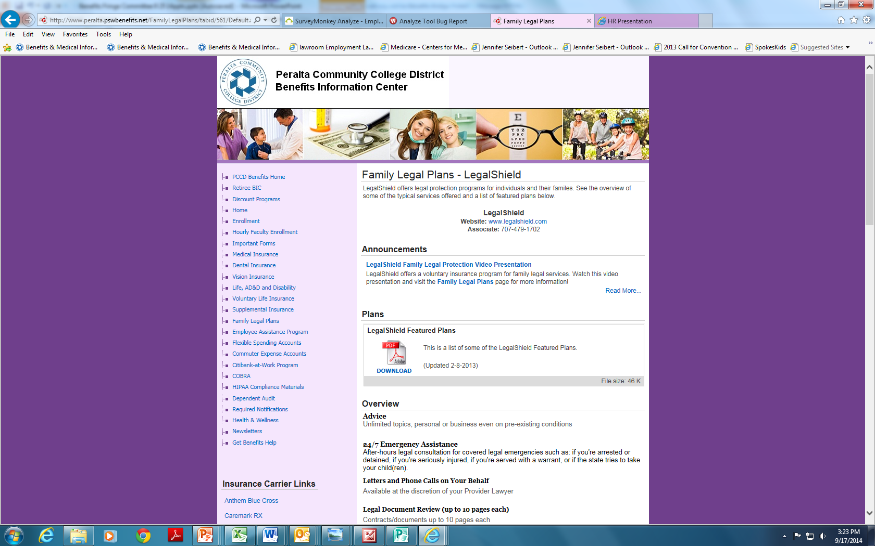
Pre-paid Legal became LegalShield

Slide 25

CVS Caremark became CVS Health
“We’re not just changing our name. We’re changing health care.”
Benefit enhancement subject to negotiation and to be further explored-coverage for eligible benefits received out of network for wellness type services such as Minute Clinics.
What is a “Minute Clinic” and how can we get “Minute Clinics” added to the Anthem BlueCross network or have the District provide internal claims support for eligible services rendered at Minute Clinic-like facilities (Costco’s, Rite Aid, Walgreens, etc)
Minute Clinic is a (brand name trademarked by CVS Caremark) who offer walk-in medical clinics are staffed by nurse practitioners and physician assistants who specialize in family health care and are trained to diagnose, treat and write prescriptions for common family illnesses such as strep throat and ear, eye, sinus, bladder and bronchial infections. Minor wounds, abrasions and joint sprains are treated, and common vaccinations such as influenza, tetanus, pneumovax, and Hepatitis A & B are available at all locations. In addition, Minute Clinic offers a wide range of wellness services, including sports and camp physicals, smoking cessation and TB testing. Routine lab tests, instant results and education is available for those with diabetes, high cholesterol, high blood pressure or asthma.

Slide 26
Minute Clinics
Issue: Out-of-network flu shot coverage.
Injections are covered, but when received out of network, then the reimbursement process is honorous.
Challenge to minimize the administrative burden to the employee
  Pursue getting Rite Aid, CVS, etc added to the Blue Cross network
  Develop an internal claims reimbursement infrastructure
  Status Quo: pay up front, then get reimbursed from Coresource.

Slide 27
Mental Health Parity
Issue: Ensure continuity of benefits between the HMO and Self-Funded plan-Management brought this issue forward for further review. Review is pending.

Slide 28
End of Year Statements for the Self-funded Plan
Statements will go out in March 2015
  Benefits through February
  2 months before open enrollment in May
  Mailed to each family member
  To home address
  Pre-2004 retirees enrolled in the self funded plan have a benefit limit of $2,000,000.
  Grandfathered plans are not protected from the unlimited benefit under the Affordable Care Act.

Slide 29
Retiree List Serve
Easy as 1-2- 3
New for
Retirees should send their requests to email account: retiree@peralta.edu
Benefits Office will be provided with a list server (distribution list) called: peraltaretiree.
The Benefits Office will manage (add, change, delete) this account as retirees send their email to retiree@peralta.edu. Once the peraltaretiree distribution list is set up the Benefits Office will be able to send an email out to all retirees that have signed up for the account.

Slide 30
State of the District
Business Services

Slide 31
Year to date Benefits Spending
Open Enrollment Glide Path
Review of Monthly Reports Distribution

Slide 32
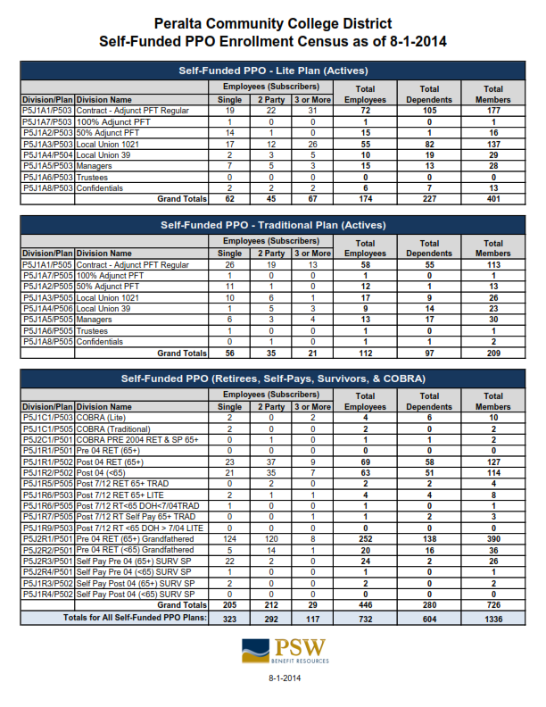

Slide 33
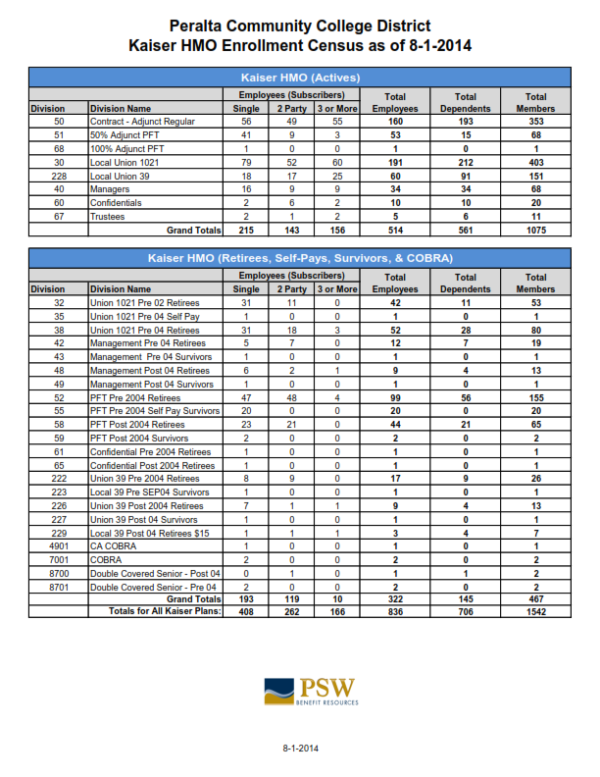

Slide 34
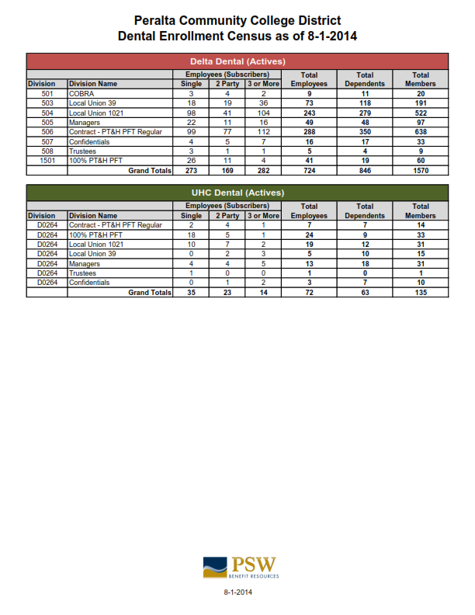

Slide 35
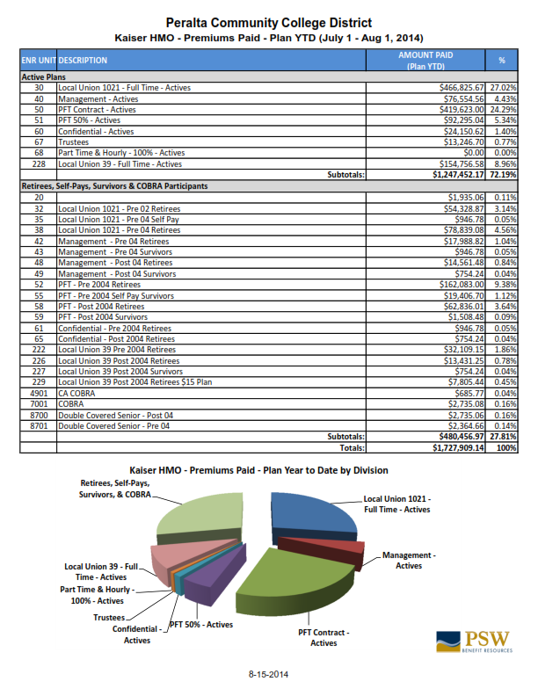

Slide 36
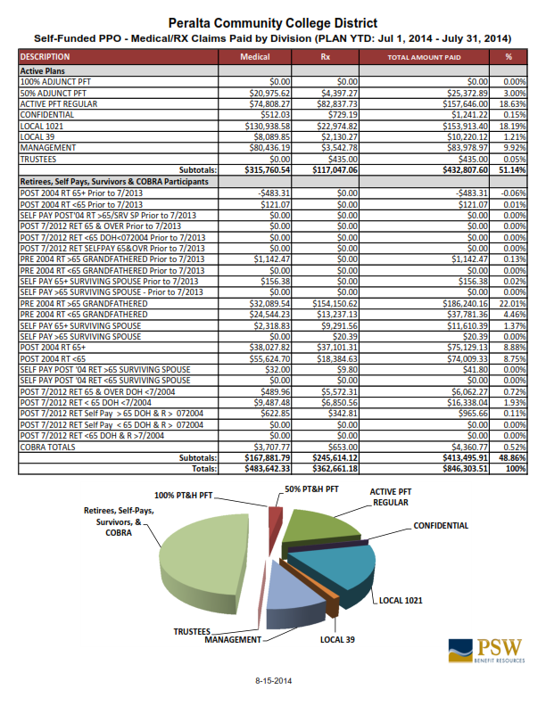

Slide 37
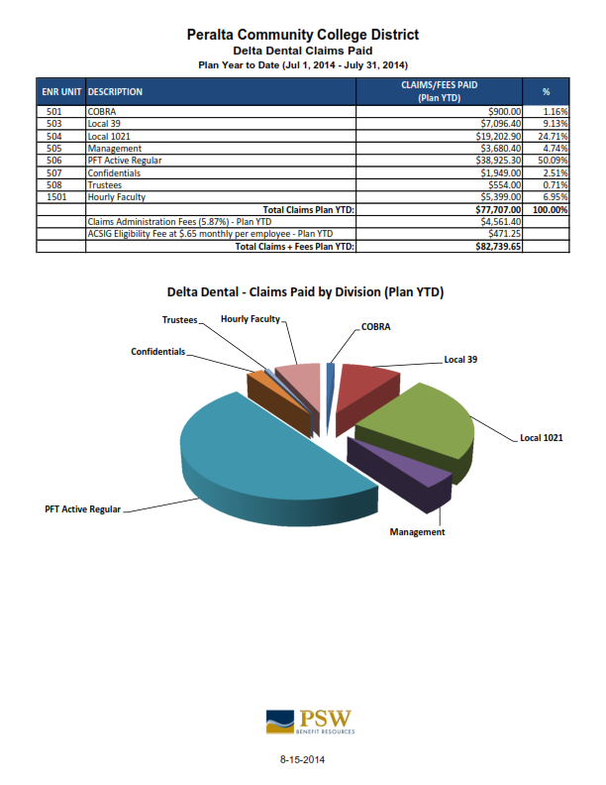

Slide 38
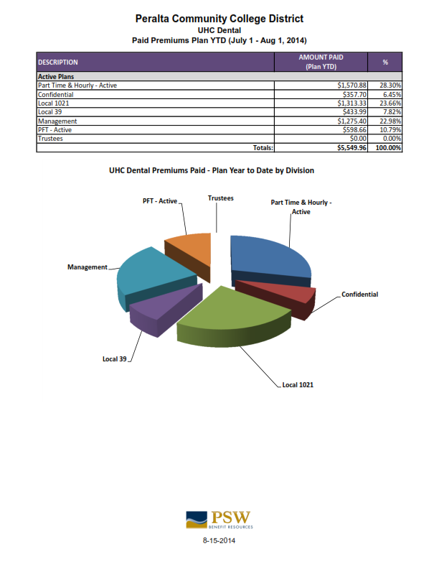

Slide 39
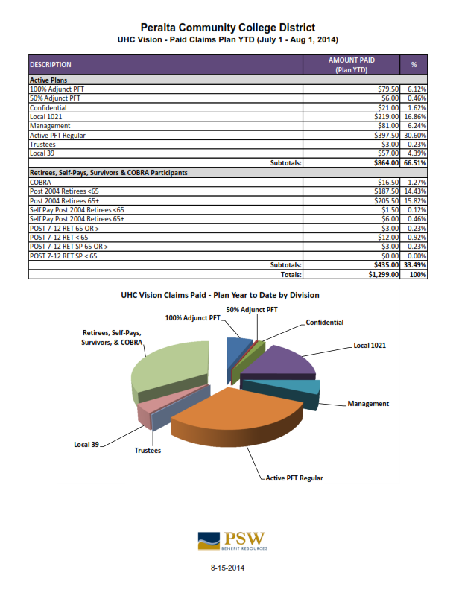

Slide 40
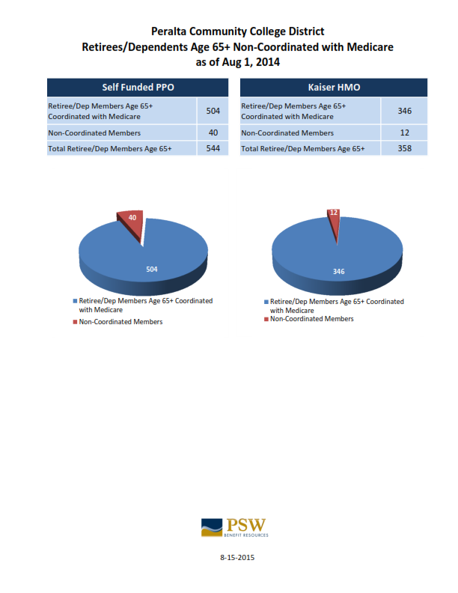

Slide 41
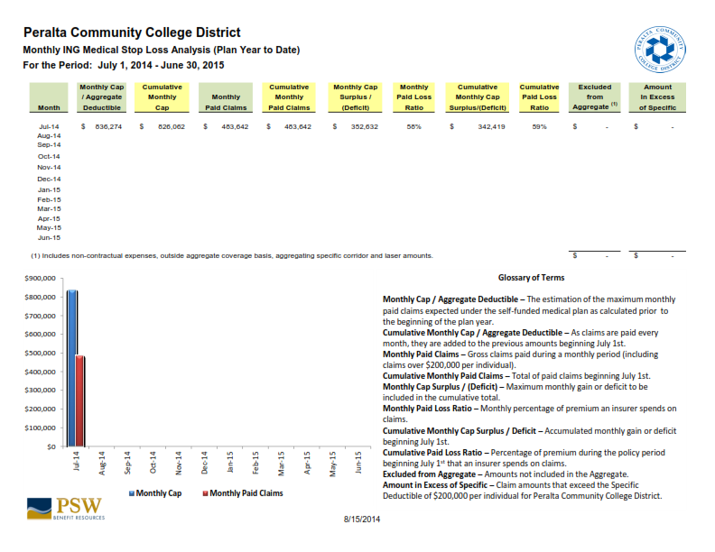

Slide 42
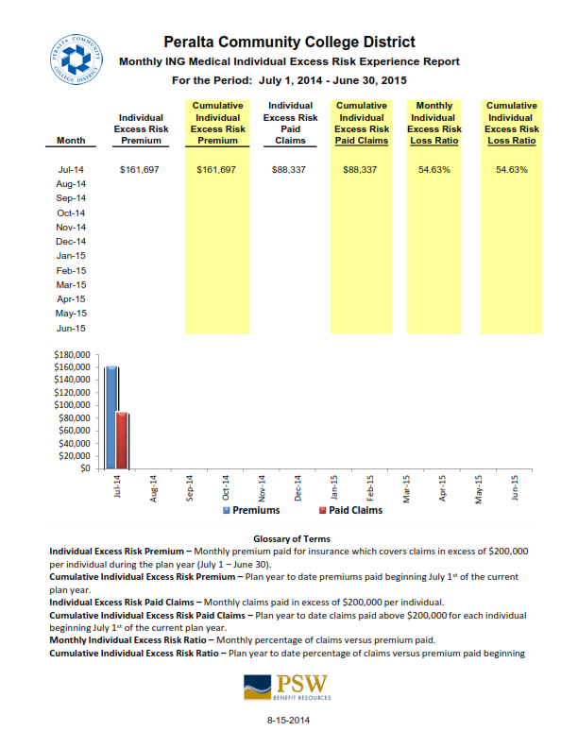

Slide 43
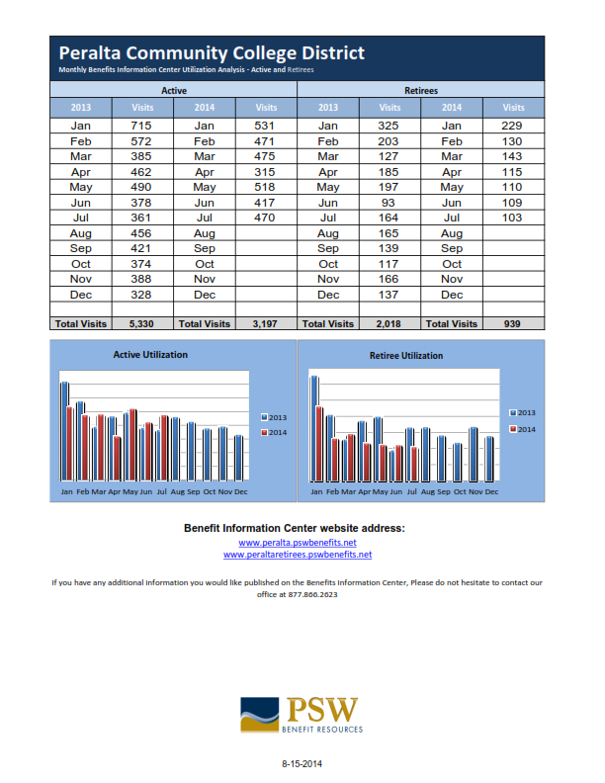

Slide 44
Agenda Items for next meeting
Next Meeting: October 16, 2014 (Thursday)

