Slide 1
MZM:
Employment Authorization Workshop
Office of International Education
Peralta Community College District
Notes:
Welcome to this section on "Overview of Employment Opportunities"

Slide 2

Agenda:
Health Insurance
Fall registration/Holds
Program Extensions
Travel Signature
Employment
Graduation
Q&A

Slide 3

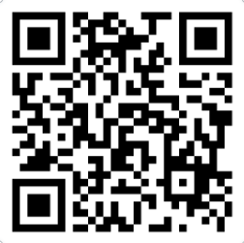
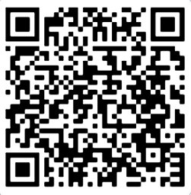
F-1 Health Insurance survey
F-1 INTERNATIONAL
STUDENT HEALTH
INSURANCE MEETING
Survey Link: https://forms.office.com/r/09nJxVYL0B
Registration Link: https://peralta-edu.zoom.us/meeting/register/ODg5oad1R5ixrjLpc5dhQA

Slide 4
Fall Enrollment/Holds
International health insurance for fall 2025 has been added to all students account and must be cleared before enrolling for classes.
All other balances owed for spring must also be cleared to enroll.
Summer and fall enrollment starts on Friday, April 11 for continuing students.
International students are allowed to enroll in one online class or up to 3 units of online classes for the first 12 units of full-time enrollment. Beyond the first 12 units you may enroll in as many online classes as you like.

Slide 5
Program Extensions
Is your I-20 ending 7/31/2025?
Do you need more time to complete your program?
Make an appointment with an academic counselor today for a student educational plan.
Submit your program extension request in ISP.

Slide 6
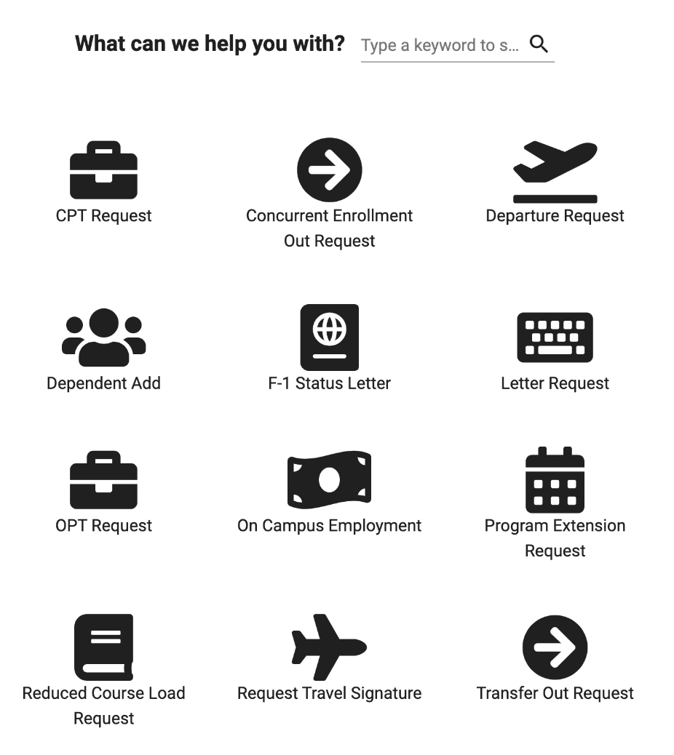
On Campus Employment/Social Security Number Request
Program Extension Request
Travel Signature Request

Slide 7

Overview
On-Campus Employment
Curricular Practical Training (CPT)
Pre-Completion Optional Practical Training (OPT)
Post-Completion OPT
Economic Hardship
Peralta Community College District
Notes:
There are 5 types of employment authorization for international students, which we will be going over:
On-Campus Employment
Curricular Practical Training (CPT)
Pre-Completion Optional Practical Training (OPT)
Post-Completion Optional Practical Training (OPT)
Economic Hardship

Slide 8

On-Campus Employment
What's permitted?
Up to 20 hours per week, except during breaks
When can you start?
No more than 30 days prior to the start of classes
for students in initial status
Locating a job:
Ask departments on campus or the district
Examples: Safety Aide, Cafeteria, Library, Computer Labs, Tutoring/Career/Transfer Centers or even in the Office of International Education!
Peralta Community College District
Notes:
Students are allowed to work on-campus for no more than 20 hours per week, except during summer and holidays, then full time is permitted. As a new student, your on-campus employment can begin no sooner than 30 days prior to the start of classes.
To find a job on campus, you must reach out to different departments on campus to see who may be hiring. Some examples include: working as a safety aide, in the cafeteria, library, computer, math, writing and tutoring labs, or even in the Office of International Education!

Slide 9
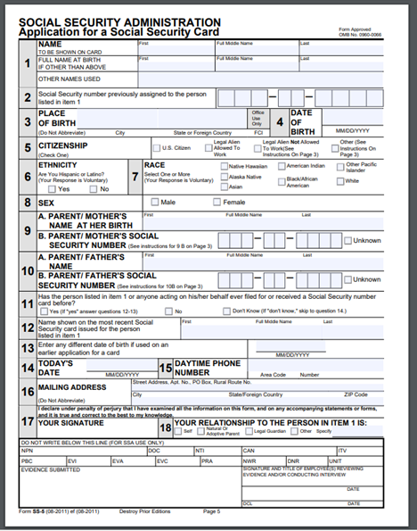
Social Security Number
If you need a Social Security Number (SSN), please provide a job offer letter from the department who is hiring you to the Office of International Education
School Letterhead
Position Title & Nature of Job
Number of Hours Per Week
Supervisor's Name and Contact information
To Social Security Office:
Proof of Full-Time Enrollment
SS-5 Form
Passport and I-94
I-20
Letter of Support from DSO
Notes:
If someone on campus would like to hire you and you need a Social Security Number, please provide a letter to the Office of International Education from the department, on school letterhead, who is hiring you. Our office will then support you in applying for your Social Security Number through the Social Security Administration office.
The letter should include position, title, nature of job, number of hours per week, and your supervisor's name and contact information.
You will then need to take Proof of Fulltime Enrollment, SS-5 Form, Passport, I-94, Form I-20, and a Letter of Support from our office to the Social Security office. Please contact our office if you have been hired on campus and need assistance with this.

Slide 10
How to Submit Request in ISP
On Campus Employment/Social Security Number Request

Slide 11

Curricular Practical Training (CPT)
Work Off-Campus In Field of Study (Academic Program)
Part-Time or Full-Time
Must Enroll in course requiring work (COPED) and have job offer letter
Can only work during the course dates (will be listed on their I-20)
Must have been a student for 1 year
Notes:
Curricular Practical Training (CPT) is Work Off-Campus in your Field of Study and you can choose to work Part-Time (20 hours or less) or Full-Time (more than 20 hours).
To apply for CPT, you must enroll in a Cooperative Work Education course (COPED) and provide a letter from a potential employer, which wishes to hire you. COPED is a 1 to 3 unit course, which involves supervised employment to assist in acquiring desirable work habits and attitudes, increase educational motivation, and develop improved human relations skills.
If you participate in full time CPT for more than 364 days (1 year), then you will no longer be eligible for OPT.

Slide 12
Pre-Completion OPT
Can be requested for no more than 1 year at a time (2 years max)
May only work part-time (20 hours per week), unless requested to work during summer break (more than 20 hours)
Must report employment related to major
Must maintain F-1 status towards a degree
Pre-Completion OPT time will take away from Post-Completion OPT at half the rate
If in 2nd semester, may apply for OPT 90 days before semester ends
Notes:
Work authorization for OPT must be obtained from the United States Citizenship and Immigration Services, also known as USCIS, so please plan ahead to ensure a timely receipt of your application.
Pre-completion Optional Practical Training (OPT) is to earn practical work experience related to your major prior to the completion of your program.
You will be eligible once you have been an international student for a full academic year.
With Pre-Completion OPT, you may only work part-time (20 hours per week), unless requested to work during summer or holiday breaks.
Pre-Completion OPT can be requested for no more than 1 year at a time and up to 2 years maximum.
You must report employment related to your major and maintain F-1 status towards a degree, meaning you will still be required to enroll in 12 units.

Slide 13
Post-Completion OPT
Can be requested for no more than 1 year
Must be in final semester of completing degree or certificate
Must work more than 20 hours per week after approved and report employment related to major
Need to submit copy of petition to graduate signed by counselor
Notes:
Post-Completion OPT is for students who are completing their degree or certificate, as long as it is not ESOL. You can apply for Post Completion OPT in your final semester of your program. You will need to petition to graduate with a counselor to verify the completion of your program. You may apply for OPT as early as 90 days before your program ends and the process typically takes 2-3 months for you to receive approval.
With Post-Completion OPT, you can request to work off campus for up to 1 year, and you are required to work more than 20 hours per week related to your major.
When you are ready to apply for Post-Completion OPT, you can find the application in the Global Peralta System (ISP). Should you transfer out while on OPT, your OPT will be automatically completed at that time.

Slide 14
Economic Hardship​
Due to unforeseen, severe economic hardship
Must be a student for at least 1-year prior to applying
Off-campus work in any job for one year
No impact on applying for OPT
Notes:
If you find yourself in a difficult financial situation due to an unforeseen circumstance, you may apply for an Employment Authorization Document (EAD card) from the US Government as long as you have already been a student for 1 full academic year. Economic Hardship allows off-campus work in any job for one year. You are not required to have a job offer before applying and students may reapply every year. Economic hardship permission does not affect OPT. You must continue to maintain your F-1 status through full time enrollment if approved.

Slide 15

OPT Application Process
Why File Online?
To ensure timely filing
  You can file on the same day OIE processes your I-20
Intuitive application
  Respond to information for OPT students
Easy to upload your required documents
Pay by card to confirm filing
Immediate filing receipt
Submit your Application ONLINE!

Slide 16
Eligibility
Post-Completion OPT: For students that are in their final semester now
  Must have been a student for at least 1 academic year (completing 2nd semester now at minimum)
  Must be in final semester of completing degree or certificate
  May begin Employment as early as May 26th

Slide 17
application
Log into your International Student Portal account https://international.peralta.edu/
Student Requests & Documents- Optional Practical Training.
Select the OPT Request, then read through and answer questions.
Fill out OPT Request by answering the questionnaire and click Done.
Read through OPT Training Rules and Regulations and Travel information.

Slide 18
Documents required (UPLOAD/Attach in ISP)
Petition to Graduate signed by a counselor.
I-765 application
Most recent I-94

Slide 19
Once documents are uploaded to isp
Email kdavid@peralta.edu to …
Confirm these 3 documents (Petition to Graduate, I-765 and I-94) have been uploaded to your OPT request in your ISP account and are ready for review
Confirm your Requested Employment Start Date (When would you like to begin employment?)

Slide 20
Other documents to collect
Copies of all past I-20s
Copy of your passport bio page
Copy of F-1 visa page
2 passport photos
$470 fee to “Department of Homeland Security” by check or money order. You may also pay by credit card using this form - https://www.uscis.gov/sites/default/files/files/form/g-1450.pdf
Form G-1145 to receive E-Notifications of Application - https://www.uscis.gov/g-1145
Previous Employment authorization documents (if available)

Slide 21
Next steps
You will be emailed a new OPT I-20 along with the directions on where to mail in your documents, which includes:
  New OPT I-20
  I-765 application
  I-94
  Copies of all past I-20s
  Copy of your passport bio page
  Copy of F-1 visa page
  2 passport photos
  $470 fee
  Form G-1145

Slide 22
After you send in your application to uscis
Within 3-6 weeks you will receive an I-797C receipt in the mail. When you receive it, upload a copy of it to your ISP account (you can check the status of your application online using the receipt number on your I-797 at https://egov.uscis.gov/casestatus/
Receive Employment Authorization Document/Approval Notice (2-3 months)
Upload a copy of your EAD card, I-797C, Notice of Action (Receipt) to the Documents Center in your ISP OPT Record
Receive Social Security Card if you don’t have one already

Slide 23
Employment requirements
SEVP Portal Account - update your employment information which you are required to report.
May not begin work until the date on the EAD Card
Report your employment related to your course of study within 10 days of being hired in the SEVP Portal
Not permitted to be out of employment for more than 90 total days during your approved OPT period
Post-Completion: Must work more than 20 hours per week (may include multiple jobs if necessary)
Receive a new I-20 with Approved I-20/Updated Employment

Slide 24
Types of employment
Regular paid
Payment by multiple short-term employers (artists, musicians, etc)
Work for hire (1099 – contractors)
Self employed – must have proper licenses
Employment through an agency
Consider self employment (if you can work from home and it relates to your major)
Offer free volunteer/internship work which can still count towards OPT
Seek other virtual employment opportunities throughout the country (remember, you are permitted to work anywhere in the U.S.!)

Slide 25
Employment Resources
INTERNATIONAL EMPLOYMENT SERVICES WEBPAGE - https://www.peralta.edu/international/employment
List of Past OPT Employers
OPT Student Profile Form
College Career websites
Career Related websites
Volunteer Opportunities
Employment Workshop/Recordings and Resources
While you are on OPT, you are required to report your employment related to your course of study within 10 days of being hired and are not permitted to be out of employment for more than 90 total days during your approved OPT period.

Slide 26


Slide 27
Questions???

