Slide 1
Transformation Data Summit
Presented by districtwide Institutional Research Team
November 3rd, 2025, PCCD Atrium

Slide 2
Welcome & Overview
Data Summit Goal: Provide SSEMC and Transformation Taskforces data overview in support of recommendations for Unification
Additional data dives and a deeper dialogue will occur in committee and taskforce meetings throughout the next several months

Slide 3
Transformation Data Summit
Agenda
Equity Centered Transformation
Academic Program Analysis
Activity
Evening & Weekend College Survey and Data Analysis
Modality Analysis
Activity
Dual/Concurrent Enrollment Report
Final Reflections & Next Steps

Slide 4
Centering Transformation in Equity
Clifton Coleman

Slide 5
Centering Transformation in Equity Disproportionate Impact
Percentage point gap
Rate for subgroup
Rate for all OTHER students
Percentage point gap is greater than margin of error
percentage point gap for subgroup
margin of error (+/-)

Slide 6
Successful Enrollment (2022-2023)
Cohort: applied for the first time as general-admit credit students
The proportion of cohort students who enrolled in the same college within the same academic year
Alameda | Berkeley | Laney | Merritt
11% [391] | 17% [708] | 13% [811] | 10% [308]
Bay Area: 17% |  | Statewide: 23%
Disproportionately impacted subgroups at more than one college
Alameda | Berkeley | Laney | Merritt
White 6% [90] | White 14% [190] | White 8% [137] | White 7% [62]
 | Black/African Am 14% [65] | Black/Af Am Female 11% [85]
Districtwide, state data show that over 20,000 prospective first-time students each year ultimately do not enroll
Application counts may be inflated by uncaught bot or fraudulent submissions during this period
Internal data show >45% of new applicants enrolled within PCCD; >50% of new, first time in higher ed applicants enrolled
This still translates to over 4,500 new prospective students who did not enroll

Slide 7
Transfer-Level English and Math in First Year (2022-2023)
Cohort: enrolled for the first time in higher education as general-admit credit students
The proportion of cohort students who completed both transfer-level math and English within the District in their first academic year
Alameda | Berkeley | Laney | Merritt
13% [159] | 19% [257] | 9% [172] | 11% [106]
Bay Area: 17% |  | Statewide: 15%
Disproportionately impacted subgroups at more than one college
Alameda | Berkeley | Laney | Merritt
Black/African Am 6% [11] | Black/African Am 8% [14] | Black/African Am 6% [22] | Black/African Am 6% [12]
Female 11% [63] | Female 16% [104] | Female 7% [56] | Female 10% [50]
Econ Disadvantage 12% [96] |  | Econ Disadvantage 9% [115]
First Gen Female 9% [21] |  | First Gen Female 7% [22]
Black/African American students complete math in their first year at significantly lower rates

Slide 8
Persistence from First to Second Primary Term (2021-2022)
Cohort: enrolled for the first time in higher education as general-admit credit students
The proportion of cohort students who persisted from their first primary term to the subsequent primary term at any community college
Alameda | Berkeley | Laney | Merritt
40% [341] | 48% [506] | 43% [654] | 38% [391]
Bay Area: 65% |  | Statewide: 67%
Disproportionately impacted subgroups at more than one college
Alameda | Berkeley | Laney | Merritt
White 27% [62] |  | White 29% [124] | White 25% [75]
Black/Af Am Female 30% [23] | Black/African Am 40% [57]
 | First Gen 42% [144] |  | First Gen Male 30% [49]
More than half of PCCD first-time students leave or stop-out of the community college system after one term

Slide 9
Completion of Degrees & Certificates (2019-2020)
Cohort: enrolled for the first time in higher education as general-admit credit students
The proportion of cohort students awarded a Chancellor's Office-approved certificate or associate degree within three years, and had an enrollment within the District the year awarded
Alameda | Berkeley | Laney | Merritt
8% [79] | 9% [111] | 6% [116] | 6% [59]
Bay Area: 16% |  | Statewide: 17%
Disproportionately impacted subgroups at more than one college
Alameda | Berkeley | Laney | Merritt
Male 6% [30] | Male 7% [41] | Male 5% [46]
Average time to associate degree is roughly 3 years for full-time students and over 7 years for part-time students
Average time to certificate of achievement is roughly 2.5 years for full-time students and over 6 years for part-time students
Three-year cohort is partially during the height of pandemic

Slide 10
Transfer to a Four-Year College or University (2018-2019)
Cohort: enrolled for the first time in higher education as general-admit credit student,
earned 12+ units at any community college, and exited the community college system
The proportion of cohort students who enrolled at a four-year college or university within 4 years of first enrollment
Alameda | Berkeley | Laney | Merritt
21% [80] | 19% [93] | 15% [92] | 20% [66]
Bay Area: 26% |  | Statewide: 27%
Disproportionately impacted subgroups at more than one college
Alameda | Berkeley | Laney | Merritt
 | Asian 13% [24] | Asian 12% [30]
Latiné 13% [12] |  |  | Latiné 13% [17]
Asian students comprised a higher proportion of the transfer cohort than the general first-time cohort or student population
Cohort partially during the height of pandemic

Slide 11
Comprehensive Student Education Plans
New, First-time, Matriculating Students (Fall 2022 – Spring 2024)
 | # in Cohorts | % SEP in First Semester | % SEP in First Year
Alameda | 2146 | 9% [185] | 12% [268]
Berkeley | 2040 | 21% [419] | 27% [545]
Laney | 2787 | 18% [488] | 23% [646]
Merritt | 1195 | 21% [249] | 27% [324]
Disproportionately Impacted Subgroups
Alameda | Berkeley | Laney | Merritt
American Indian, Asian, Pacific Islander | Black/African American, Latiné, Multi-ethnic, White | Aged 25+, Asian, White female | Latiné

Slide 12
Equity Considerations for Transformation Recommendations
District wide transformation grounded in equity and social justice to mitigate barriers for students. Transformation to be student ready colleges fostering a sense of belonging for all student groups.
Keep equity and student success at the center of transformation planning and decision-making
Use the transformation process to identify and reduce structural barriers that hinder access, persistence, or completion
Develop a cross-district approach to increase students completing SEPs

Slide 13
Academic Program Analysis
Dr. Helen Ku

Slide 14




Academic Programs at Peralta Colleges
378 current unique academic programs

Slide 15

Degree and Award Types AA = Associate of Arts AAT = Associate of Arts -Transfer AS = Associate of Science AST = Associate of Science –Transfer CA = Certificate of Achievement CP = Certificate of Proficiency

Slide 16

Top 12 PCCD Program (Degrees/Awards)
Liberal Arts/Social & Behavior, AA (162)
Social Sciences, AA (152)
Assistant Teacher, CP (143)
Health Sciences, AS (120)
Business Administration, AST (111)
Psychology, AAT (103)
Biology, AS (74)
Associate Teacher, CP (73)
Mathematics, AST (60)
Cosmetology, CA (53)
Emergency Med Tech I, CP (41)
Sociology, AAT (41)
AY 2025 PCCD Total Degrees/Awards
3,400

Slide 17

10 Academic Programs Offered at Every PCCD College
Anthropology (AAT)
Business/Accounting (AST)
Business Administration (AST)
Communication Studies (AAT)
Economics (AAT)
Mathematics (AST)
Psychology (AAT)
Sociology (AAT)
Transfer Studies/IGETC (CA) *
Transfer Studies/CSU GE Breadth (CA) *
* no longer an option moving forward

Slide 18
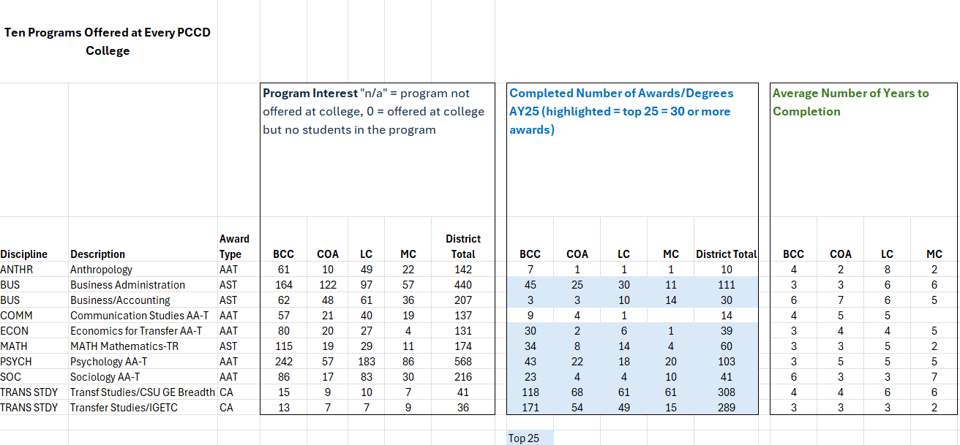
10 Academic Programs Offered at Every PCCD College

Slide 19
Programs Offered Only at 3 Peralta Colleges
BCC & COA & LC
English (AAT)
History (AAT)
Political Science (AAT)
BCC & LC & MC (no duplicated programs)
BCC & COA & MC
Liberal Arts/Arts & Humanities (AA)
COA & LC & MC
African-American Studies (AA)
Business/Accounting (CA)
Mathematics (AS)

Slide 20
Programs Offered Only at 2 Peralta Colleges
BCC & COA
Art History (AAT)
Liberal Arts/Social & Behavior (AA)
BCC & LC
CIS Computer Programming (AS)
Studio Arts (AAT)
Philosophy (AAT)
Global Studies (AAT)
Spanish Language (AAT)
BCC & MC (no duplicated programs)

Slide 21
Programs Offered Only at 2 Peralta Colleges
COA & LC
Mexican/Latin-American Studies (AA)
Geography (AAT)
COA & MC (no duplicated programs)
LC & MC
Business/Business Administration (AS)

Slide 22
Programs Offered Only at 1 Peralta College
BCC 67 programs
COA 64 programs
LC 143 programs
MC 77 programs

Slide 23
Academic Programs Across Peralta Colleges
Table Discussion Activity
Examine programs across Peralta Colleges: Students majoring in each program and awards completed​
What do you notice? (duplication, gaps, interest vs completers, etc?)
Through your lens (as students, instructors, administrator, and classified staff at each college), what are factors to consider to help maximize program efficiency in serving students?
What are possible environmental/community factors that should also be considered as we try to most efficiently unify Peralta Colleges?​

Slide 24
PCCD Evening and Weekend Survey & Course Enrollment Analysis
Phoumy Sayavong
Rhiannon Follenfant

Slide 25
Evening and Weekend College Survey
Research and recommend a design framework for launching an Evening & Weekend College that expands student access.
Survey Focus Areas
Student preferences for in-person evening and weekend course and program offerings
Challenges that affect enrollment in evening and weekend classes
Examine results by student demographics (e.g., ethnicity, part-time, full-time, major, age group, etc.)
Survey Administration
Nov 3 – 24, 2025 via Canvas
Results will be reported on December 12th at SSEMC Meeting

Slide 26
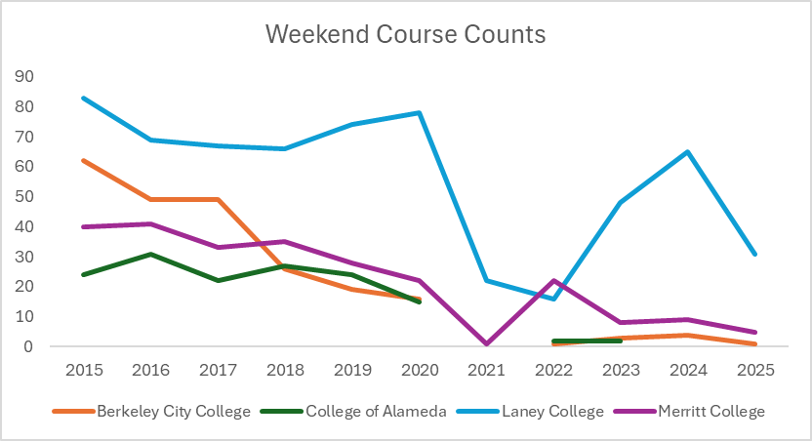
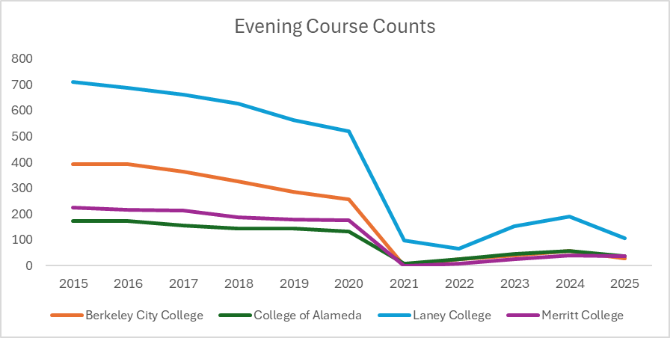
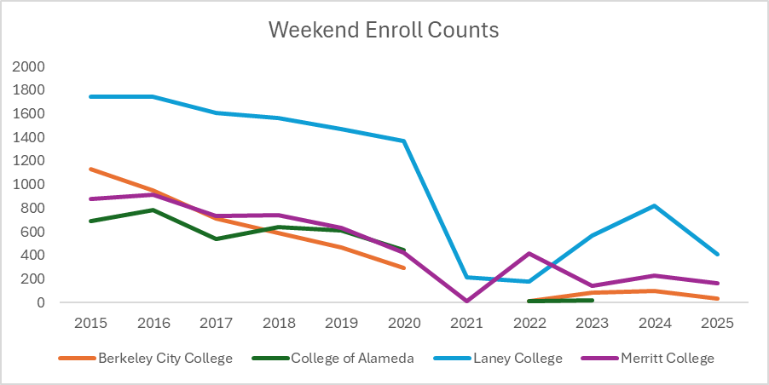
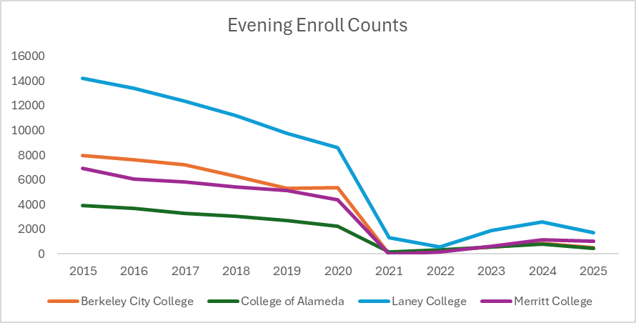
Weekend and Evening Course and Enrollment Counts
Number of courses offered, and enrollment changed dramatically after 2021.

Slide 27
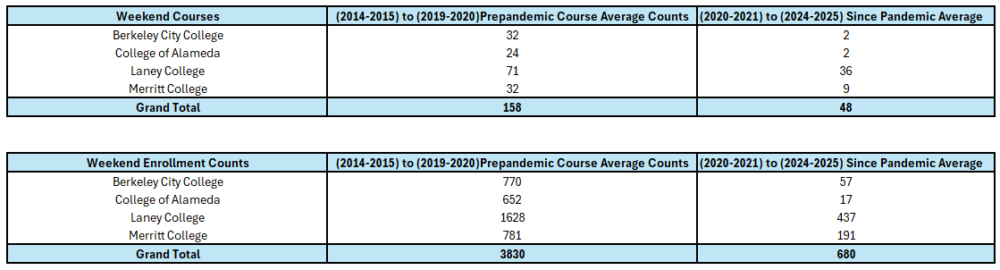
Weekend Course Counts and Enrollment Counts
Number of courses offered, and enrollment changed dramatically after 2021.
After 2019-20, Laney offered the most weekend courses.
On average, weekend course offerings in Peralta dropped 70% pre- to since pandemic.
Enrollment in weekend courses dropped 82% pre- to since pandemic.

Slide 28
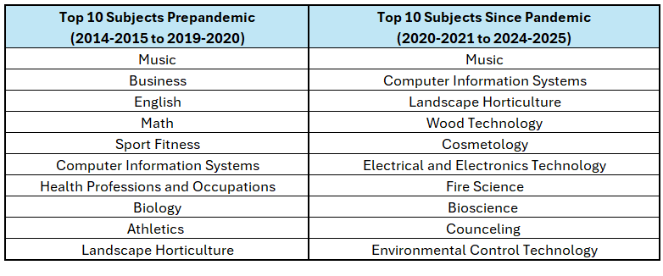
Weekend Top Enrolled Disciplines
Music courses were offered the most pre- and since pandemic.
Top 10 subjects offered on weekends may vary across colleges.
English and Math are no longer in top 10 Weekend Courses
More CE courses are in the top 10 Subject in Recent Years

Slide 29
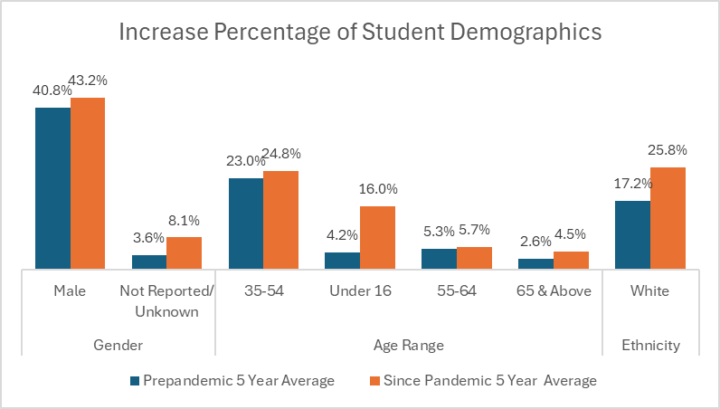
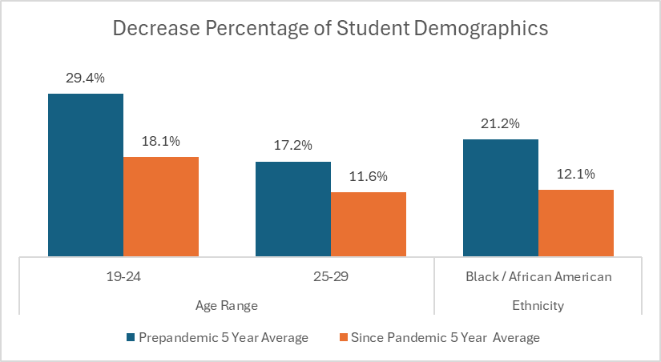
Weekend College Student Demographics
A possible reason for change in percentages is decline in number of courses and/or the course types offered currently for in person weekend courses

Slide 30
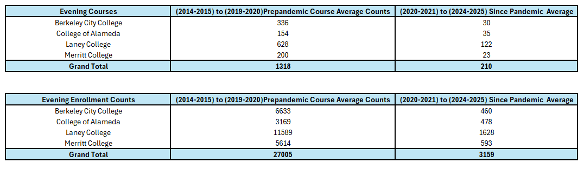
Evening Course Counts and Enroll Counts
-91%
-77%
-81%
-89%
-93%
-85%
-86%
-89%
On average, the rate of change in the decrease in the number of courses offered pre- and since pandemic ranged between 77% and 91%.
The rate of change in course enrollment ranged from a decrease of 85% to 93%.
After 2019-20, Laney offered the most evening courses.

Slide 31
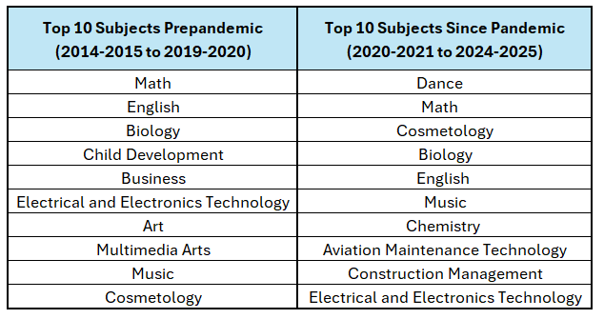
Evening Top Enrolled Disciplines
Math, English, Biology, Electrical and Electronics Technology, Music and Cosmetology have stayed in the top 10 subjects enrolled for Evening courses.
More CE Courses have entered the top 10 subject in recent years

Slide 32
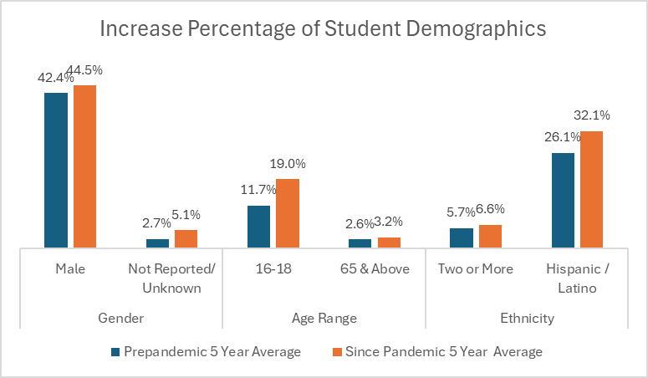
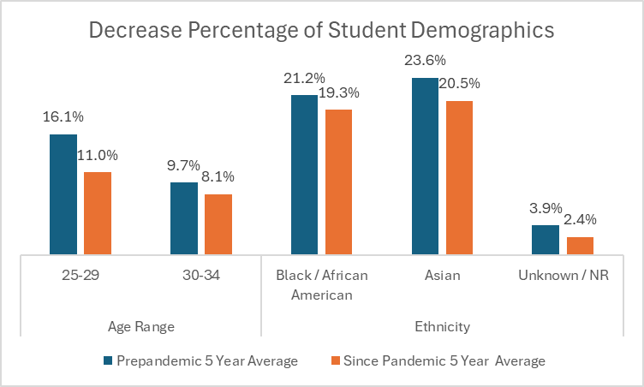
Evening Courses Student Demographics
A possible reason for change in percentages is decline in number of courses and/or the course types offered currently for in person evening courses

Slide 33
Future Data Inquiries Possibilities
Course Offering and Enrollment Trends at Other Bay Area Colleges
Success Rates of Evening and Weekends Courses
100% Stack Bar Graph Courses (In Person Day Course/ In Person Evening Course/ In Person Weekend Course/ Online Async/ Online Sync)
Separate Data by College for Top Enrolled Courses
Any Ideas from Transformation Task Forces

Slide 34
PCCD Academic Program Modality Analysis
Nathan Pellegrin

Slide 35
College and Regional Modality Comparison

Slide 36
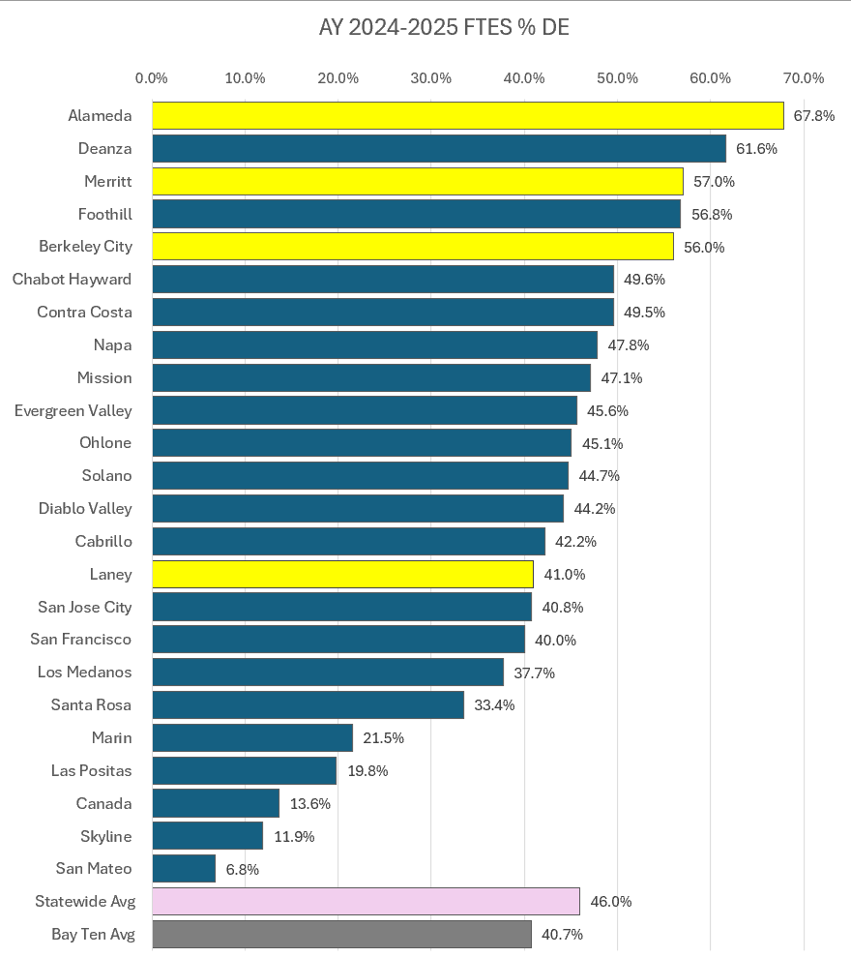
FTES % Distance Education 2024-2025
How do Peralta Colleges Compare to the Bay Ten? ​
Hybrid classes included in Non-DE category
FTES: Full-Time Equivalent Students = 12 semester units
Data Source: CCCCO Data Mart

Slide 37
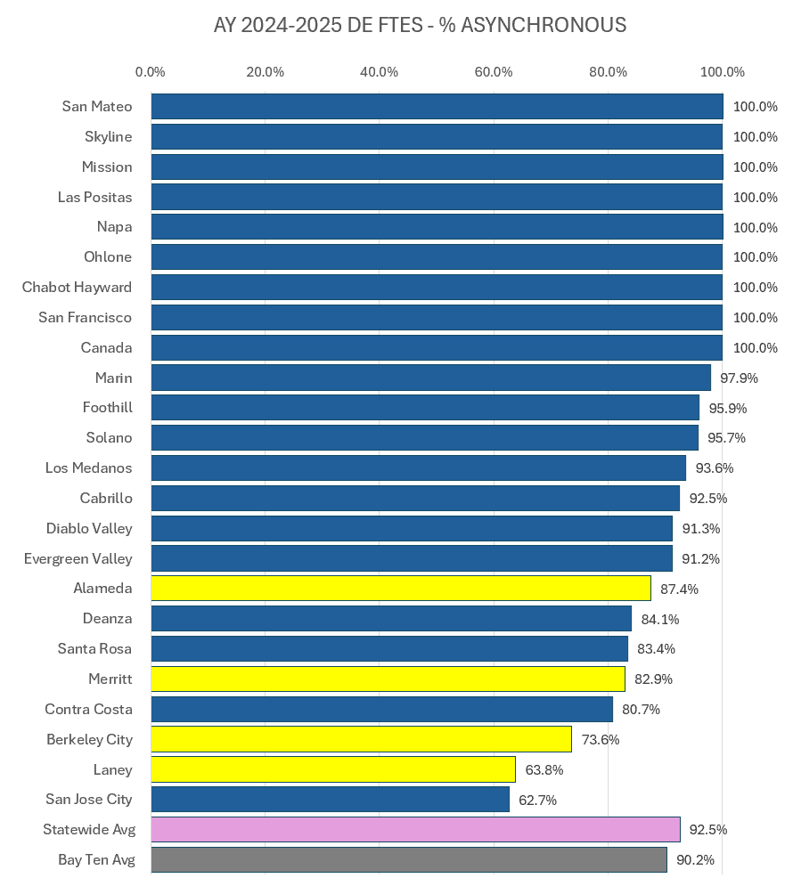
FTES % of Distance Education: Asynchronous
How do Peralta Colleges Compare to the Bay Ten?
Hybrid classes included in Non-DE category
FTES: Full-Time Equivalent Students = 12 semester units
Data Source: CCCCO Data Mart

Slide 38
Disciplines and Modality

Slide 39
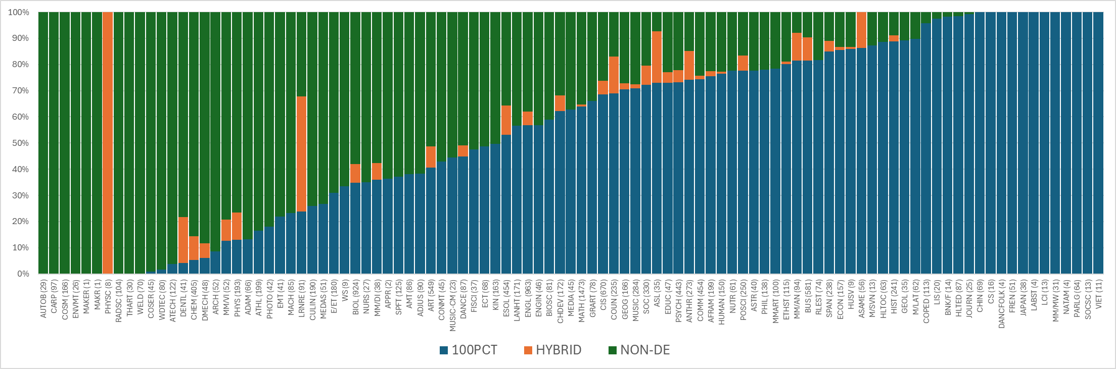
Percentage of FTES by Modality & Discipline
Data Source: PCCD Data Warehouse, 2024-2025 AY; FTES shown in parenthesis

Slide 40
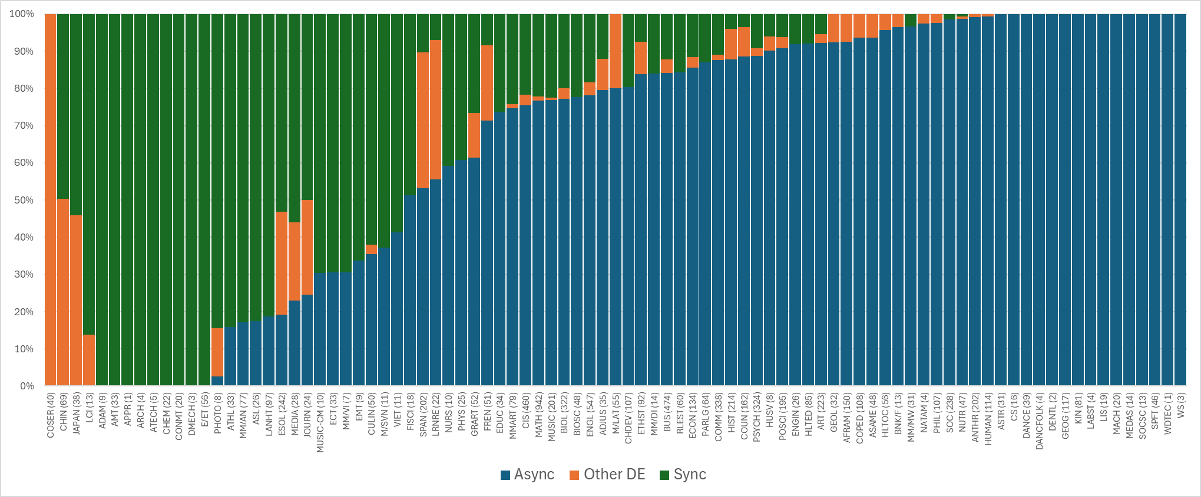
Percentage of FTES by Online Modality & Discipline
Data Source: PCCD Data Warehouse, 2024-2025 AY; FTES shown in parenthesis

Slide 41
PCCD Disciplines by % Online FTES
100% FTES Online
Chinese
Computer Science*
Dance Folk
French
Japanese
Labor Studies
Legal Community Interpreting*
Multimedia Arts Mobile and Web*
Native American Studies
Paralegal Studies*
Social Science
Vietnamese
Journalism*
0% FTES Online
Community Social Service*
Auto Body & Paint*
Carpentry*
Cosmetology*
Environmental Management &Tech*
Physical Science
Radiologic Science*
Theatre Arts
Welding*
Data Source: PCCD Data Warehouse, 2024-2025 AY
* CE

Slide 42
Career Education & Modality

Slide 43
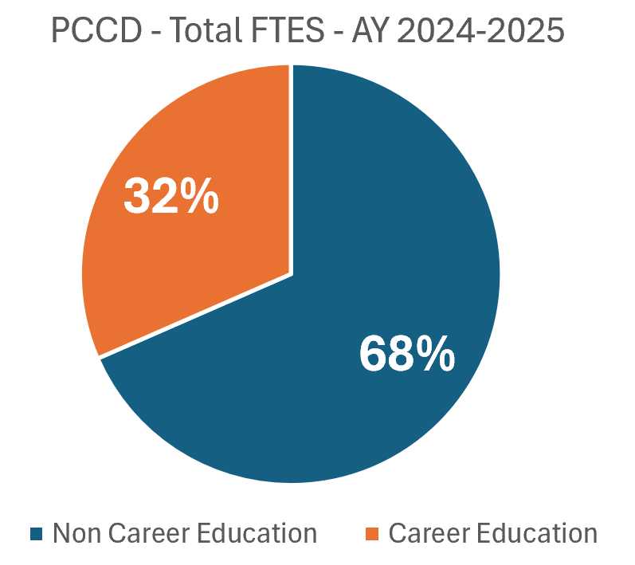
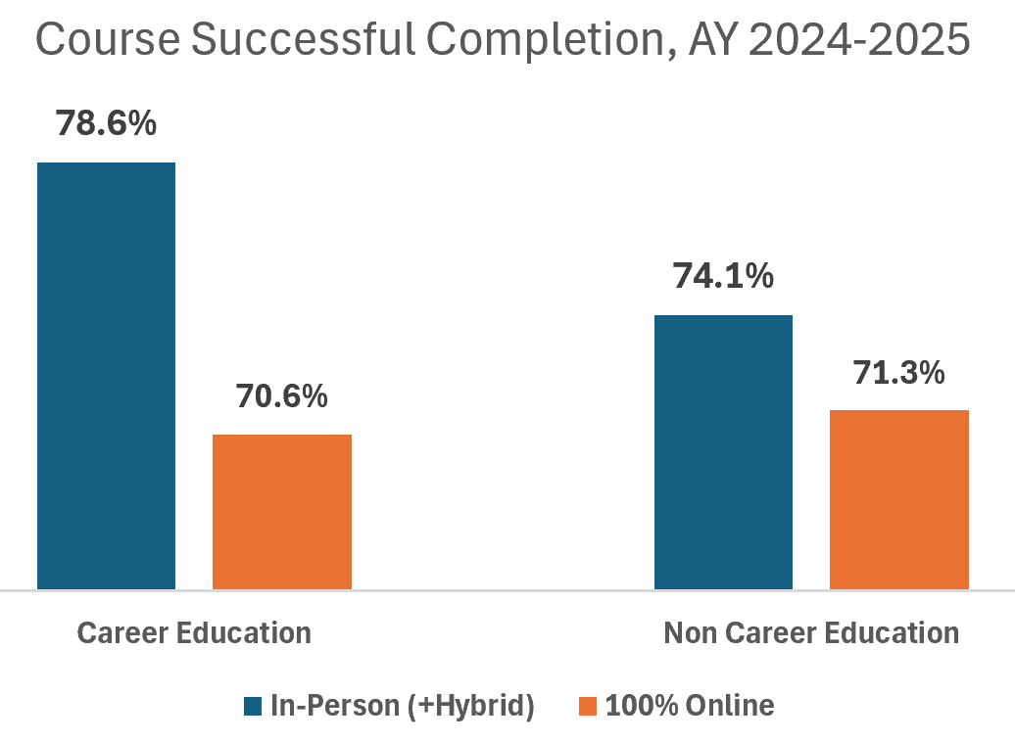
Modality, Career Education and Course Completion
Data Source: Peralta CCD Data Warehouse

Slide 44
Student Enrollment & Completion

Slide 45
Analysis of Student Enrollment and Completion
SAMPLE #1: 60+ Credits (12,909)
Attempted at least one class in the last 5 years
Earned 60 or more degree applicable units over their entire time in Peralta
Calculation per Student
Pull data on all classes completed in Peralta
Calculate the % of credits earned online
Check to see if they have been conferred an Associates

Slide 46
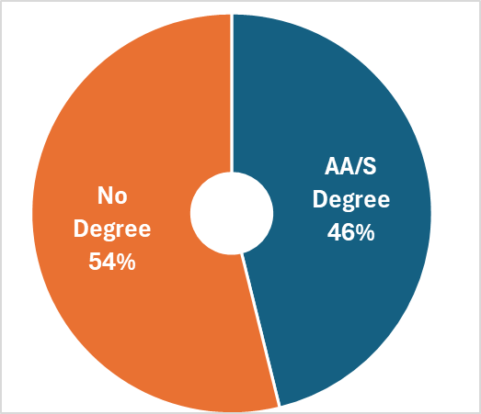
Associate Degrees Earned
What percentage of students earned an Associate degree?
SAMPLE #1: 60+ Cred’s
12,909 Students
46% with earned degrees
Equity Lens:
Asian - 42%
White - 41%
Male - 41%
Non-Binary- 37%

Slide 47
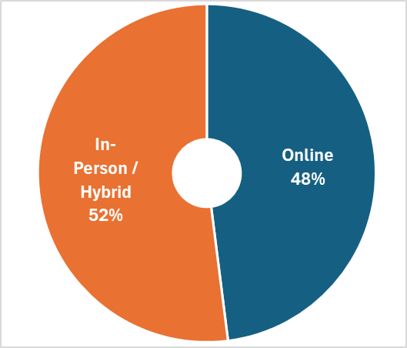
Associate Degrees Earned % Completed Online
What percentage of credits were earned online?
SAMPLE #1: 60+ Cred’s
12,909 Students
46% Conferred AA/S
48% of Credits earned online (on average)

Slide 48
Associate Degrees Earned and Percentage of Credits Completed Online
SAMPLE #1: 60+ Cred’s
12,909 Students
46% Conferred AA/S
48% Credits Online (avg)
579 Students or 4% earned ALL units online

Slide 49
Relationship Between % of Credits Earned Online and Time Enrolled
SAMPLE #1: 60+ Cred’s
12,909 Students
46% Conferred AA/S
48% Credits Online (avg)
4% of students completed all credits online
The proportion of credits taken online is inversely related to the time since starting in Peralta*
Years between first term and most recent term
*acausal relationship

Slide 50
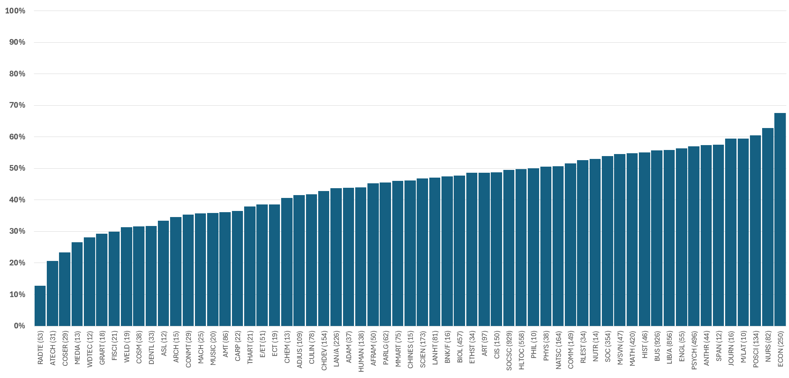
Students Completing First-Time Associates Degree Percentage of All* Attempted Units Taken Online By Program
First Time Associates Degree: 6,187 received in last 4 years.
Hybrid classes included in Non-DE category
Data Source: CCCCO Data Mart
Data Source: PCCD Data Warehouse, Academic Years 2020-21 to 2024-25; * includes classes outside of degree req’s.

Slide 51
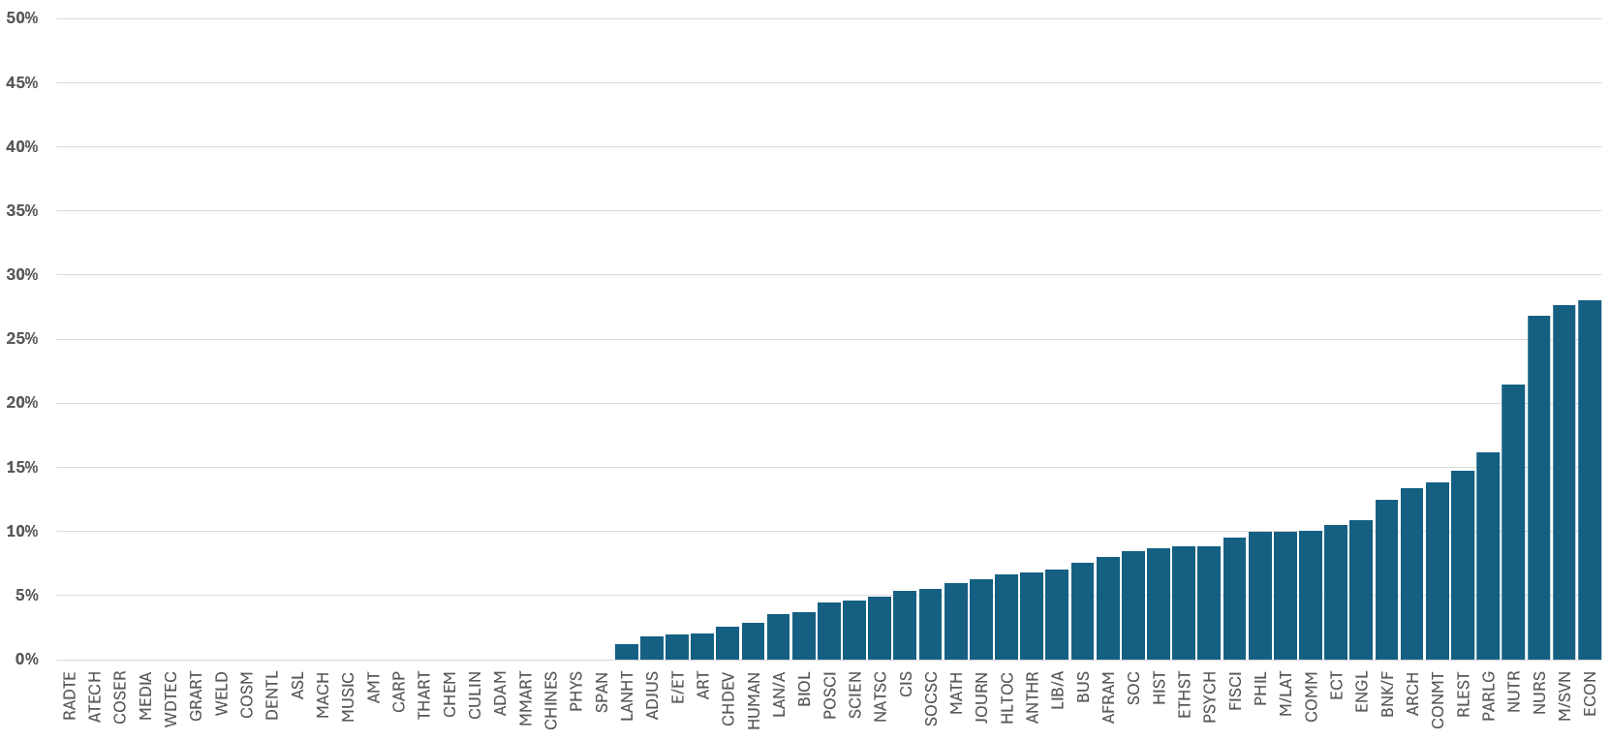
Students Completing First-Time Associates Degree Percentage of Students whose Journey was 100% Online by Program
First Time Associates Degree: 6,187 received in last 4 years.
Hybrid classes included in Non-DE category
Data Source: CCCCO Data Mart
Data Source: PCCD Data Warehouse, Academic Years 2020-21 to 2024-25

Slide 52
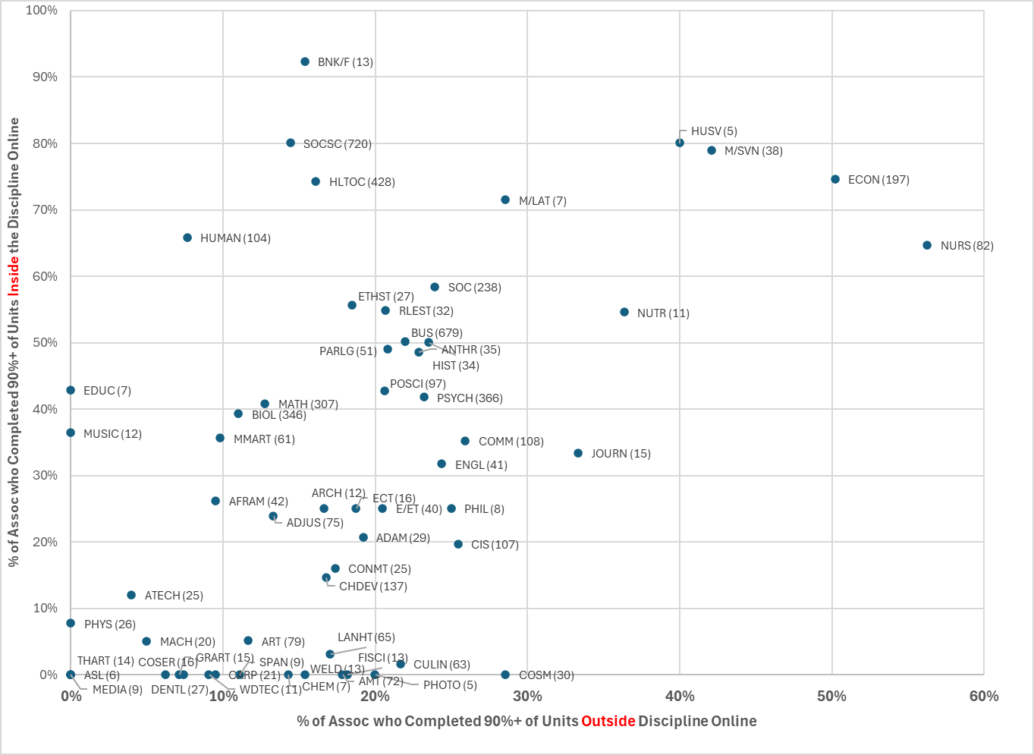
Students Completing First-Time Associates Degree Percentage of Students Completing at least 90% of Credits Online (Inside vs. Outside of Program)
Data Source: PCCD Data
Warehouse, Academic Years
2020-21 to 2024-25

Slide 53
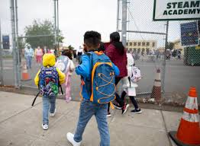

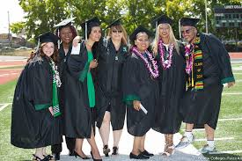




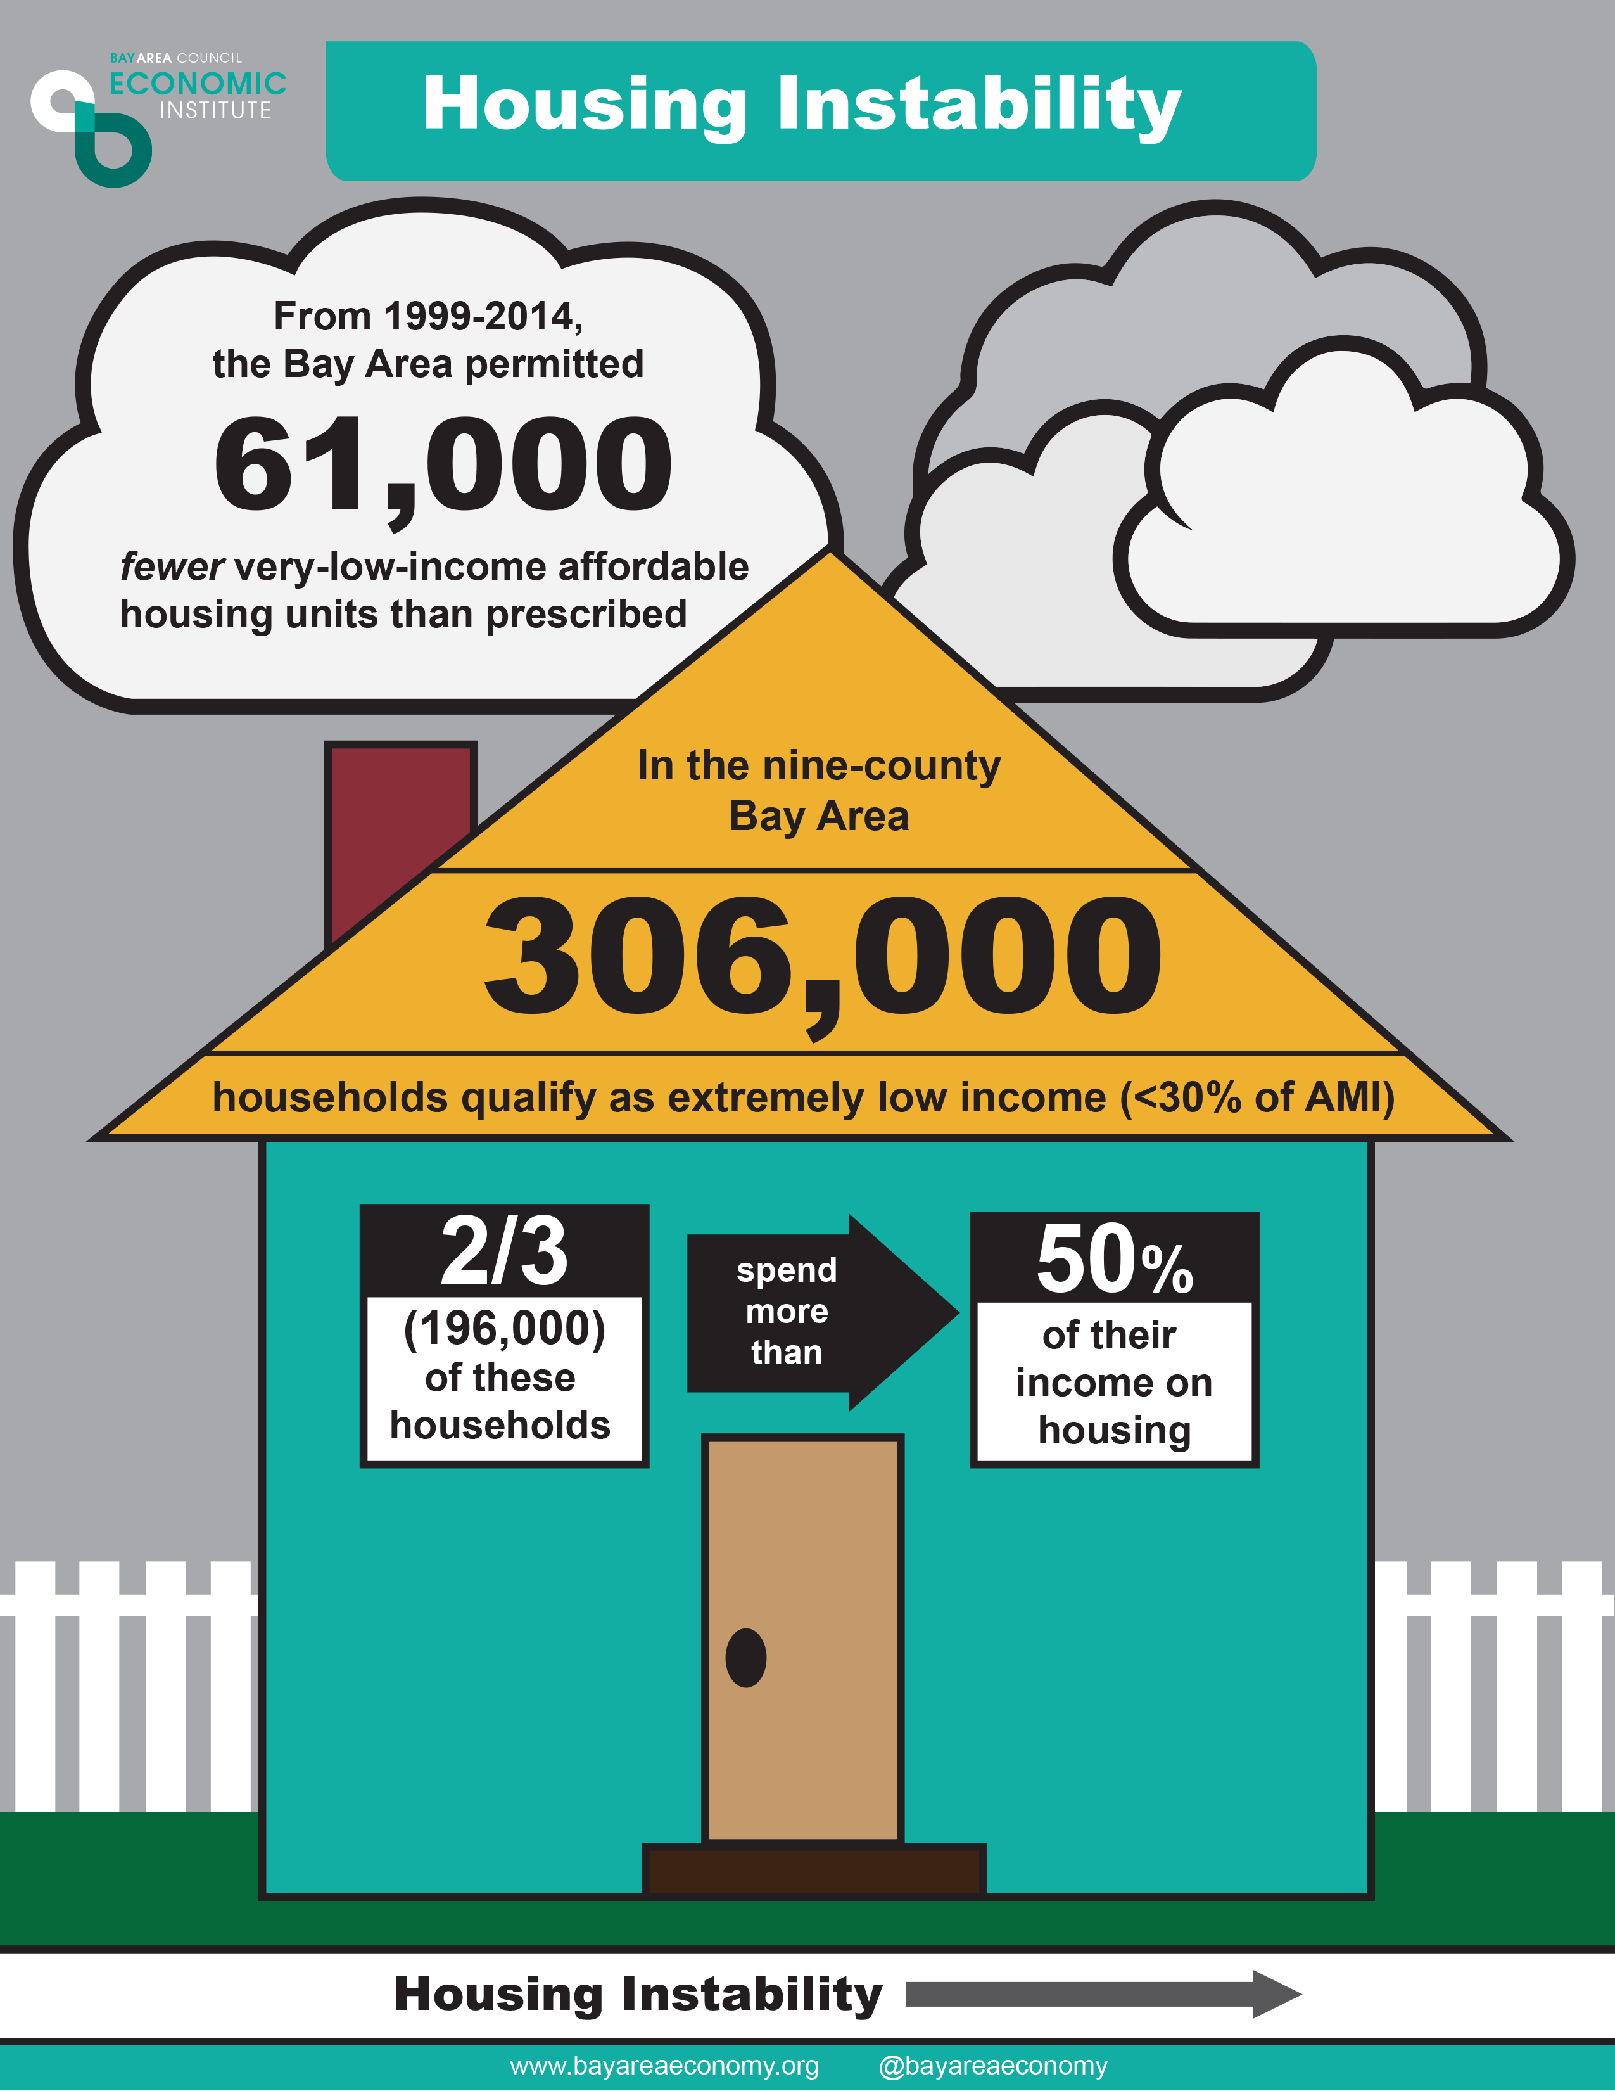
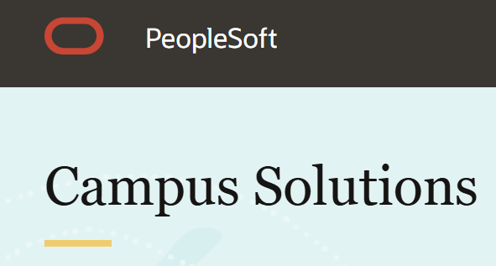

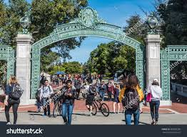
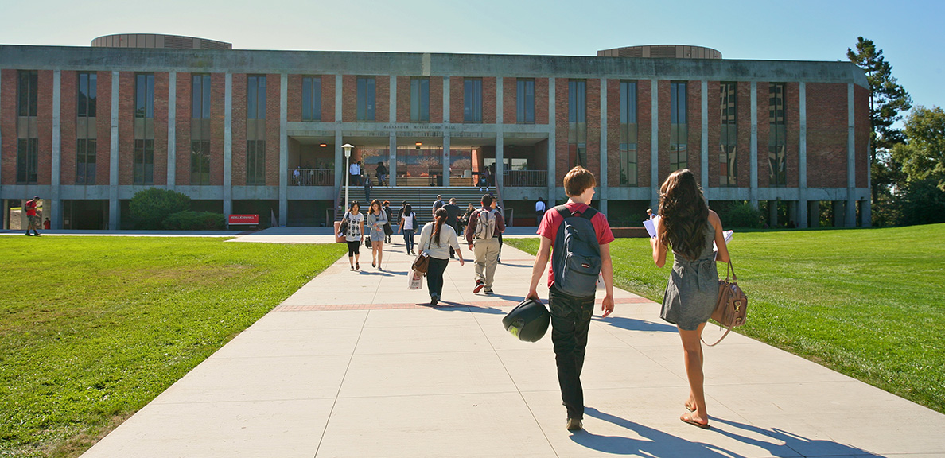
The Student Journey
Notes:
INCLUDE METRICS ON THE STUDENTS’ JOURNEY
Defines metrics where the student is the unit of analysis.
Consider students who complete their first Associates Degree
Include all courses they attempted (inside and outside the major, pass, fail or withdrawal).
Calculate the percentage of units attempted by modality.
What information does this provide?
Student take classes that meet their life situation
Online classes are easier to fit – especially online and especially asynchronous
Student piece together the pathways they need to reach their goals

Slide 54
Table Discussion Activity
PCCD Academic Program Modality
Which programs appear most feasible for full online delivery, and which may face significant barriers (based on the data showing program size and the proportion of courses already offered online)
What considerations—such as lab components, fieldwork, or industry certifications—should guide whether a program can or should transition to being fully online?
The data suggest that completion rates vary by modality and that a subset of students complete their entire degree online.
What equity implications should we consider when expanding fully online programs?
For example, how might online pathways improve access for working adults or remote learners, and conversely, how might they create new barriers for students needing hands-on or community-based learning experiences?
What additional data would help us evaluate the student experience and success in online programs (e.g., disaggregated retention data, course pass rates by modality, student demographics)?
What kinds of instructional and student support systems (tutoring, counseling, technology access, orientation to online learning) are essential to ensure equitable completion in a fully online degree environment?

Slide 55
PCCD Dual and Concurrent Enrollment Analysis
Dr. Helen Ku
Dr. Yang Hu

Slide 56
Serving Middle and High School Students
Dual Enrollment and Concurrent Enrollment
Early kick-start for college pathways and explore career trajectories
Students earn high school and college units at the same time (weighted GPA)
Dual Enrollment: Taught at partnering high school campuses and/or online
Concurrent Enrollment: High school students from any high school can enroll in courses offered at any Peralta College on Peralta College campuses and/or online

Slide 57
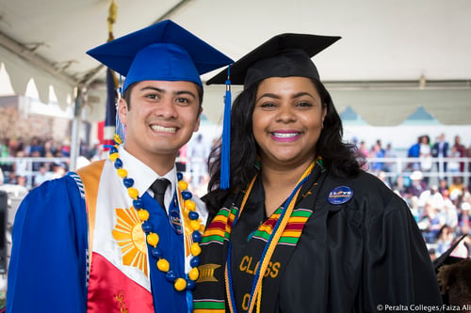
Total Dual Enrollments and Concurrent Enrollments at PCCD Academic Year 2024-2025 12,220 +7% over the last three years 10% of overall PCCD FTES
Dual and Concurrent Enrollments Report AY 2023-2025

Slide 58
Overall, more Concurrent Enrollments than Dual Enrollments at PCCD in AY 2025
Dual Enrollments and Concurrent Enrollments across the Colleges
Laney College: highest Dual Enrollments and Concurrent Enrollments

Slide 59
Top Five High Schools with the most Dual Enrollments for Laney College
Coliseum College Prep (224)
Madison Park Academy (199)
Oakland Technical High School (169)
Young Adult Program (168)
Fremont High School (150)
(____) = enrollments

Slide 60
Top Five Most Enrolled Dual Enrollment Classes at Peralta Colleges
1. Career and Life Planning (69)
Berkeley High School (BCC partner)
2. Math for Liberal Arts Students (49)
Oakland Intl High School (LC partner)
3. Orientation/College (42)
Arise High School (BCC partner)
4. Abnormal Psych (40)
Skyline High School (MC partner)
5. Intro Forensic Investigation (38)
Skyline High School (MC partner)
(____) = enrollments

Slide 61
Top 2 High Schools with the Most Concurrent Enrollments
BCC
1. Berkeley High School (324)
2. Alameda Science Tech Institute (115)
COA
Alameda Science Tech Institute (408)
Oakland High School (117)
LC
Oakland Technical High (229)
Coliseum College Prep (169)
MC
1. Alameda Science Tech Institute (163)
2. Oakland Technical High (98)
(____) = enrollments

Slide 62
Top Five Most Enrolled Concurrent Enrollment Classes
1. Work Experience (85)
Berkeley High School (BCC partner)
2. Intermediate Algebra Lab (30)
Encinal High School (LC partner)
3. Intermediate Algebra Lab (25)
Coliseum College Prep (LC partner)
4. Hip Hop Dance (23)
Richmond High School (LC partner)
5. Calculus 1 (22)
Latitude High School (LC partner)

Slide 63
Dual Enrollment and Concurrent Enrollment Course Success & Retention Rates
PCCD course success rate 73%
PCCD course retention rate 86%

Slide 64
Dual Enrollment Charter and Non-Charter School Partnerships
Number of Non-Charter Schools
20
Number of Charter Schools
14

Slide 65
AY 2025 Dual Enrollment Charter and Non-Charter Course Outcomes
Course success and retention rates were relatively the same across Dual enrollment courses offered at non-charter and charter schools

Slide 66
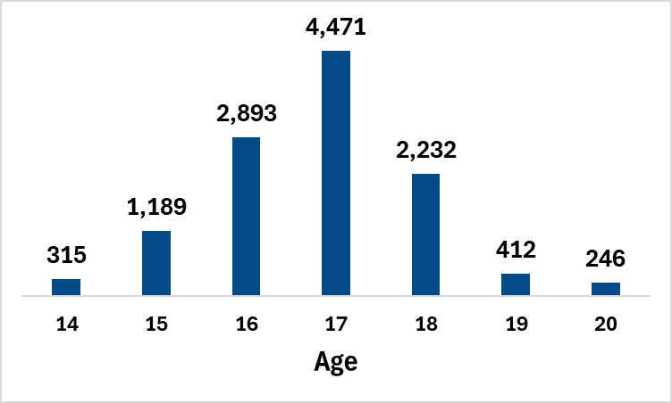
Dual and Concurrent Enrollments Student Age
Ages 14-20
96% of
Dual and Concurrent Enrollments

Slide 67
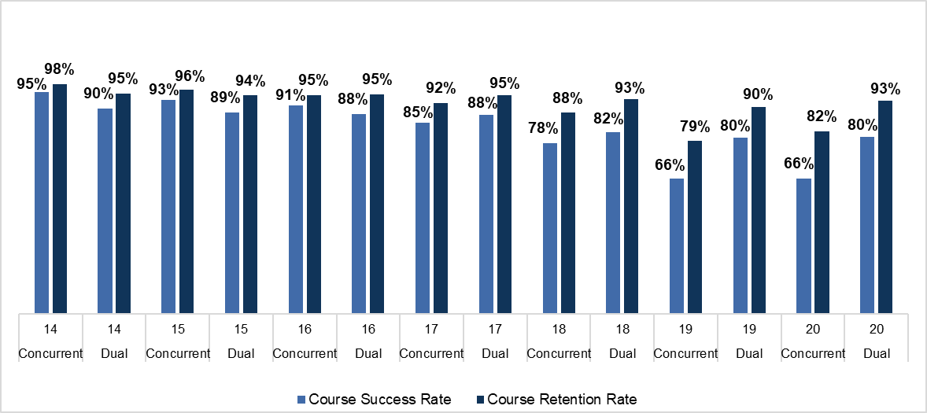
Dual and Concurrent Enrollment Course Success by Age

Slide 68
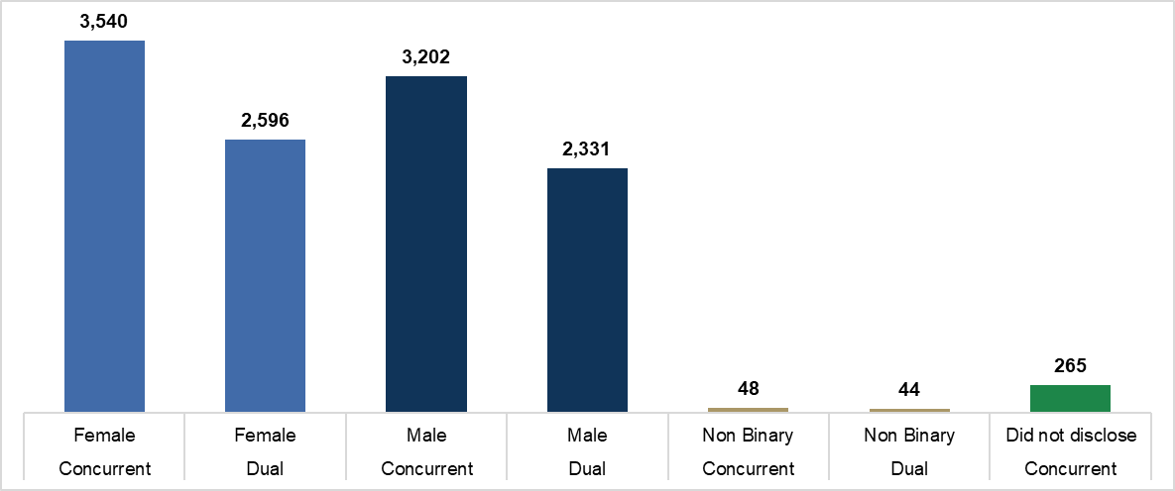
Dual and Concurrent Enrollments by Gender

Slide 69
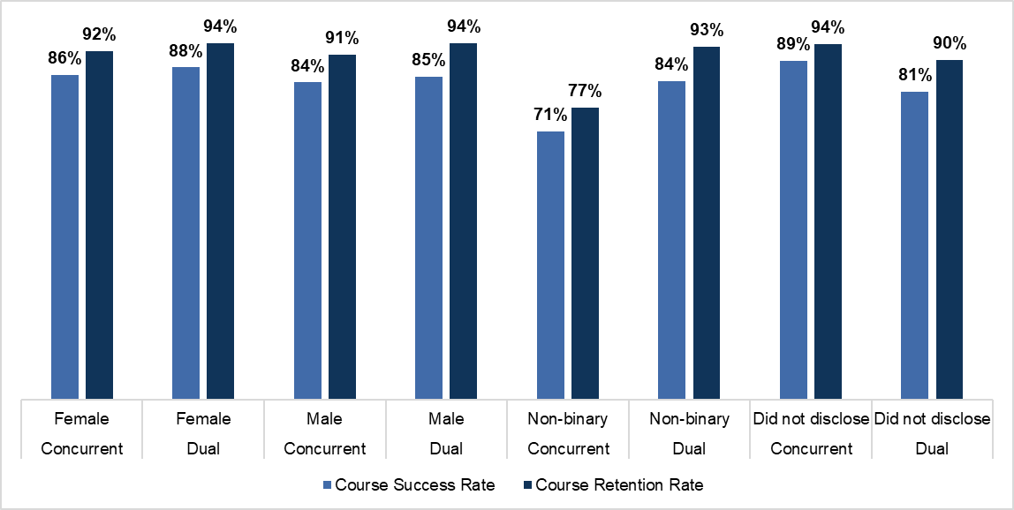
Dual and Concurrent Enrollment Course Success by Gender

Slide 70
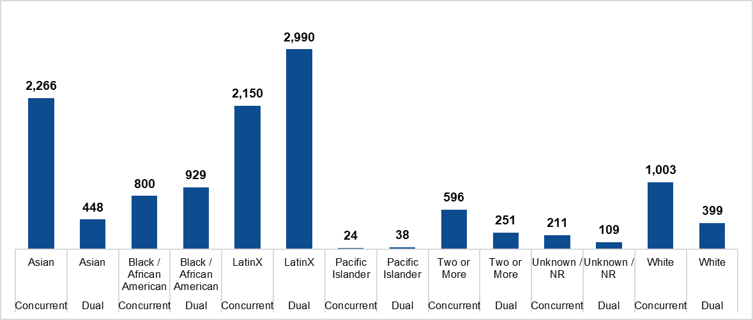
Dual and Concurrent Enrollment by Race/Ethnicity

Slide 71
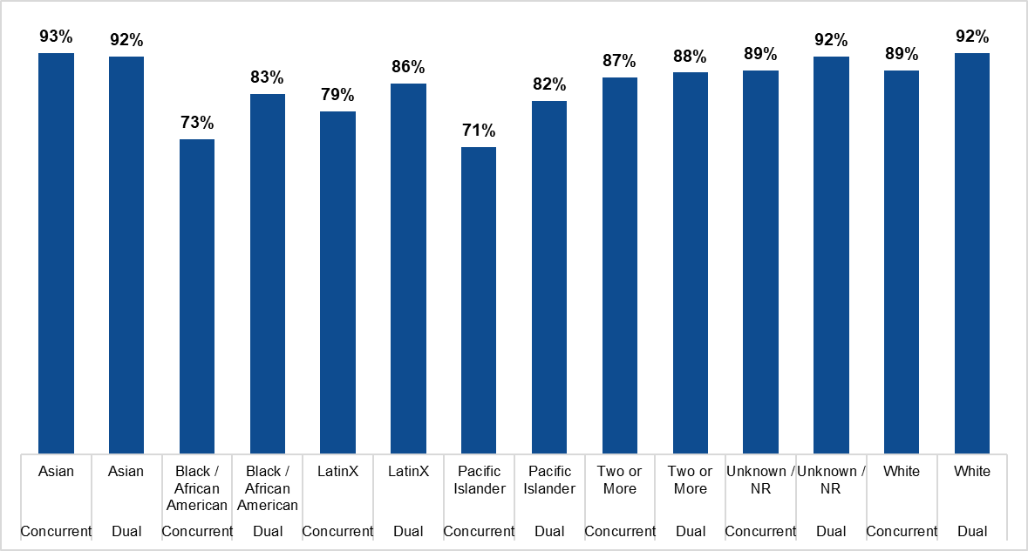
Dual and Concurrent Enrollment Course Success by Race/Ethnicity

Slide 72
Student Groups and Course Outcomes
Course success rates are higher among younger students (14-16 yrs. old) than older students
Non-binary students in concurrent courses had the lowest rates of course success (71%) and course retention (77%)
Lower rates of course success (both Concurrent and Dual enrollments) relative to other racial/ethnic groups
Black/African American
LatinX
Pacific Islander

Slide 73
Guiding the Next Phase of PCCD Dual and Concurrent Enrollment
1. Partner with Middle Schools and Families to Expand Dual and Concurrent Enrollment Access
Begin partnering with middle schools that feed into high schools
Offer family-facing education
Host college readiness events at middle school campuses
2. Strengthen Supports for Non-Binary Students in Dual and Concurrent Enrollment
Incorporate gender inclusivity into faculty training
Foster a sense of belongingness for students Student Success Navigator training
Partner with high school clubs for LGBTQAI+ and Wellness Staff
3. Increase Support for Black, Latinx, and Pacific Islander Students in Concurrent Enrollment
Collaborate with existing equity-focused programs at Peralta Colleges: Umoja, Puente, APASS and co-design supports for concurrent enrollment for student onboarding, peer mentorship, and advising
Foster a sense of belongingness
Conduct focused research and listening sessions

Slide 74
Dual and Concurrent Enrollment Dashboard
Dr. Yang Hu

Slide 75
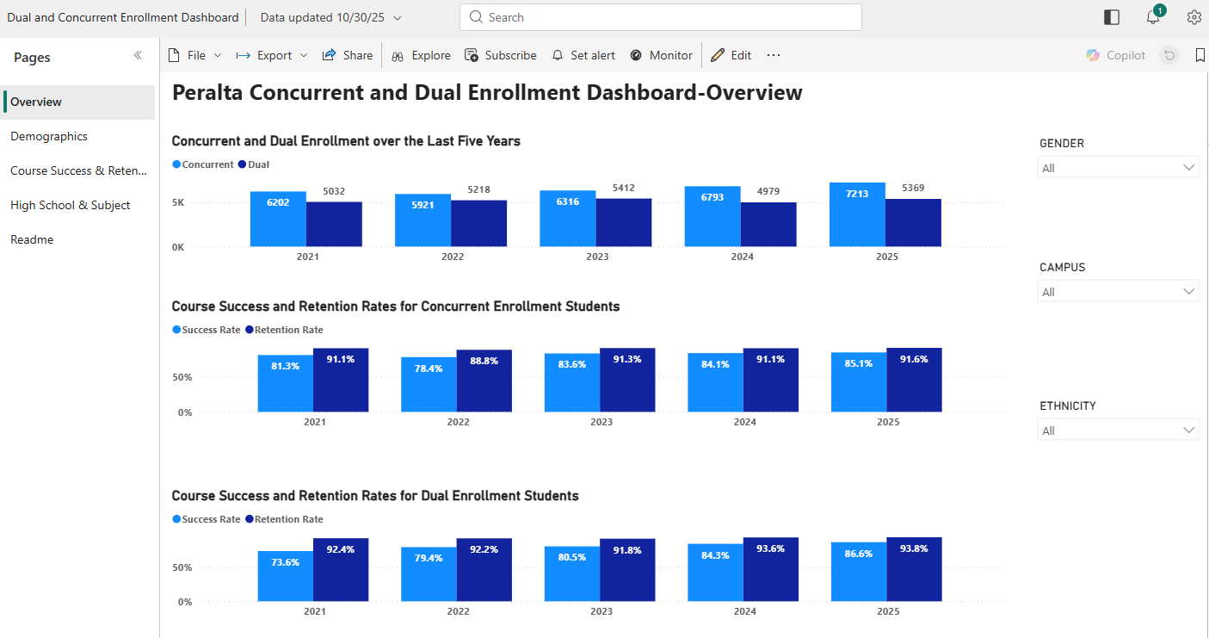
Dual and Concurrent Enrollment Dashboard

Slide 76
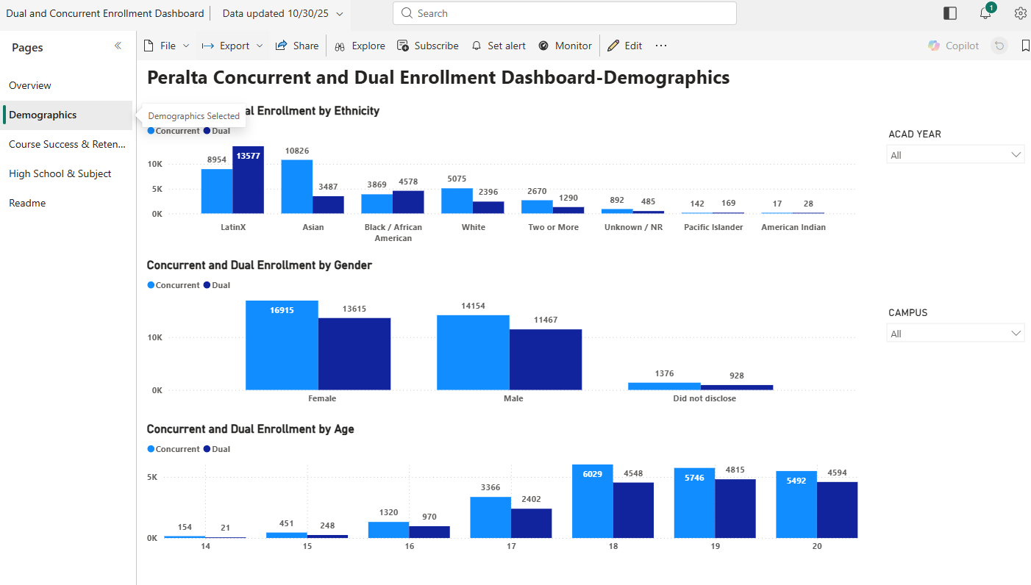
Dual and Concurrent Enrollment Dashboard

Slide 77
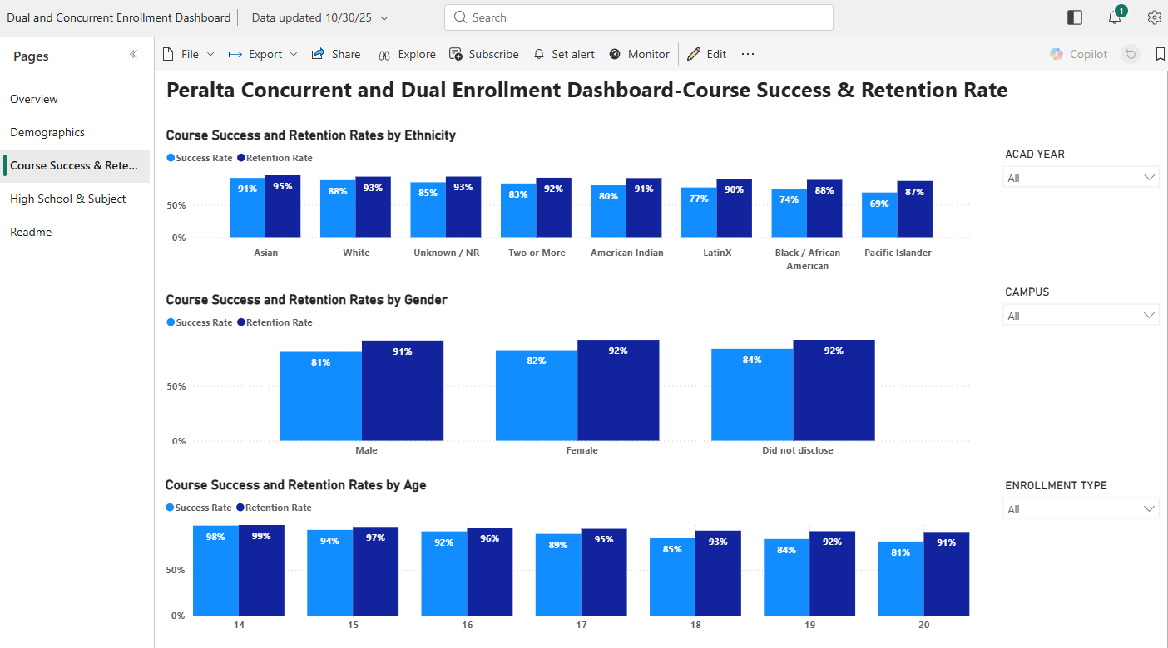
Dual and Concurrent Enrollment Dashboard

Slide 78
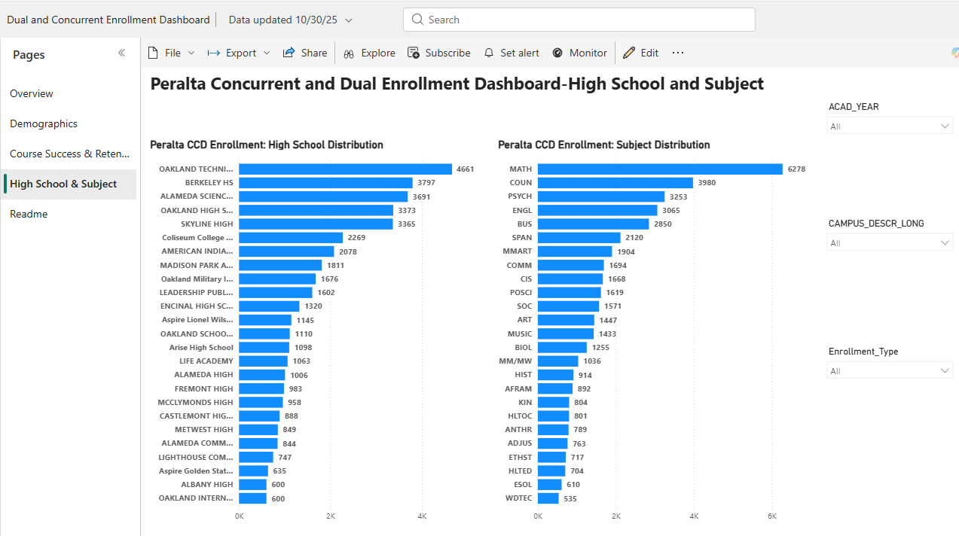
Dual and Concurrent Enrollment Dashboard

Slide 79
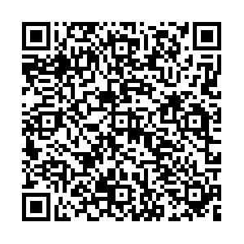
Dual and Concurrent Enrollment Dashboard
Overview - Dual and Concurrent Enrollment Dashboard - Power BI

Slide 80
Final Reflections & Next Steps of Data Summit
What is one thing you learned or noticed in the data that was unexpected or new?
Next Steps- Further Data Analysis and Dialogue over next 5 months
SSEMC Meets November 14, 2025
Taskforce Meetings TBD: https://www.peralta.edu/transformation

