Slide 1
Credit for Prior Learning
Notes:
Chantee

Slide 2

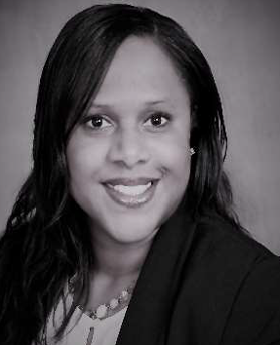



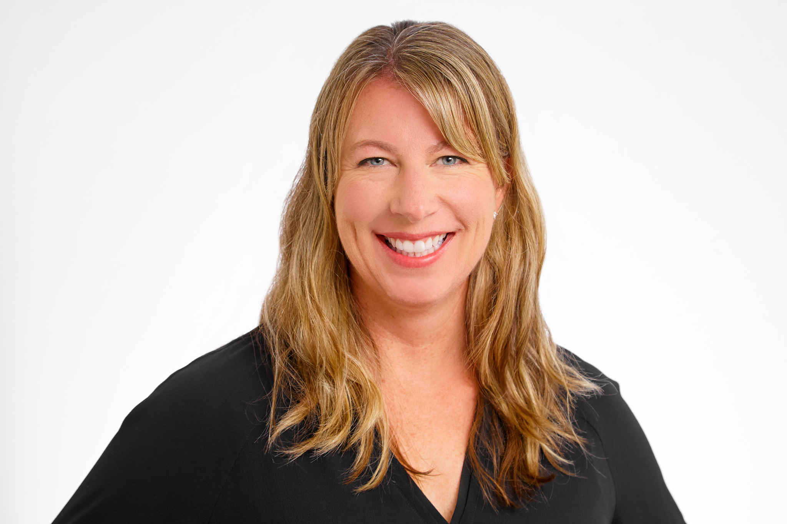

Today’s Presenters
Benjamin Mudgett
Palomar College Articulation Officer
CPL Workgroup Co-Chair
Chantée Guiney
Educational Services & Support
CPL Specialist
Candace Rose
Palomar College CPL Coordinator, Media Studies Faculty
Jodi Lewis
Success Center, Foundation CCC
Director of Strategic Initiatives
Notes:
Chantee

Slide 3
Presentation Learning Outcomes
Participants will be able to:
Identify CPL methods of assessment and the role CPL plays in ensuring equitable learning and achievement;
Discuss the importance of stakeholder engagement across the campus, onboarding students into the CPL process;
Identify CPL implementation, resources and strategies
Notes:
Chantee

Slide 4
Presentation Format
What is CPL and why is it important?
State level updates on CPL and resources available
Discussion re: CPL from a student and institutional perspective
  Practice sharing then Google doc collaboration
Challenges
  Sharing then Google doc collaboration
Notes:
Chantee

Slide 5
What is Credit for Prior Learning?
Credit for Prior Learning (CPL) is college credit awarded for validated college-level skills and knowledge gained outside a college classroom. Students’ knowledge and skills might be gained through experiences such as:
Military training Industry training and certification State/federal government training | Volunteer and civic activities Apprenticeships, internships, work-based learning, or other industry-based experiential learning
Methods of Assessment:
Portfolio Review
Credit by Exam
Industry Certification
Military Transcript
Advanced Placement, International Baccalaureate, College Level Exam Preparation
Notes:
Jodi

Slide 6

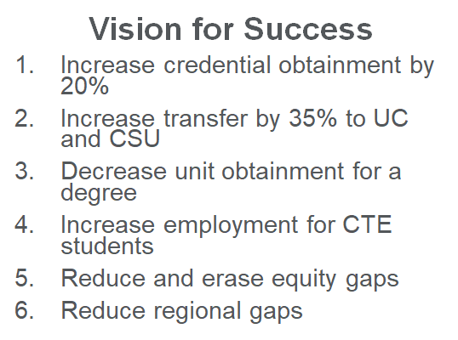
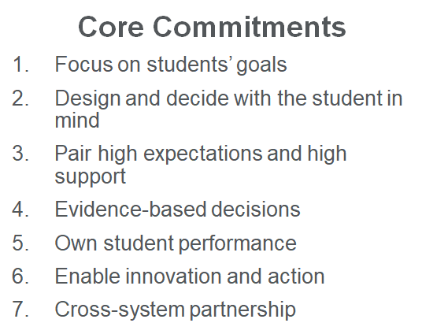
CPL is an E Q U I T Y Lever
CCC Vision for Success and Core Commitments
Notes:
Jodi

Slide 7
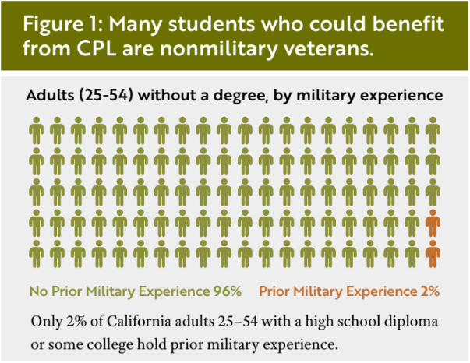
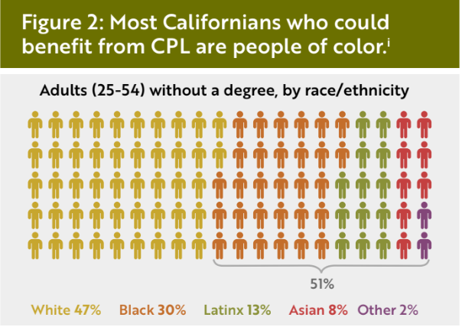
Closing the equity gap
ASCCC: Credit for Prior Learning as an Equity Lever
CA Competes "Credit for Prior Learning: Leveraging Past Learning to Close Present-Day Equity Gaps"
Most Californians who could benefit from CPL are people of color¹
Validates learning that has occurred
Saves money and time
Increases employer partnerships
Aligns with Guided Pathways
¹ California Competes CACompetes_CPL-Brief_Final.pdf (californiacompetes.org)
Notes:
Jodi

Slide 8
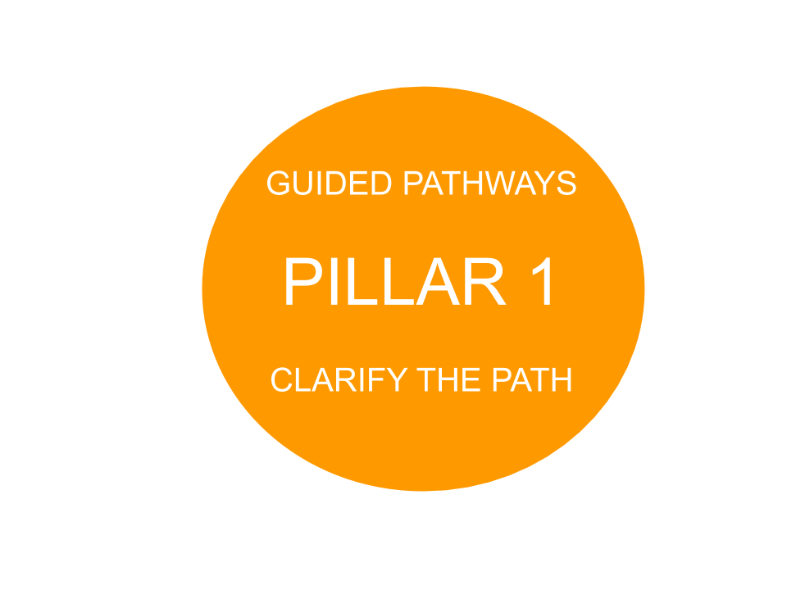
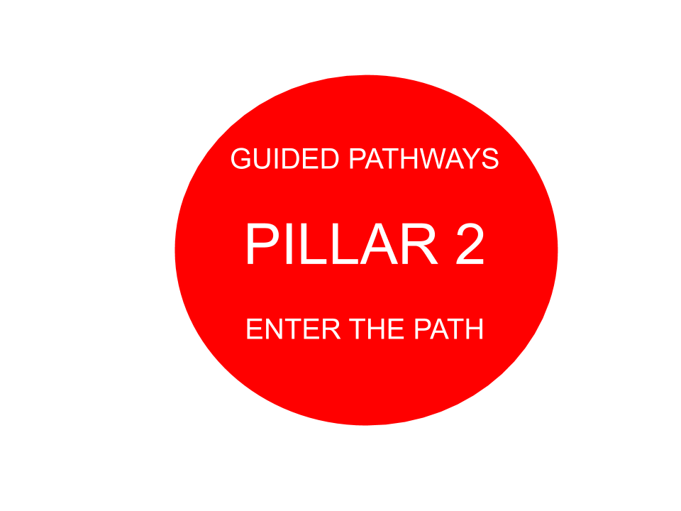
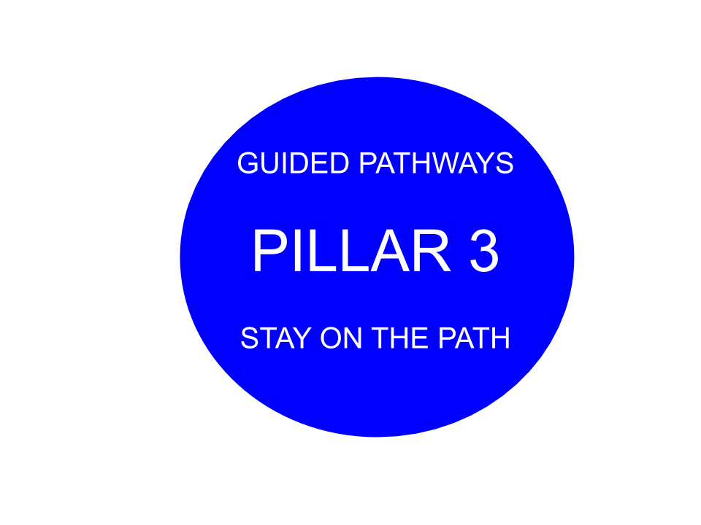
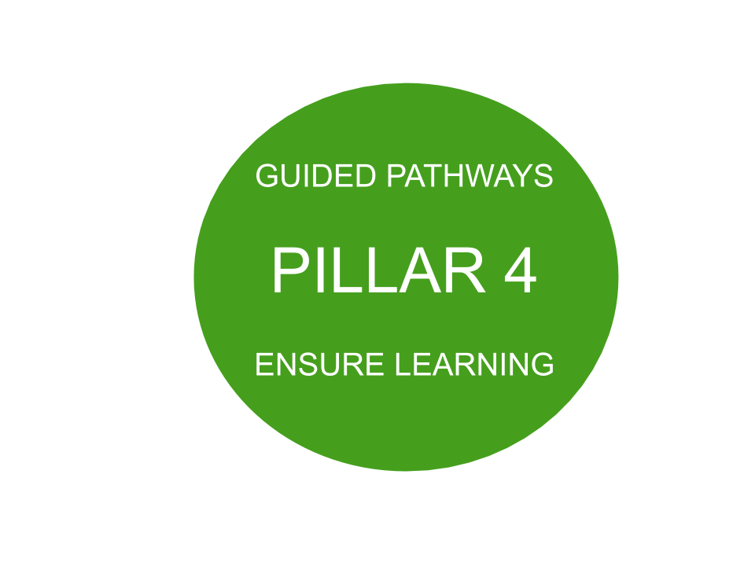
Tying it all together...
CCC Vision Goals Guided Pathways Strong Workforce
“The pandemic-induced recession presents a uniquely important opportunity to support unemployed and underemployed Californians, particularly those of color, in reskilling and upskilling to secure better-paying jobs in the future.”
“When colleges require students to take courses with content they have already mastered on the job, in the military,... potential graduates often must spend extra time and money duplicating their education—or deferring it.”
“By contrast, more uniform and widely implemented CPL policies throughout California’s public higher education segments could elevate the economic trajectories for hundreds of thousands of uncredentialed adults — while helping the state increase degree attainment and meet workforce demands.” California Competes: Higher Education for Stronger Economy
Notes:
Jodi

Slide 9
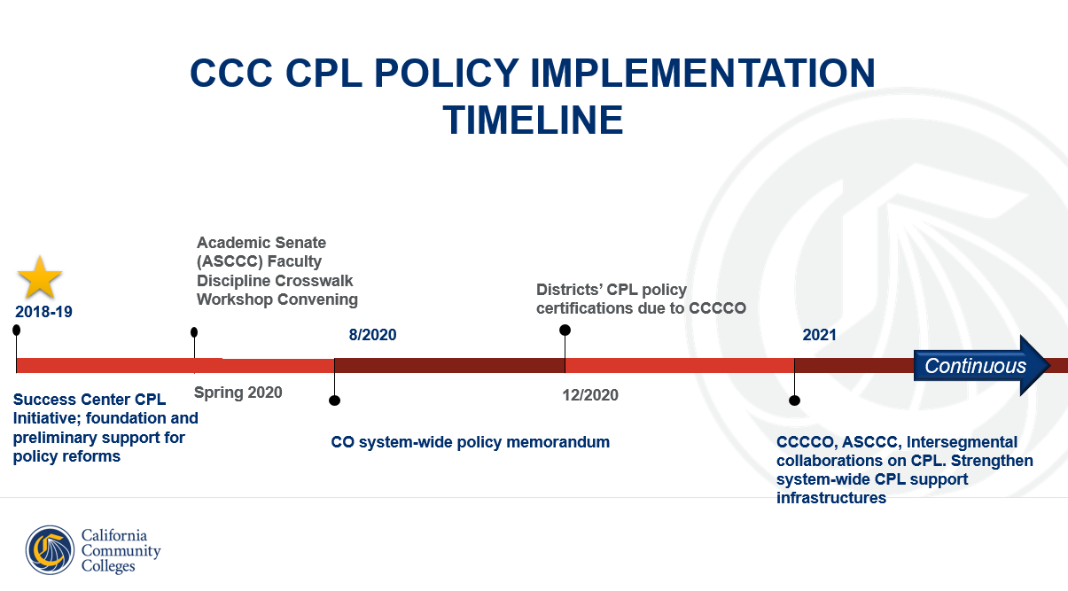
Title 5, § 55050
Credit for Prior Learning
Notes:
Chantee

Slide 10
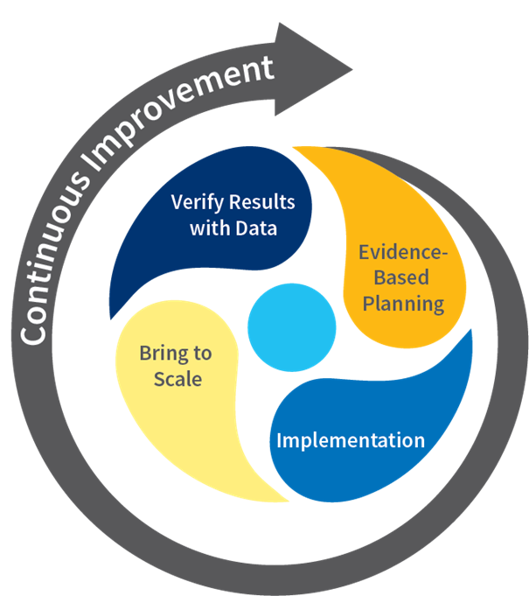
Update on CPL MIS Data Elements
“SY” file is a new term file collected beginning summer 2021
SY file contains one record for each district combination of college, student, and assessment of credit for prior learning which occurred during the reporting term
SY record includes course control number (CB00) and course department number (CB01) and corresponding course must be reported in CB file for term
SY record includes assessment date and method, units awarded, and grade earned
System of Continuous Improvement
Notes:
Chantee

Slide 11
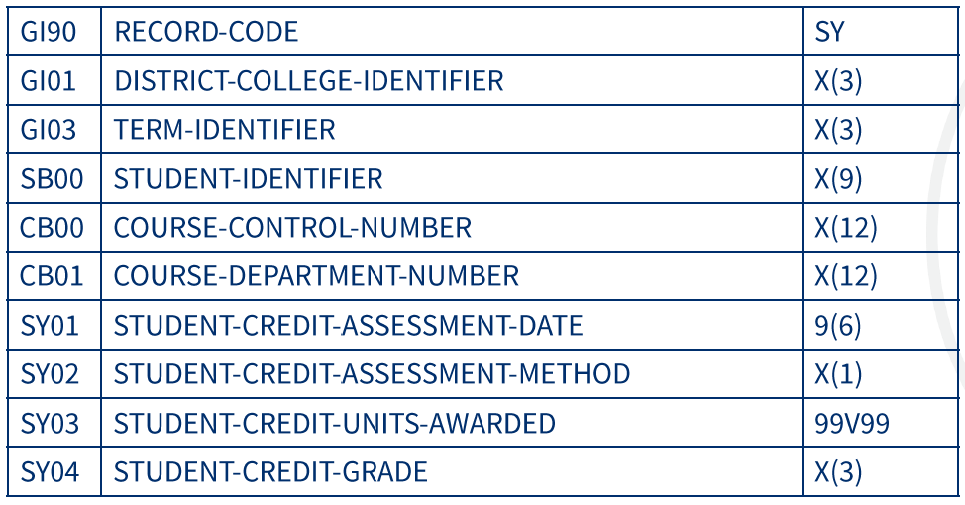
CPL New “SY - Record Code” File
CCCCO MIS Data Element Dictionary for CPL reporting https://webdata.cccco.edu/ded/sy/sy_all.pdf
Notes:
Chantee

Slide 12
Update on CPL MIS Data Elements
SY02 STUDENT-CREDIT-ASSESSMENT-METHOD
A - Locally developed assessment by portfolio or other methods
B - Locally developed assessment by exam
C - Advanced Placement (AP)
D - International Baccalaureate (IB)
E - College Level Examination Program (CLEP)
F - Industry certification
G - Military training (excluding CLEP)
Z - Other
CCCCO MIS Data Element Dictionary for CPL reporting https://webdata.cccco.edu/ded/sy/sy_all.pdf
Notes:
Chantee

Slide 13
CPL Intersegmental Update
Last revised in 2008, CSU EO 1036 addresses how externally earned credits should be evaluated and applied toward CSU admissions, transfer and credits toward a degree. The current EO 1036 addresses credits earned from three sources: examinations, experiences, and learning in non-collegiate settings, i.e. military and workplace. Proposed revisions to CSU EO 1036 include:
Revised title to reflect updated nomenclature and common terminology (Credit for Prior Learning)
Policy makes explicit that it applies to both undergraduate and graduate degrees
Introduction identifies benefit of CPL for students
Replace term “non-collegiate instruction” with “learning acquired outside formal higher education”
Updated references to military training and credits combined in new section
Strengthened language around challenge exams to better reflect Title 5 requirements
Affirm articulation and transfer of credits earned by CCC students through credit-for-prior-learning with reference to existing Transfer policy.
Description of workplace training credentials
Recommendation that CPL be transcribed as a specific course or specific category of degree requirements (GE, major, elective)
Added Glossary and Related resources
Added option to appeal CPL awards
Notes:
Chantee

Slide 14
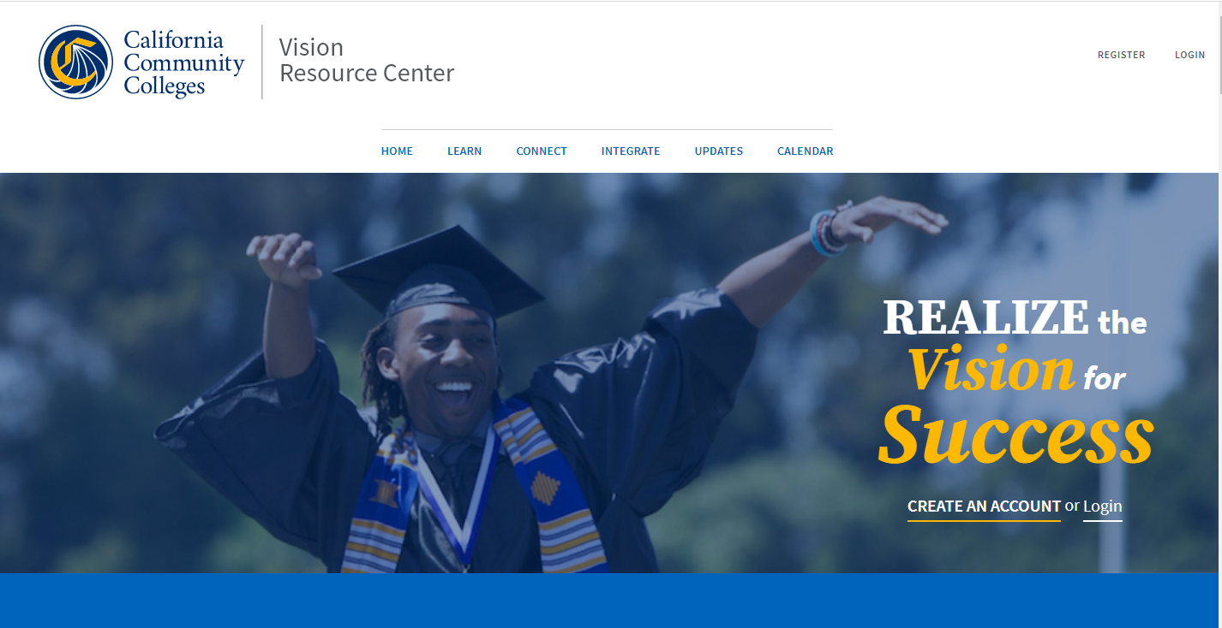
Vision Resource Center
Systemwide professional learning platform available to all
Create an account: visionresourcecenter.cccco.edu
CPL Community:
  resources such as CPL Implementation Toolkit
  connect with peers
  address problems of practice
Sign in
Hover over “Communities” at top left
Select “All Communities”
Select “CCC | Credit for Prior Learning”
Click “Join”
Notes:
Chantee

Slide 15
CPL from a Student’s Perspective:
Lessons from the field
Notes:
Ben and Candace

Slide 16
The Student CPL Experience
Getting the word out to students about Credit for Prior Learning opportunities
Who can students contact to learn more about CPL?
Guidance for students by a CPL Counselor
  Is CPL the right choice?
  Developing an education plan
Streamlining the CPL petition process from start to transcription
Additional Support to make sure your CPL students succeed:
  Portfolio review support
  Credit by Exam preparation
  Submitting Military Transcripts
  Submitting Industry Certifications
Notes:
Ben and Candace

Slide 17
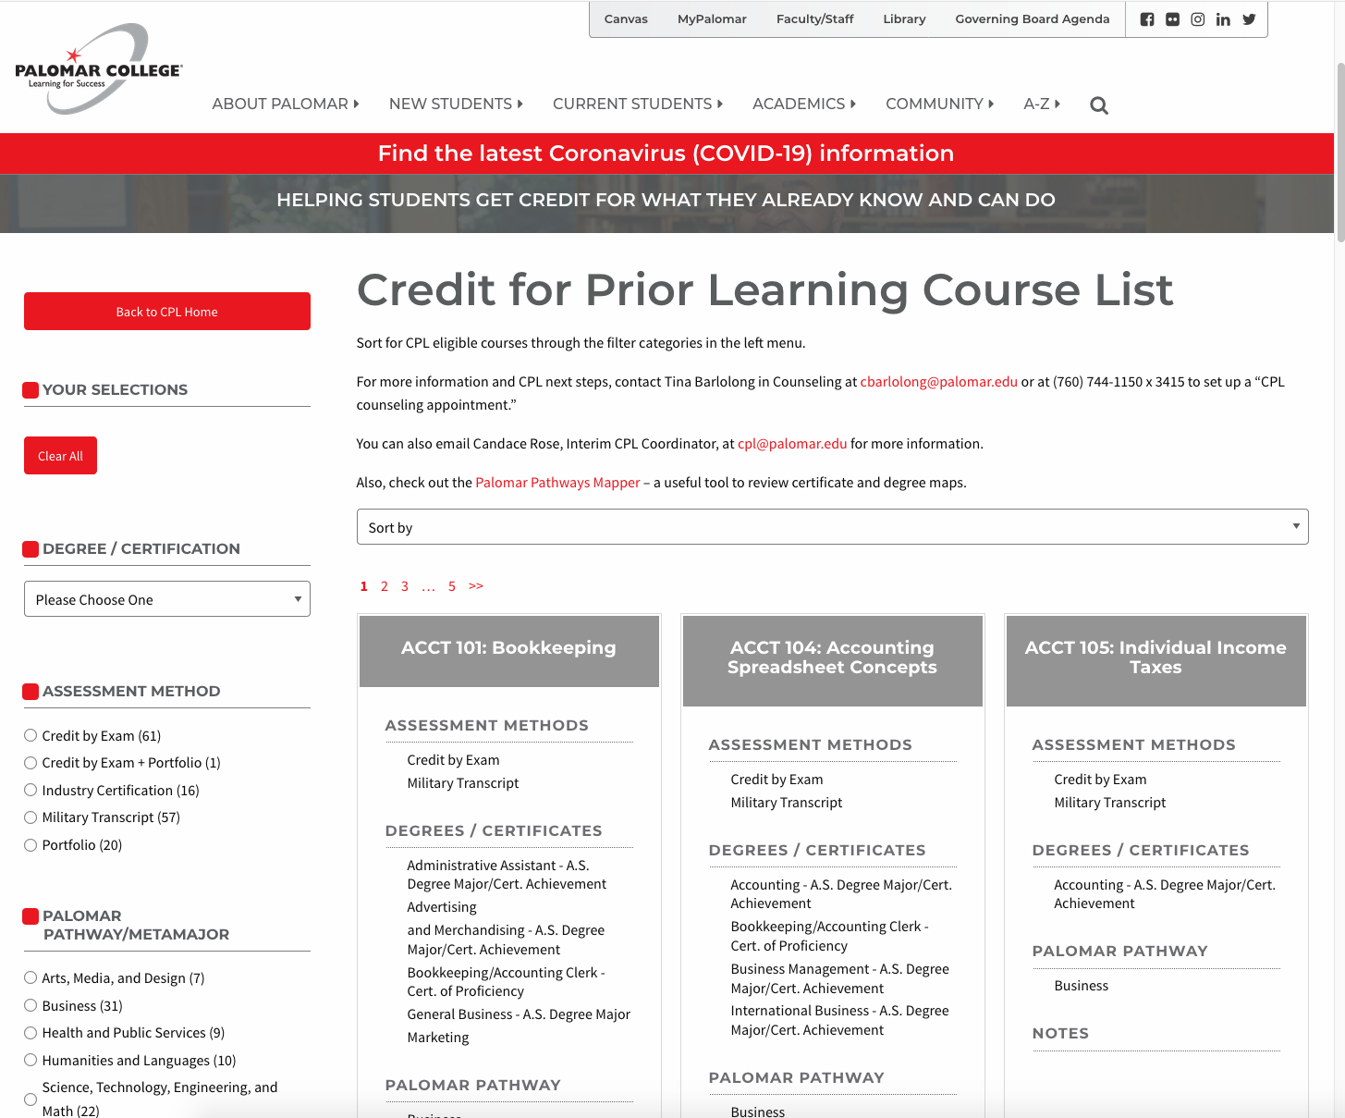
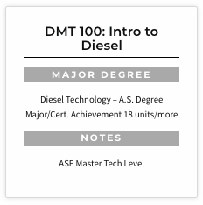
Palomar College searchable
CPL Webpage
Enhancing the Student Experience
Easily search for CPL eligible courses by:
Assessment Method
Discipline
Palomar Pathway/Meta Major
Degree(s)/Certificate(s) and course specific CPL notes
Notes:
Ben and Candace

Slide 18
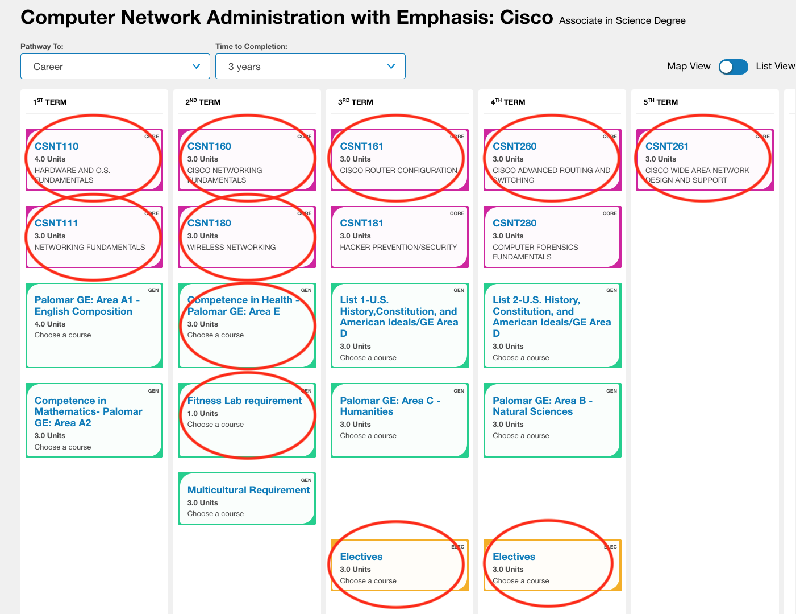
Military Credit
Thinking outside the box...
Aviation Communication Systems Technician
Marine Corps Communications Electronics School
Marine Corps students who complete this 600+ hour training program qualify for 7 courses (22 units) of CSNT credit plus 2 elective courses (6 units) towards a Certificate or AS degree in Computer Network Administration with Emphasis: Cisco
Notes:
Ben and Candace

Slide 19
Now it’s your turn...
Click on the Google doc to answer the following question:
What effective student-facing practice is your college using to help students access CPL?
Notes:
Ben and Candace
Link to Google doc:
https://docs.google.com/document/d/15eVk6ujFRoHDk3iu559rjOcm_psX8xwvmfF2lAcwr6c/edit?usp=sharing

Slide 20
CPL from an Institutional Perspective:
Lessons from the field
Notes:
Ben and Candace

Slide 21
Institutionalizing CPL
Effective CPL practices requires a team:
Faculty, Student Services, Administrators, Instruction, Academic Technology, Information Services, Counselors, Articulation Officer, Veterans Services and more...
CPL AP and BP Policies
CPL and Guided Pathway
Transcribing CPL
CPL Petition Process
CPL Database
Integrating CPL into the Curriculum Process
Statewide partnerships CCCCO
CPL messaging to student
CPL website and course list
Notes:
Ben and Candace

Slide 22
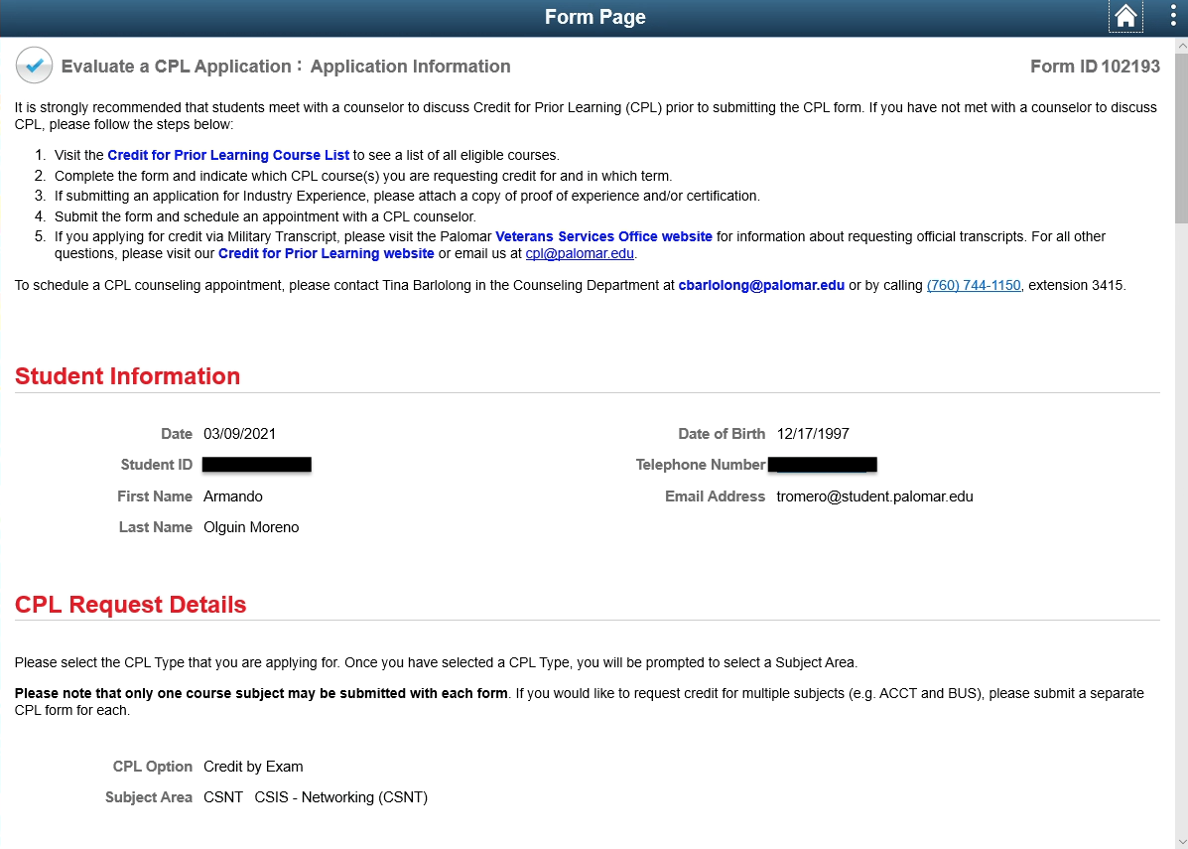
CPL Petition Form Example
Gideon Taylor workflow-enabled petition eform for CPL methods of assessment:
  Credit by Exam
  Portfolio Review
  Military Transcript
  Industry Certification
Students meet with the CPL Counselor and initiate the form
Approval workflow dependent upon the method of assessment
Form pulls data from PeopleSoft
Integrated with our CPL course database
Auto response and email notifications to keep everyone informed
CPL Petition Form student view
Notes:
Ben and Candace

Slide 23
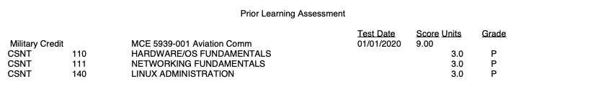
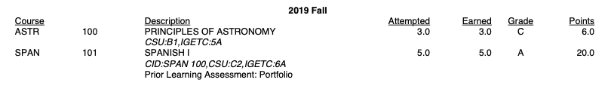
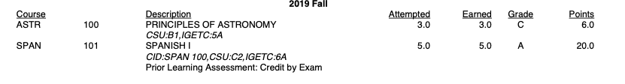

Transcribing Credit for Prior Learning Example
“If awards are for credit, transcript entries should clearly describe what learning is being recognized and should be monitored to avoid giving credit twice for the same learning.”
ACCJC Policy on Credit for Prior Learning, June 2020
* Please note these are examples of transcript verbiage only and not necessarily what is actually being awarded for CPL.
Notes:
Ben and Candace

Slide 24
Now it’s your turn...
Click on the Google doc to answer the following question:
What effective practice is your college using to institutionalize CPL and make it part of your campus culture?
Notes:
Ben and Candace
Link to Google doc:
https://docs.google.com/document/d/1k5rKrJSAbX2uKCoxlksAH6IbXVvrtNIMMTt537rRKB0/edit?usp=sharing

Slide 25
Challenges going forward:
Lessons from the field
Funding for implementation activities
Transcribing CPL
Transfer of CPL
Notes:
Ben and Candace

Slide 26
Now it’s your turn...
Click on the Google doc to answer the following questions:
What challenges are you aware of that hinder CPL?
What solutions do you propose?
Please suggest different solutions for challenges others have identified.
Notes:
Ben and Candace
Link to Google doc:
https://docs.google.com/document/d/1cwHsRuqDROu1dShyO76HcEJeG8RGQ11CM07LDEuhiE4/edit?usp=sharing

Slide 27
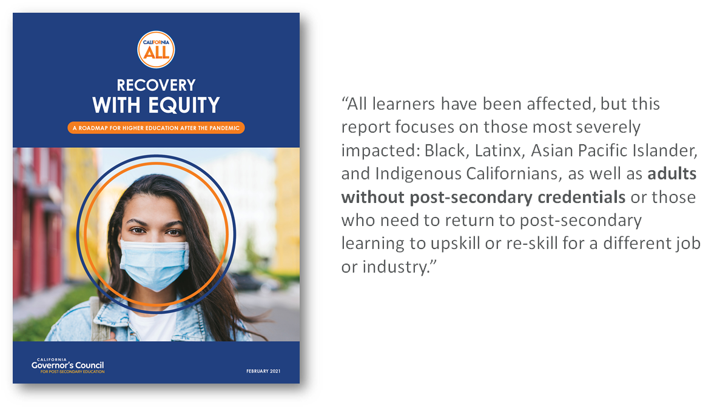
Opportunity and alignment
Notes:
Chantee
Suggestion: CPL is a prime opportunity to align with the state’s higher education systems, as called for by the Governor’s Recovery with Equity Task Force: to focus on students of color, especially those adults without postsecondary credentials. CPL is a proven strategy to help increase attainment and economic mobility for these students.

Slide 28
Questions?
Contact Us:
Chantee Guiney cguiney@cccco.edu
Jodi Lewis jlewis@foundationccc.org
Ben Mudgett bmudgett@palomar.edu
Candace Rose crose@palomar.edu
Notes:
Chantee

