Slide 1
Benefits Fringe Committee
October 22, 2015

Slide 2
Agenda
Introductions
State of the District
Five Year review of District Medical and Dental Claims
Fall 2015 Open Enrollment
  125 Flexible Benefits Plan
  Fiscal Fitness Workshops
  Medicare Open Enrollment
Announcements/Issues/Feedback/Topics for Next Meeting:
  Next Meeting December 3, 2015 9am

Slide 3
1.Introductions
Introductions & confirmation of committee members
The Fringe Benefits Committee studies manners and mechanism in the cost-effective delivery of benefits services
Representatives from:
1021: Ava Lee-Pang, Abigail Brewer,
PFT: Rick Greenspan, Jennifer Shanoski, Ed Jaramillo
39: Rick Putz, Selwyn Montgomery, William Highsmith
PRO: Debby Weintraub, Thomas Branca, Diana Lara
Management: Chanelle Whitaker, Marybeth Benvenutti, Charles Neal, Finance
Confidentials: Laura Maurice Leon
Facilitator: Jennifer Benford Seibert

Slide 4
2.State of the District, Vice Chancellor Ron Little
Accreditation
Other Post Employment Benefit (OPEB)
State Funding
Fiscal Health of the District
Approved Budget
Audit

Slide 5
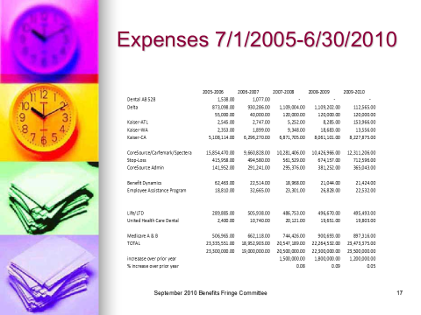
3. Five Year Review of District
Medical and Dental Costs 2005 – 2010
As presented in 2010

Slide 6
3. Five Year Review of District Medical and Dental Costs
2011- 2015 as prepared by District Finance

Slide 7
3.Revenues and Other Offsets
2011-2015
Revenue & Other offsets | 2011 | 2012 | 2013 | 2014 | 2015
Cobra, refunds | 1545337 | 1113315 | 659818 | 683664 | 870590
Medicare D Subsidy | 329309 | 328346 | 283383 | 313249 | 0
Total | $ 1,874,646.00 | $ 1,441,661.00 | $ 943,201.00 | $ 996,913.00 | $ 870,590.00
Does not include payroll deductions
Only tracks revenues received through the Benefits Office; Some transactions are processed directly through finance

Slide 8
3. Ten year Review Of Medical Only
(actives and retired combined)

Slide 9
4.Fall 2015 Open Enrollment
125 Flexible Benefit Plan Open Enrollment
Fiscal Fitness Workshops
On-site flu shots provided by CVS to CoreSource members
Invited guests are based on Spring 2015 employee and retiree responses to Survey Monkey

Slide 10
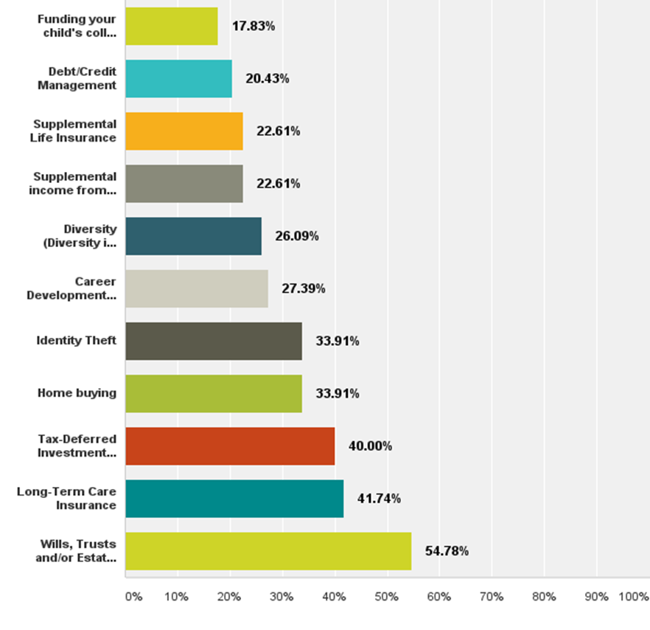
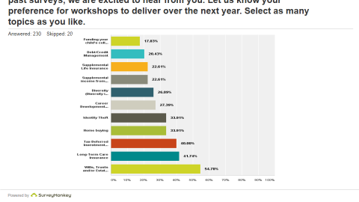
2015
Survey Monkey
Q1: Each year the Benefits Office enlists feedback from our community of employees and retirees to help us plan upcoming events. In keeping with past surveys, we are excited to hear from you. Let us know your preference for workshops to deliver over the next year. Select as many topics as you like

Slide 11
.
Answered: 230 Skipped: 20

Slide 12

October 2015 Newsletter
Peralta Community College District Benefits Office
333 East 8th Street
Oakland, CA 94606
http://web.peralta.edu/benefits/
Inside this issue:
It’s Flexible Benefits Open Enrollment Time
Customer Services Resources on the Peralta benefits homepage.
BenefitBridge-Check your benefits
Medicare Reimbursement Program Expanded
Fall Fiscal Fitness 2015
Flu Shots for members of our self-funded plan (CoreSource CVS Caremark)
2015 Fit, Fun, Fab Summer Weight Loss Challenge Winners Circle
In Memoriam
Need help?
Email your inquiries to benefits@peralta.edu or call the Benefits Office for assistance or re- routing.
Call 510-466-7229. Staff Assistant Ronnie Roberts-Roberts McCain can provide medical or dental insurance claims assistance, enrollment and eligibility support.
Direct policy questions to 510-587-7838,
option 5.

Slide 13
Medicare Updates
Newsletter mailing: 10/23 (audience=all)
Summary Plan Description (SPD) & Forms Mailing: 10/26 (all current retirees only)

Slide 14

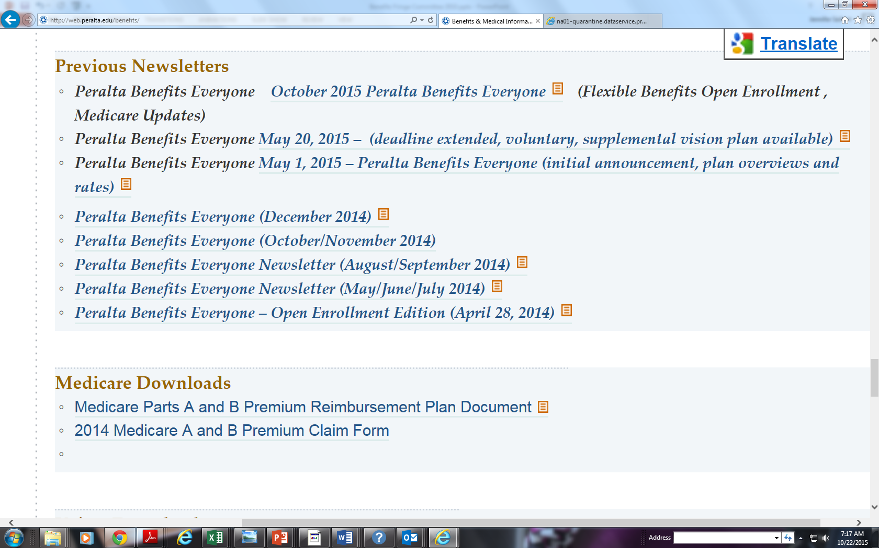
Newsletter and Announcements on www.Peralta.edu; http://web.peralta.edu/benefits/files/2011/04/October-2015-Peralta-Benefits-Everyone.pdf

Slide 15

5. Announcements/Issues/Feedback/Topics for Next Meeting: Other Announcements
Next Meeting Thursday, December 3, 2015 - 9:00am in District Board Room
Other Topics:
  Communications
    What if you are a surviving spouse or other cobra participant who may miss a payment What happens to coverage
    How do I use my vision plan better
    Flex 125 mailing to current participants
  Committee Goals
  Other feedback
Save The Dates
Upcoming Key Dates for 2016
11/1-11/30/2015 Flexible Benefits Enrollment window for calendar year 2016 participation
12/31/15 Deadline for submitting the Kaiser Reimbursement Form (next deadline 6/30/16)
2/3/16 Annual Medicare Campaign
1/1/16-/3/31/16 Medicare Open Enrollment Window

