Slide 1
Peralta Community College District Benefits Fringe Committee Meeting
10:00am – 11:45am

Slide 2
Agenda
10:00 – 10:10
    Announcements and carry-forward items
Account Balance to retirees on the self funded plan first quarter 2015
Retiree List Serve Update
10:10- 10:40
Review of immunization coverage
10:45-11:30
        Employee Benefits Insurance Broker and Consulting Services
        Scope of Services
        Timeline
        Next Steps
4. 11:30 – 11-40
  YTD Benefits Spending, Benefits Office
11:40 – 11:45
Agenda items for next meeting, all
        Update on Employee Benefits Insurance Broker and Consulting Services Request for proposal
        Flexible Benefits Open Enrollment
        Medicare Open Enrollment for Peralta Retirees
        Affordable Care Act

Slide 3
Handouts
Peralta Benefit Schedule for Flu Vaccination CoreSource & Claim Form
Peralta Benefit Schedule for Flu Vaccination: CVS Health & Claim Form
Kaiser “Give it your Best Shot – Knowing The Facts About The Flu Can Save Your Life”
Request for Proposal Employee Benefits Insurance Broker and Consulting Service-Scope of Work
September/October 2014 Employee Benefits Everyone Newsletter
April 24, 2014 Open Enrollment Announcement
Project Timeline

Slide 4
Focus of the Committee
Language reflected in spirit of all three Collective Bargaining Agreements:
The parties agree that a study committee shall be established to study manners and mechanisms which will reduce the impact of health and welfare costs to the District. The study committee shall consist of representatives from PFT, SEIU Local 1021, IUOE Local 39, Management and Retirees to review potential changes and/or modifications to health and welfare plans. The role of the Committee shall be limited to making recommendations to the unions and the District.

Slide 5
Retiree List Serve
Easy as 1-2- 3
In response to requests received by our office from PCCD retirees and their family members, the District Benefits Office is pleased to that the retiree listserve is in place.
1. Retirees send their requests via email to email account: retiree@peralta.edu
    First name
    Last name
That’s the only information we need for the email list serve!
2. Benefits Office will update the list-serve as requests are received.
3. The Benefits Office will send the Peralta Benefits Everyone Newsletter (and other District announcements) electronically to those on the list-serve.
Request to Peralta Retirees’ Organization:

Slide 6
Annual Statements for the Self-funded Plan
Statements will go out in March 2015
  Benefits through February
  2 months before open enrollment in May
  Mailed to each family member
  To home address
  Pre-2004 retirees enrolled in the self funded plan have a benefit limit of $2,000,000.
  Grandfathered plans are not protected from the unlimited benefit under the Affordable Care Act.

Slide 7
Review of Immunization Coverage
Refer to handouts
  Peralta Benefit Schedule for Flu Vaccination – CoreSource
  Peralta Benefit Schedule for Flu Vaccination – CVS Health
  Other marketing piece from Kaiser- “Give it your Best Shot”

Slide 8
Change of Health & Welfare Benefits Consultancy & Brokerage Services

Slide 9
Review Scope of Service
Refer to Scope of Service (Handout 4) submitted to purchasing from the Benefits Office during the week of October 6, 2014.
  Handout 5: September/October 2014 Employee Benefits Everyone Newsletter
  Handout 6: April 24, 2014 Open Enrollment Announcement

Slide 10
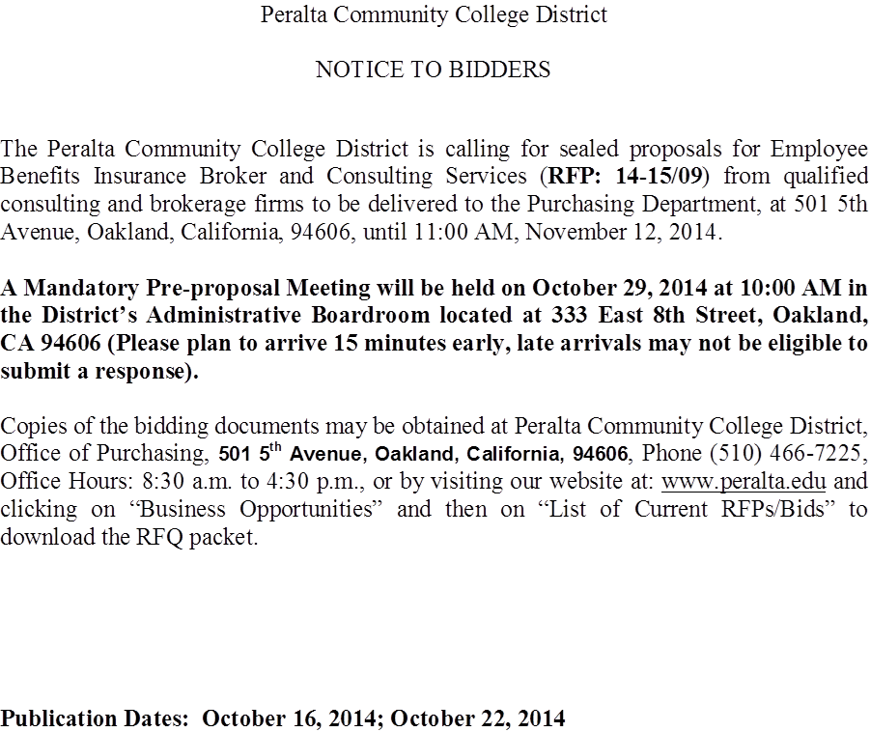
Bid Announcement
Marie Hampton, PCCD
Purchasing Director

Slide 11
Request for Proposal Process & Timeline- Marie Hampton,
PCCD Purchasing Director
Refer to Schedule of Events & Product Data RFP No 14-15/09-
Project Name Insurance Broker Services (Handout #7)

Slide 12
Proposed Dates For Request For Proposal Process
Goals
  Have a new consultant on board by December 31, 2014
    Last Board Meeting of the year is Tuesday, December 9, 2014)
  Minimize disruption to customer service
Panel Selection
  Odd number
  Cross section of representatives from the Benefits Fringe Committee
  Notify me via email by Friday, 10/31 if you want to represent your constituents AND are
  Available to meet and interview candidates on the important dates noted below:
Important Dates/Selection Committee Commitment
  Pre-meeting selection criteria: Thursday, 11/6
    Refine and prioritize what we are looking for
    Determine scoring criteria
    Bids due to Purchasing Wednesday, 11/12
  Panel Meeting with Purchasing: Thursday, 11/13
    Review bids and next steps
  Ranking of applicants by cmte : Monday, 11/17
    Iden
    tify top ranking candidates
  Panel Interviews: Wednesday, 11/19
                Friday, 11/21
  Reference Check : Monday , 11/24
  Deadline for Recommendation to Board :
                Tuesday, 11/25
  Last Board Meeting of the year Tuesday 12/9

Slide 13
Year-to-date PCCD Benefits Spending
Review of Monthly Utilization Reports

Slide 14
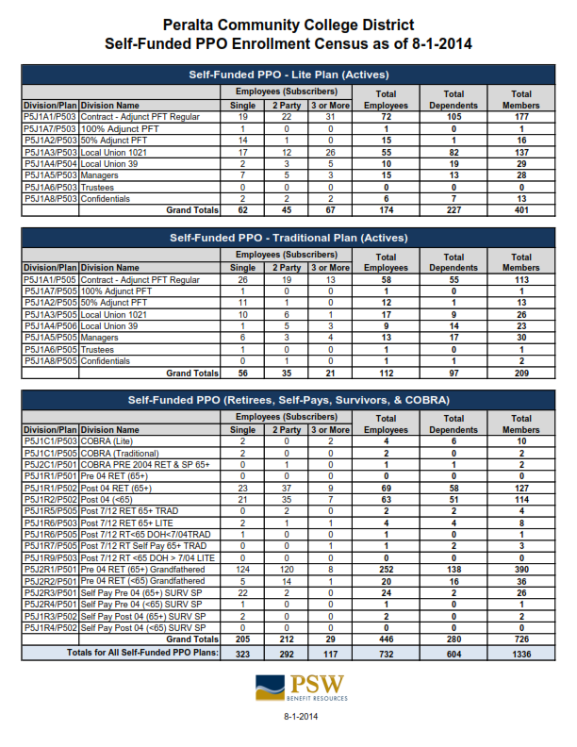

Slide 15
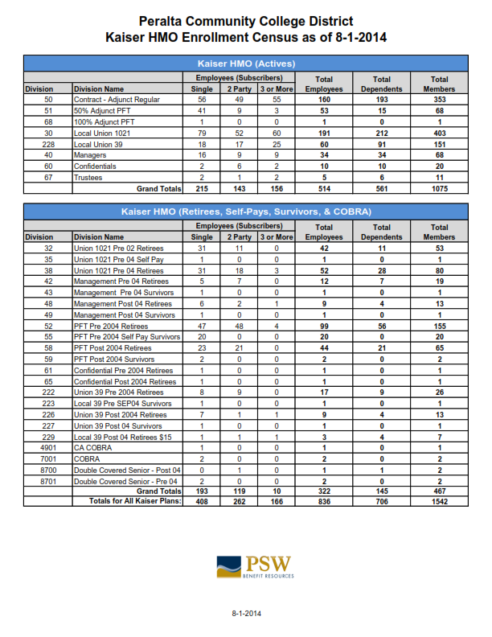

Slide 16
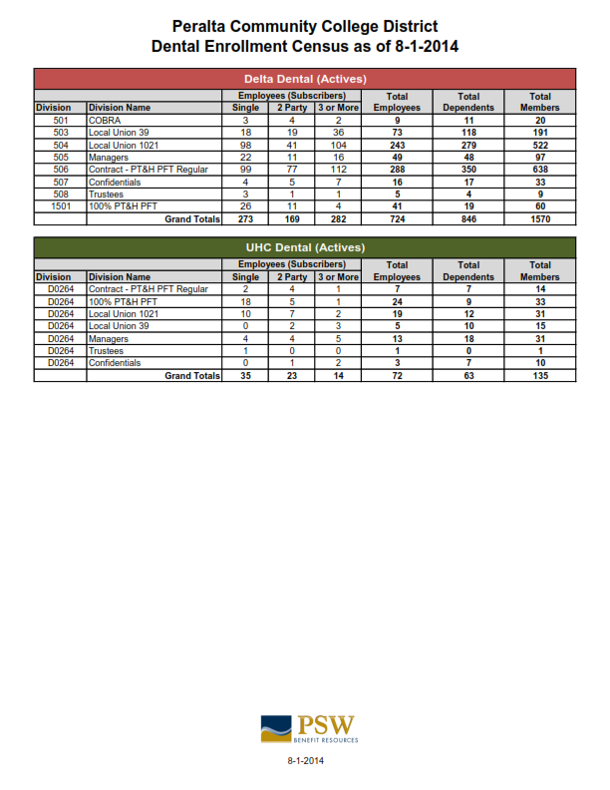

Slide 17
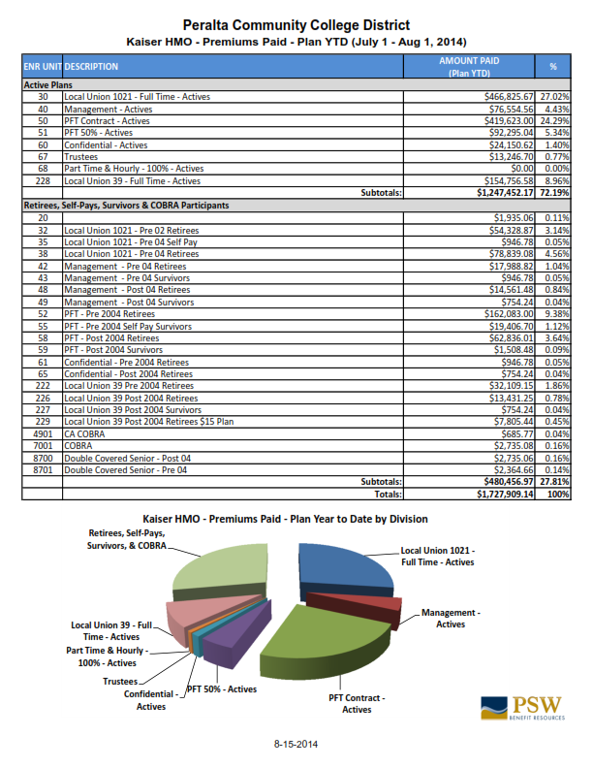

Slide 18
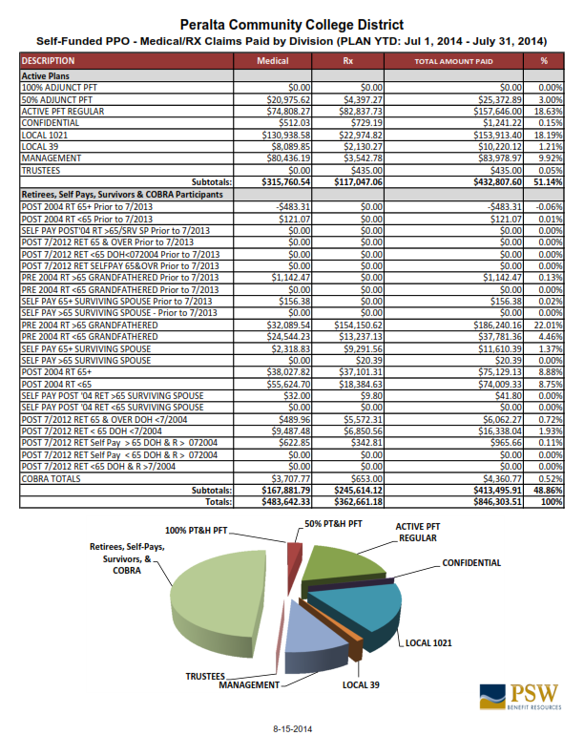

Slide 19
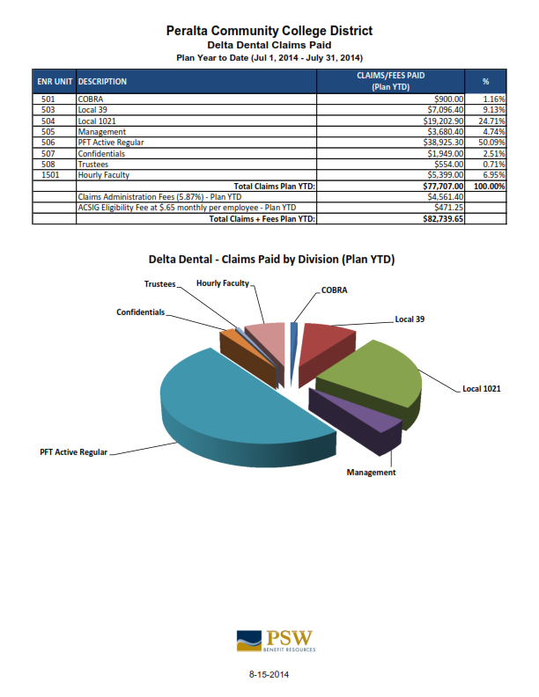

Slide 20
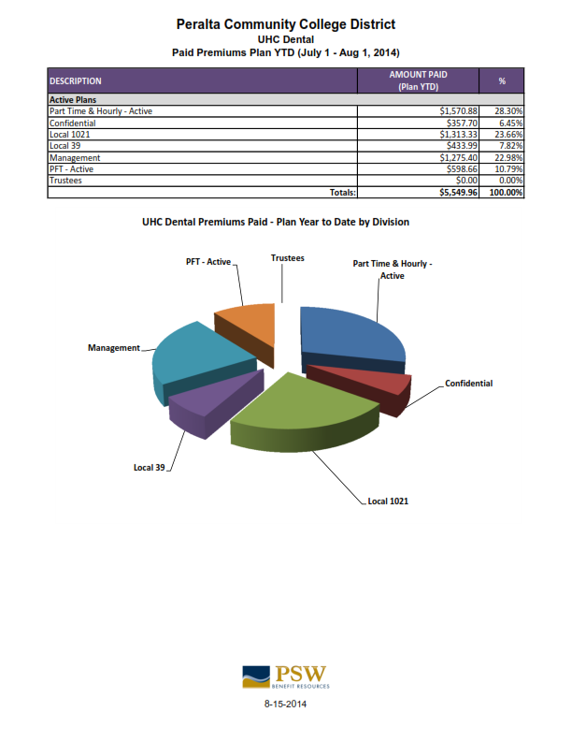

Slide 21
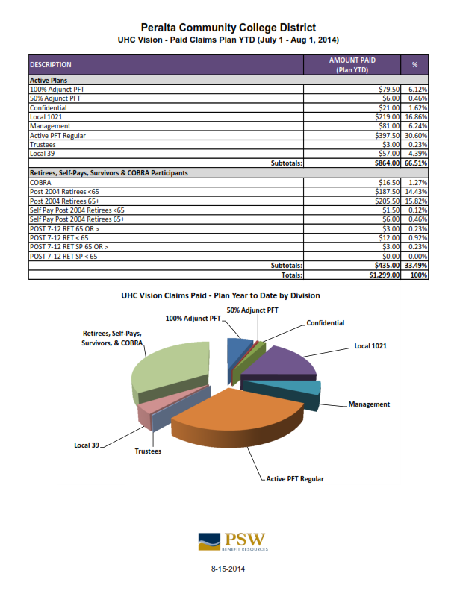

Slide 22
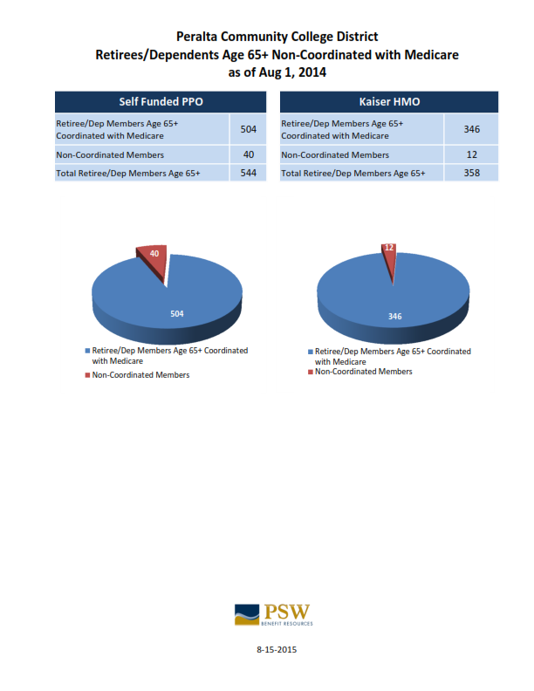

Slide 23
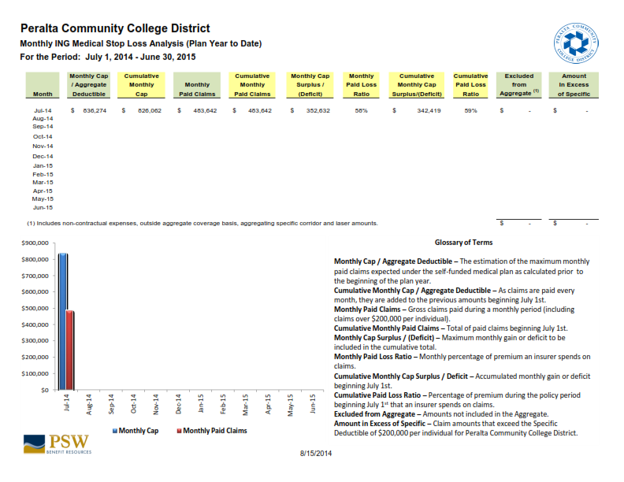

Slide 24
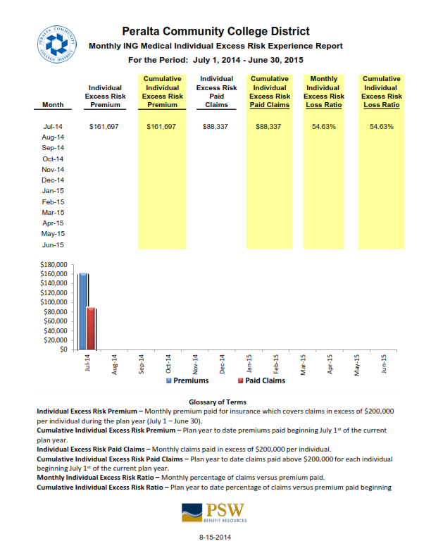

Slide 25
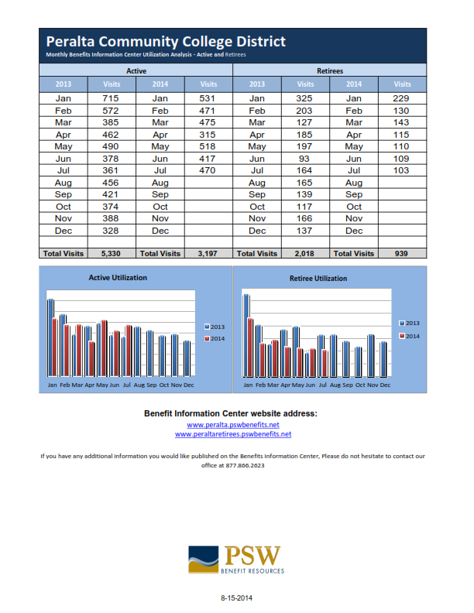

Slide 26
Agenda items for next meeting November 13, 2014
        Update on Employee Benefits Insurance Broker and Consulting Services Request for proposal
        Flexible Benefits Open Enrollment
        Medicare Open Enrollment for Peralta Retirees, Wednesday, February 4, 2014 Social Security, Medicare CoreSource and Kaiser Senior Advantage Programs invited
        Affordable Care Act

