Slide 1


Health Benefits Fringe Committee
(Studies the manners and mechanisms to provide cost-effective and fiscally sustainable benefits to the Peralta community of active employees, retired employees and their eligible dependents)
September 8, 2016

Slide 2
Agenda
Announcements-Benefits Office, Jennifer Benford Seibert, Benefits Manager
  Self Service Address Changes
  Appointment of Personal Representative
  2016 Dependent Audit
Benefits Office Spending Plan – Jennifer Benford Seibert, Benefits Manager
  Benefits Office Spending (Fiscal Year 2014 through 2017)
  Benefits Office Revenues
State of the District- PCCD Finance, Luther Aaberge-Budget Director
Census as of July 1, 2016
  Active Enrollment / Retiree Enrollment
Issues in Self-Funding & Other Plan Updates Alliant Insurance Services
  Medicare Claims Adjudication & Coordination of payments
  Flexible Benefits Plan
Communications-Alliant Insurance Services (Consultant) & Benefits Office
  Ben IQ usage
  BenefitBridge
  Peralta Landing Page
  2016/2017 Timeline, Jennifer Benford Seibert, Benefits Manager
  Part Time and Hourly Faculty Open Enrollment
  Medicare Open Enrollment
  Teachers Pension Dinner Seminars
  2017 Plan Considerations, Alliant Insurance Services
  Community Campaigns Update
  Next Meetings & Share the Information

Slide 3
1.PeopleSoft/PROMT
Self-Service Address Changes
 | Current | Effective 10/1/16
Active employees | Paper form to Human Resources for data entry | Use PeopleSoft for self-service updates to: Home address for W-2 distribution Emails-greener sustainable communications
Retirees | Paper form to Human Resources for data entry to PPS | Self-service option for retirees Paper still accepted by Human Resources

Slide 4
PeopleSoft/PROMT
Self-Service Address Changes
Pros | Cons/Challenge
Secure | Learning Curve
Reduces paper filing
Reduces staff time and possibility of error
Increased accuracy and timeliness of address changes
Increases employee active engagement
Increases utility of our PeopleSoft products
Consistent with other common business processes

Slide 5
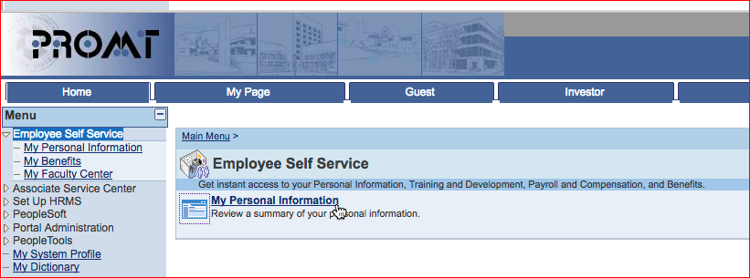
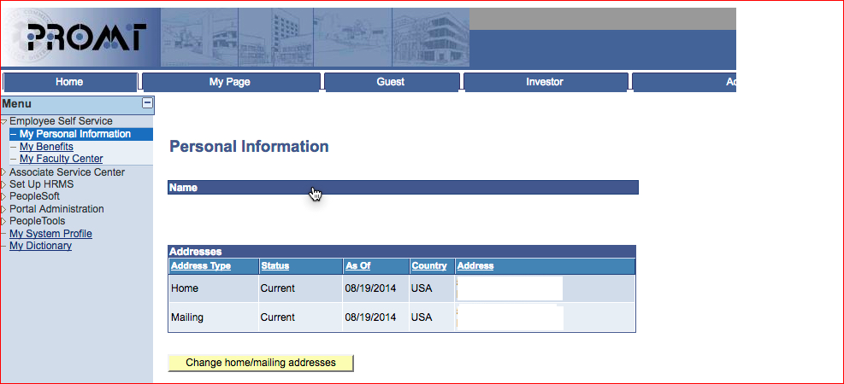
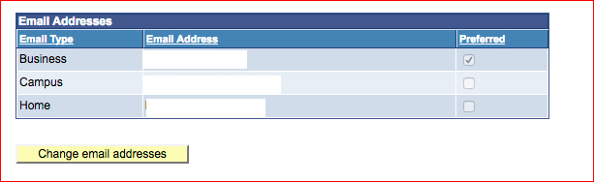
PeopleSoft/PROMT
Self-Service Address Changes-How to Navigate
Where we send plan information; default;ts Peralta.edu email
District office mailings (I.e.W-2)
Navigate to Personal Information
Update the Home mailing for W-2 and benefits information
Save
Navigate to Personal Information
Update the Home email address
Save
Inform your constituents of the availability of these online services:
Troubles should be reported to the Peralta Information Technology Helpdesk: helpdesk@peralta.edu

Slide 6
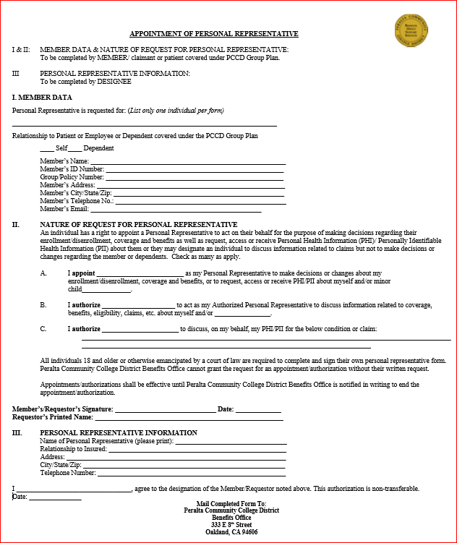
Appointment of Personal Representative-
Protected Health Information & Privacy
Due to Protected Health Information and privacy statutes, we are now using this form to protect the patient and the District, we supporting our efforts to protect through the Appointment of Personal Representative Form:
The Appointment Form is initiated by the patient.
Parents can act on behalf of minor child without the Appointment.
Must be used for patients/covered members age 18 and over.
The person appointed must also agree to act

Slide 7
2016 Dependent Audit
Initial announcement from Vice Chancellor Week of 9/9
Home mailing week of 9/16
Confirmations mailed and reminders mailed – Ongoing
Response due
10/14
Dependents enrollments ends due to no or incomplete response
12/31/2016
What: Dependent Audit
Who: All Peralta active and retired employees who had a dependent enrolled in a Peralta group-sponsored medical and/or dental plan on or before 6/30/16
Why: The purpose of this audit is to confirm the continuous eligibility of dependents covered under a group insurance plan sponsored by the District.
  The last audit was performed in 2014.
  We have requested that CoreSource perform this audit for all Peralta medical and dental plans.
    All employees and retirees covering a dependent will receive a request for information if they had a dependent on the plan on or before June 30, 2016.
  Key Dates & Timelines
  Who do I contact with questions? Question regarding…
    Documentation, verification of receipt of your information, to request a duplicate packet or to clarify documentation to be submitted, then contact CoreSource:
      Dependent Eligibility Audit experts: DependentAuditsBalt@coresource.com or 866-434-1211
    Benefit plan features or the reinstatement process, then contact the Peralta District Benefits Office:
      Staff Assistant Ronnie Roberts McCain: benefits@peralta.edu or 510-466-7229
      Benefits Manager Jennifer Benford Seibert: jseibert@peralta.edu or 510-587-7868
  Facts and considerations
    According to the CoreSource proposal, the average annual dependent cost $4,000 even if the dependent does not use the plan\;
    Our self funded plans (PPO Lite and PPO Traditional) are exempt from lifetime maximums for active employees; stop loss limit is $225,000.
    Prescriptions are about 1/3 of our overall medical expense
  Request to Committee Representatives
  Supplement District communication efforts by communicating to your constituent groups

Slide 8
2.Benefits Office Spending
Fiscal Years 2014 through 2017
Excludes run-out; incurred but not paid
Excludes attrition hires, change in coverage, etc.
Excludes enrollment glide path

Slide 9
Benefits Office Revenues 2014-2016
 | 2014-2015 | 2015-2016
Receipts/Stop Loss/Provider refunds | $442,886 | $1,442,029
Payroll Deductions | $871,520 | $812,843
Medicare Drug Subsidy | $283,382 | $313,249
Total | $1,597,788 | $2,568,121

Slide 10
3. State of the District
Budget Director, Luther Aaberge

Slide 11
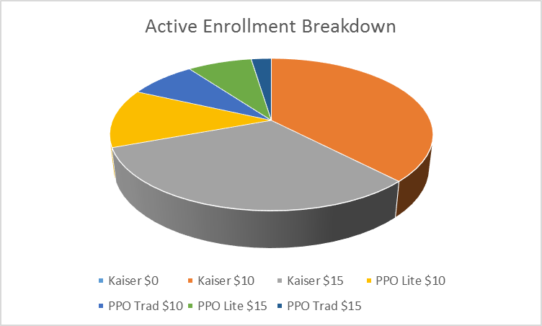
4.Census as of July 1, 2016:
(Medical - Active Coverage)
Alliant Insurance Services

Slide 12
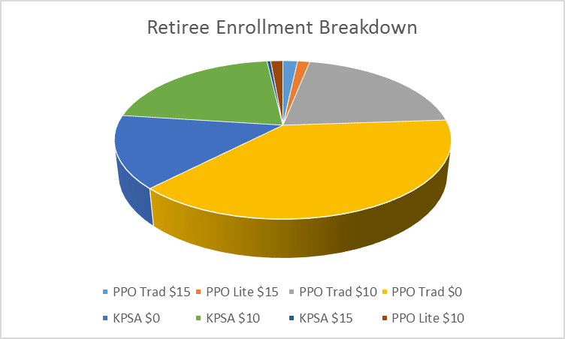
Census as of July 1, 2016:
(Medical - Retiree Coverage)

Slide 13
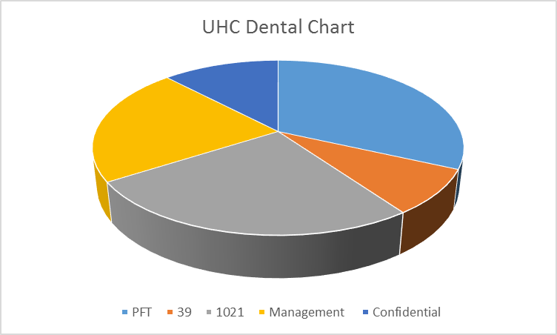
Census as of July 1, 2016: UHC Dental

Slide 14
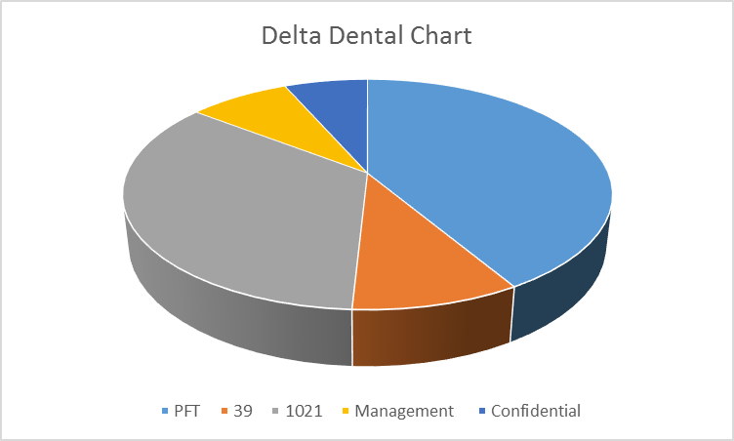
Census as of July 1, 2016: Delta Dental

Slide 15
5. Issues in Self-Funding - 2016/2017 Plan Updates
Retiree Claims Adjudication process used by CoreSource
Medicare coordination of claims language clarification to be consistent with adjudication protocols and based on Medicare mandate – Effective July 1, 2012 per the Collective Bargaining Agreements
Options

Slide 16
2016/2017 Plan Updates
Flexible Benefits Plan Enhancements
Open enrollment starts November 1st through 31st for a January 1, 2017 effective date.
PDC debit card will be issued to those who enroll effective January 1, 2017.
Adding the Pension Dynamics Benefits Debit Card to the plan will give you the following:
  Eligible out-of-pocket expenses can be paid with the one card
  Auto substantiate most approved out of pocket FSA expenses at point of purchase
  Limit out-of-pocket expenses, the debit card will directly reduce the annual election
  Immediate use of accumulations

Slide 17
6.Communications
Ben IQ Stats (May 1 –September 2)

Slide 18
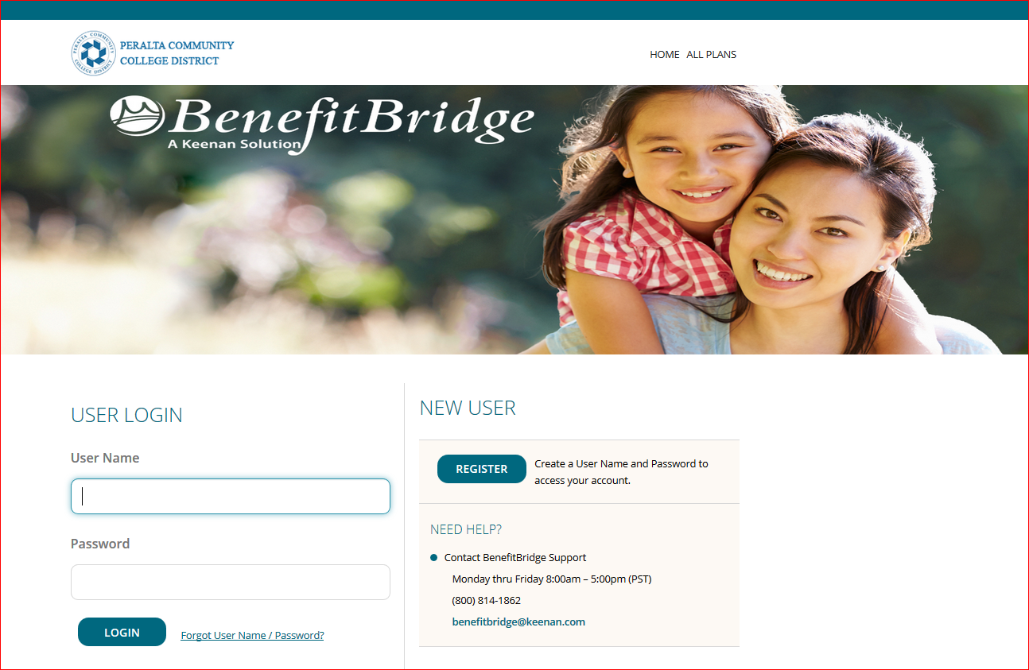
Benefit Bridge
Online and secure portal to enrollment and information - Requisite checklists, plan comparisons, other links to CalPERs,CalSTRS, social security and more.
Reset password annually.

Slide 19
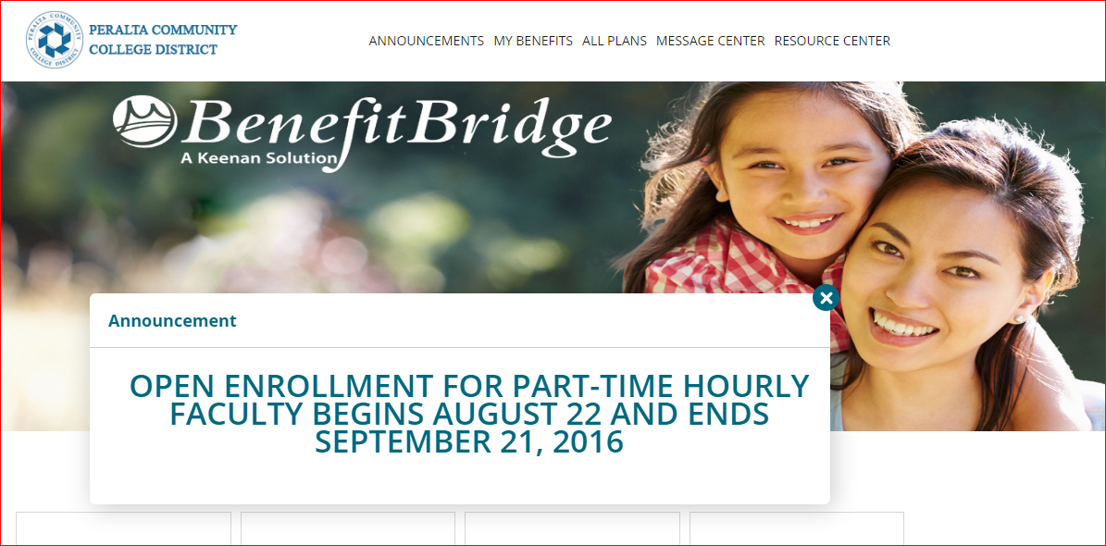
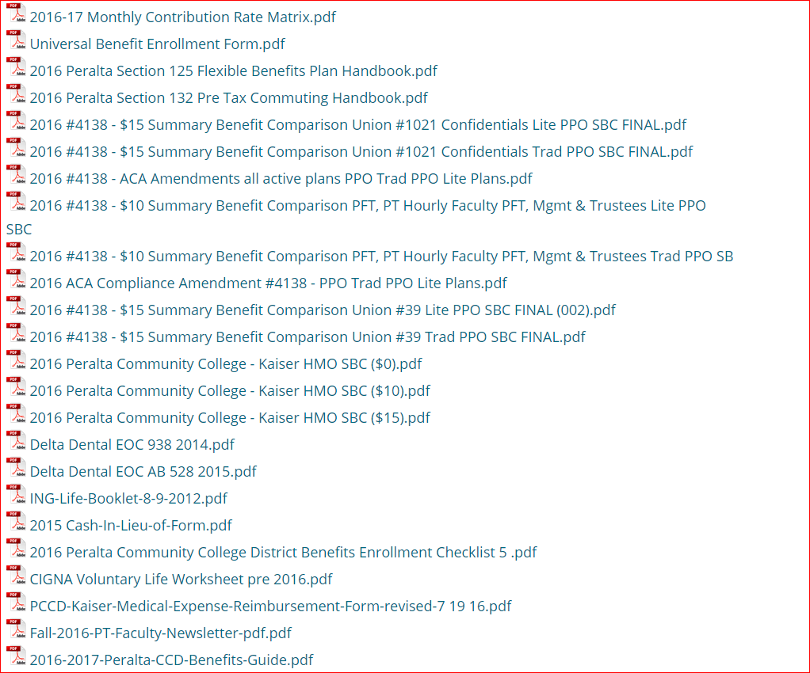
Online Web Resources-BenefitBridge
(also to be added to the Benefits Landing Page by the end of the month over 250 enrollments/changes processed since go-live in 2015)
Partial List

Slide 20
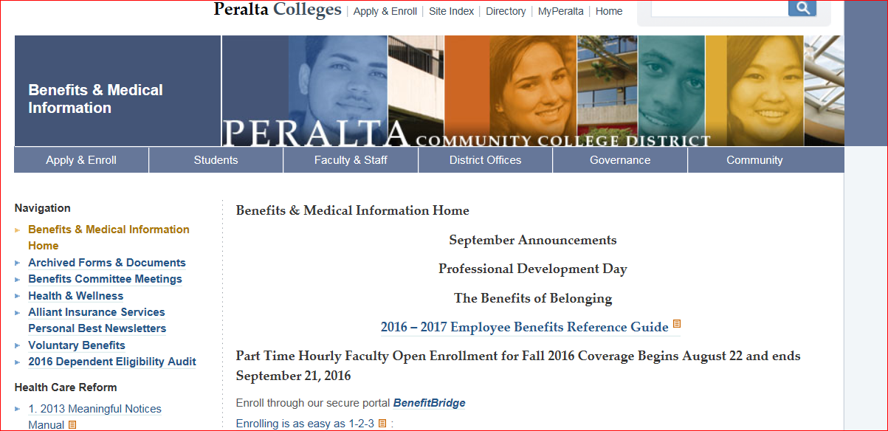
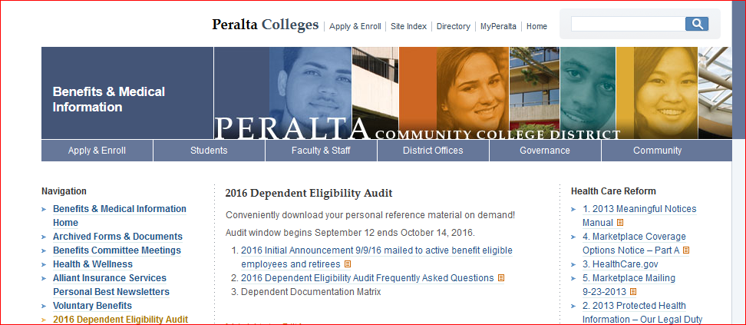
Benefits Landing Page

Slide 21
7. 2016-2017 Timelines
Jun
JUL
AUG
SEP
OCT
NOV
DEC
JAN
FEB
MAR
APR
MAY
Save the Dates/Share the Dates
October 1 - Self service begins
August 22 – September 21 - Part Time Hourly faculty Open enrollment for Fall 2016 coverage
January –February - Part time hourly faculty open enrollment for spring 2017 coverage
September – October - Dependent Audit
February 3, 2017 - Medicare Campaign –call banking in March
January 1 – March 31, 2017 - Medicare open enrollment
Hourly Faculty O/E
Dependent Audit
Self Service for Address changes
Flex 125 Plan O/E
Hourly Faculty O/E
Medicare O/E
O/E for all others
Estate and Tax deferred planning:
Update your life insurance beneficiary on BenefitBridge campaign

Slide 22
8. 2017 Plan Considerations
Update on Community Campaigns Claims Re-pricing:
  Request from Community Campaigns forwarded to Alliant Insurance Services for response on our behalf:
  Response from Alliant: We are in receipt of your request for re-pricing of your self-funded claims. This option makes the most sense to be considered as part of the regular 2017 renewal process. We can provide an update on this over the next six months as a possible alternative for July 1, 2017.

Slide 23
Next Meetings & Share the Information
Next Meetings:
October 13
December 8
  Pass along & Share
  Remind your constituents of upcoming events as noted on previous slide
  Dependent Audit: Now through the end of the year
  Medicare Open Enrollment Campaign- We need PRO volunteers to make outgoing calls in February and March
  Address changes self-service-an added convenience.

