Slide 1
Fall 2025
Bond Project Update
September 2025

Slide 2
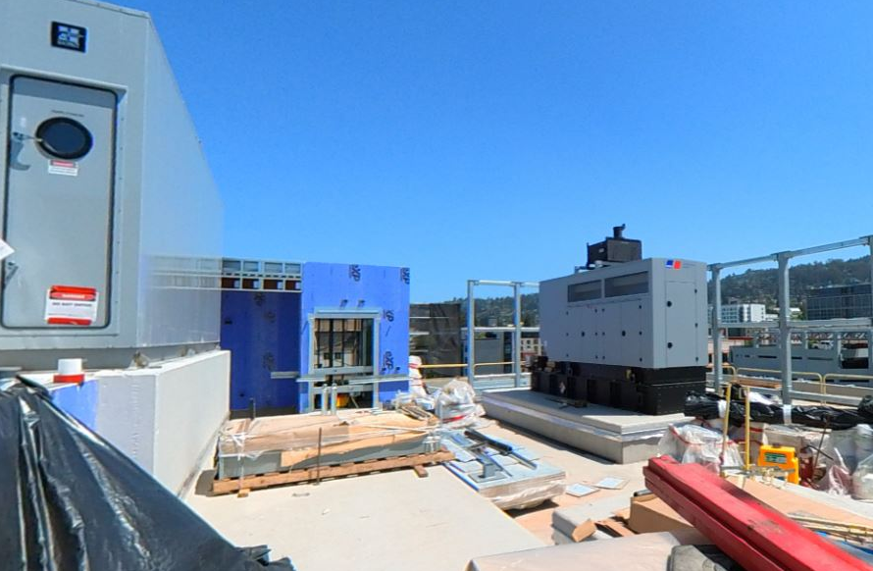
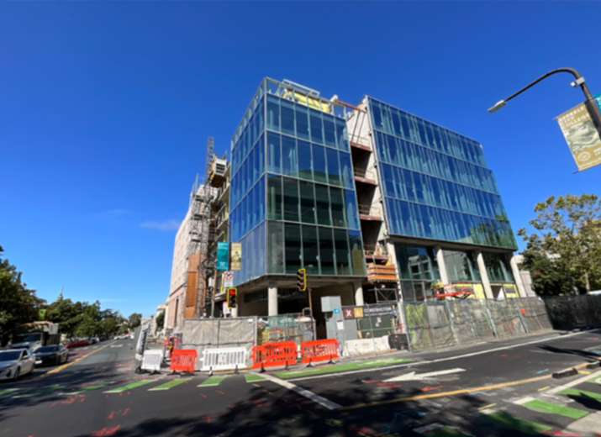
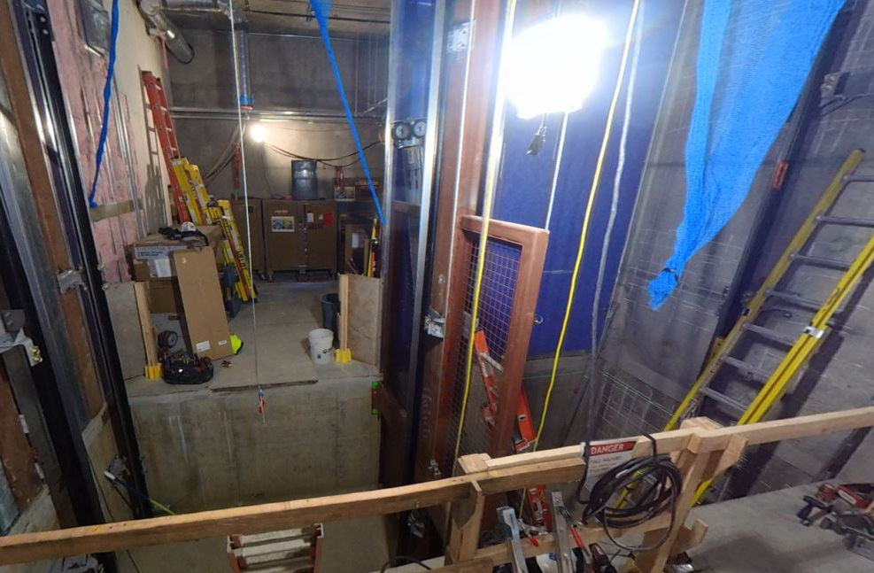
Berkeley City College – 2118 Milvia Street
A six-story, 60,000 SF building with classrooms, student services, and collaborative spaces. Substantial completion is scheduled for December 31, 2025, with a project budget of $101.2M
Summer Progress: Interior build-out and finishes advanced with drywall, painting, ceilings, lighting, restrooms, and stairs, while major systems moved forward with electrical, mechanical, windows, roofing, and elevators.
Roof / Mechanical
Windows / Glazing
Elevator

Slide 3
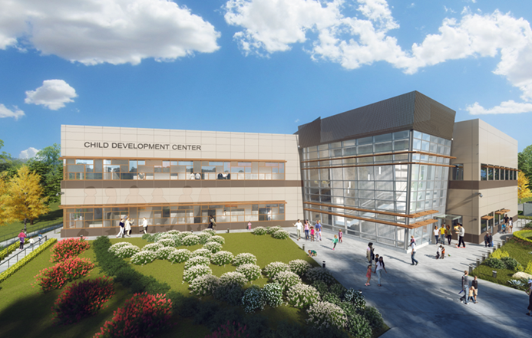
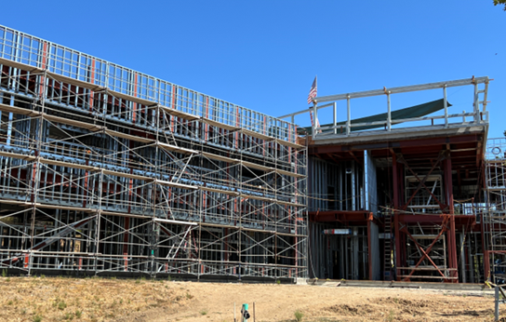
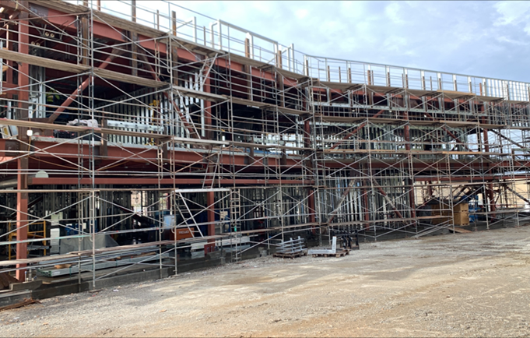
Merritt College – Child Development Center
A two-story building combining Child Care and the Lab Practicum Program, with preschool and adult classrooms, administrative offices, support spaces, and a children’s play yard. Substantial completion is scheduled for August 9, 2026, with a budget of $39.3M.
Summer Progress: The contractor was terminated in April, and a Takeover Agreement was approved at the August 26 Board of Trustees meeting. Work resumed on August 28 with structural steel corrective work.
Child Development Center Rendering
Structural Steel Work
Framing Work

Slide 4
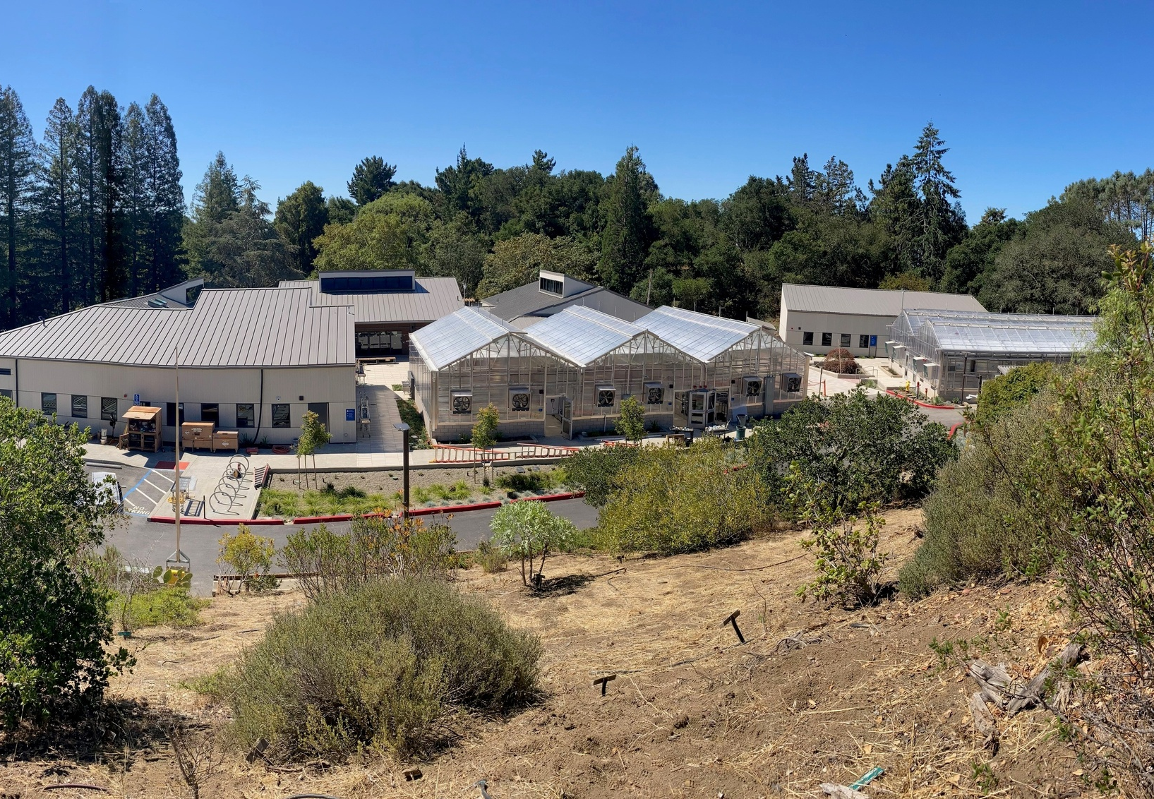
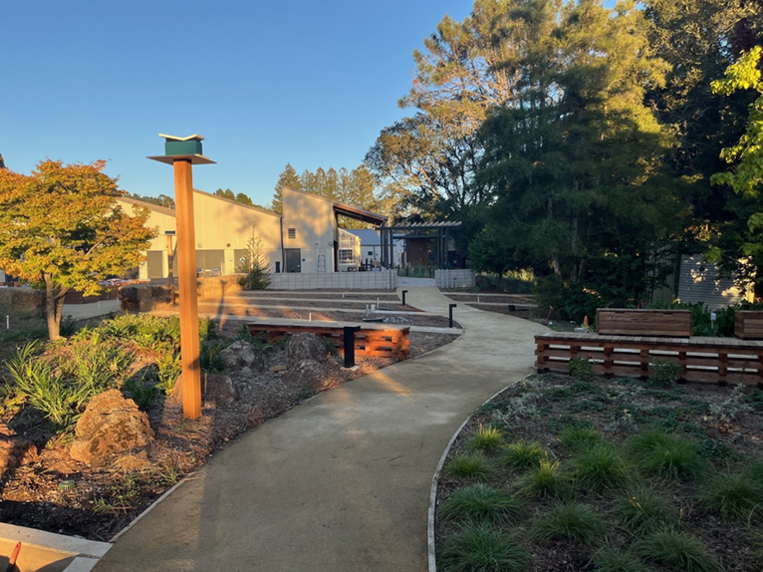
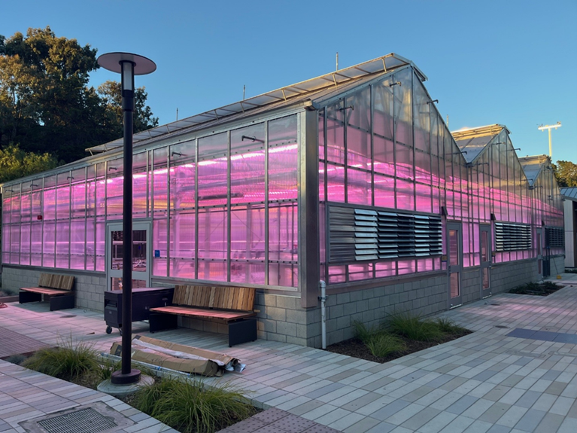
Merritt College – Horticulture Center
A new horticulture complex with three class labs, a library, five greenhouses, a head house, workshop, soil bins, and landscaped site improvements. The project reached substantial completion on August 18, 2025, with a budget of $40.6M.
Summer Progress: Work focused on greenhouse systems, electrical and fire safety, workshop and site improvements, and final commissioning. A ribbon cutting was held on September 2, 2025.
Horticulture Center
Landscape and Walkways
Greenhouses

Slide 5
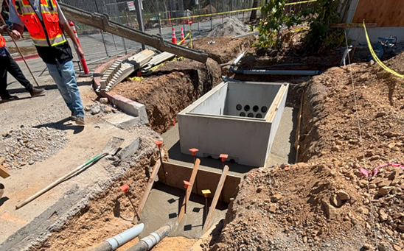
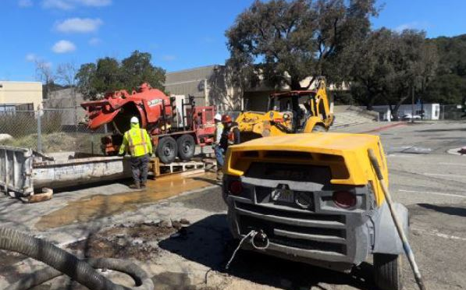
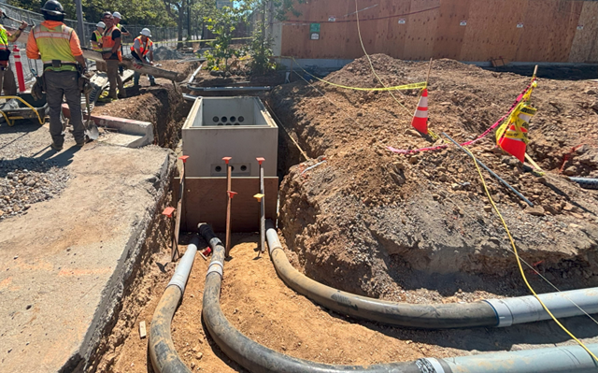
Merritt College – Substation C
Upgrading the 12kV electrical system and adding capacity to support the new Child Development Center. Substantial completion is scheduled for November 6, 2025, with a budget of $3.5M
Summer Progress: Excavation and conduit trenching, placement of conduits from manhole #13 to the new electrical vault, and vault backfilling.
Electrical Vault Installation
Excavation and Site Work
Conduit Installation to Vault

Slide 6
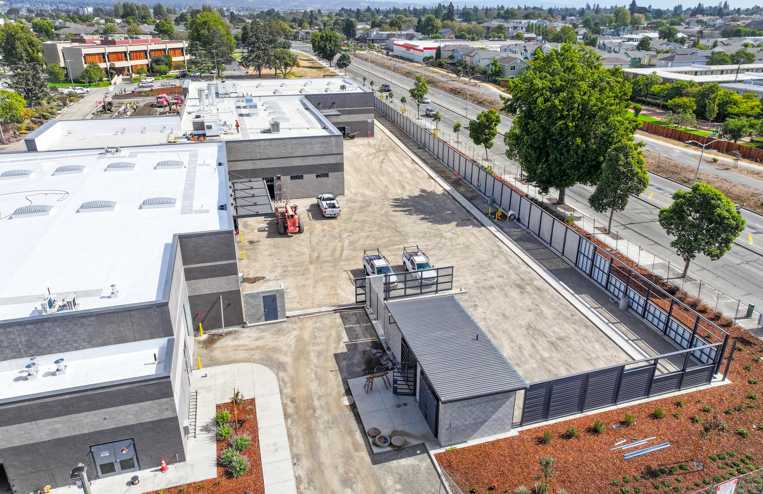
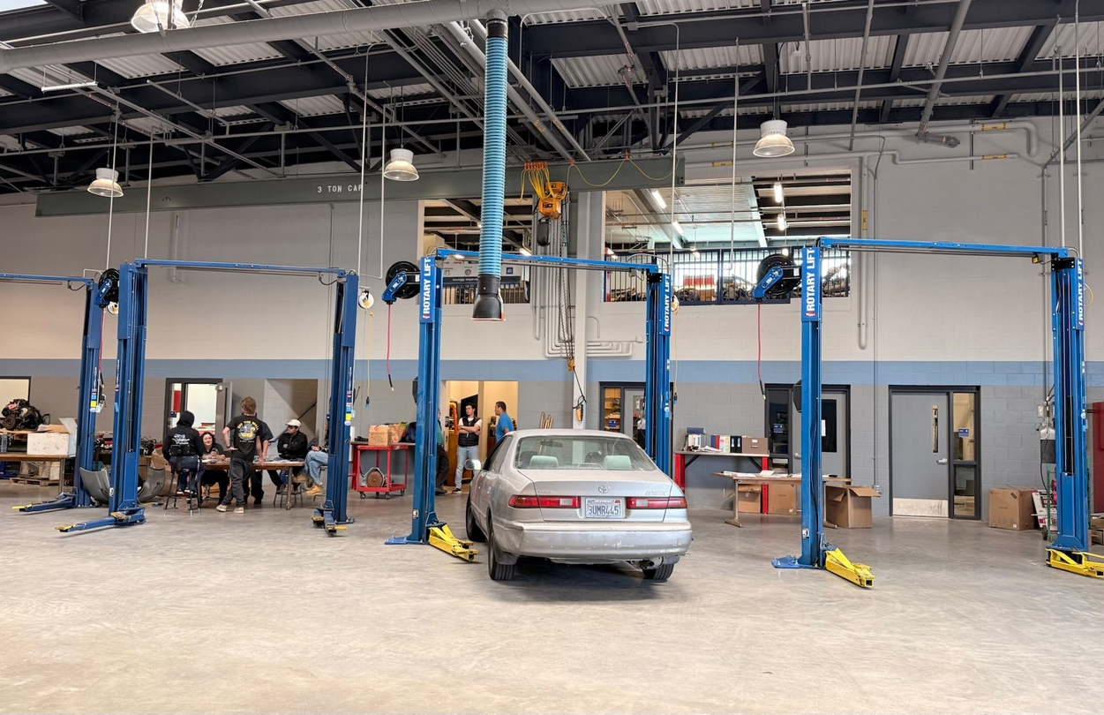
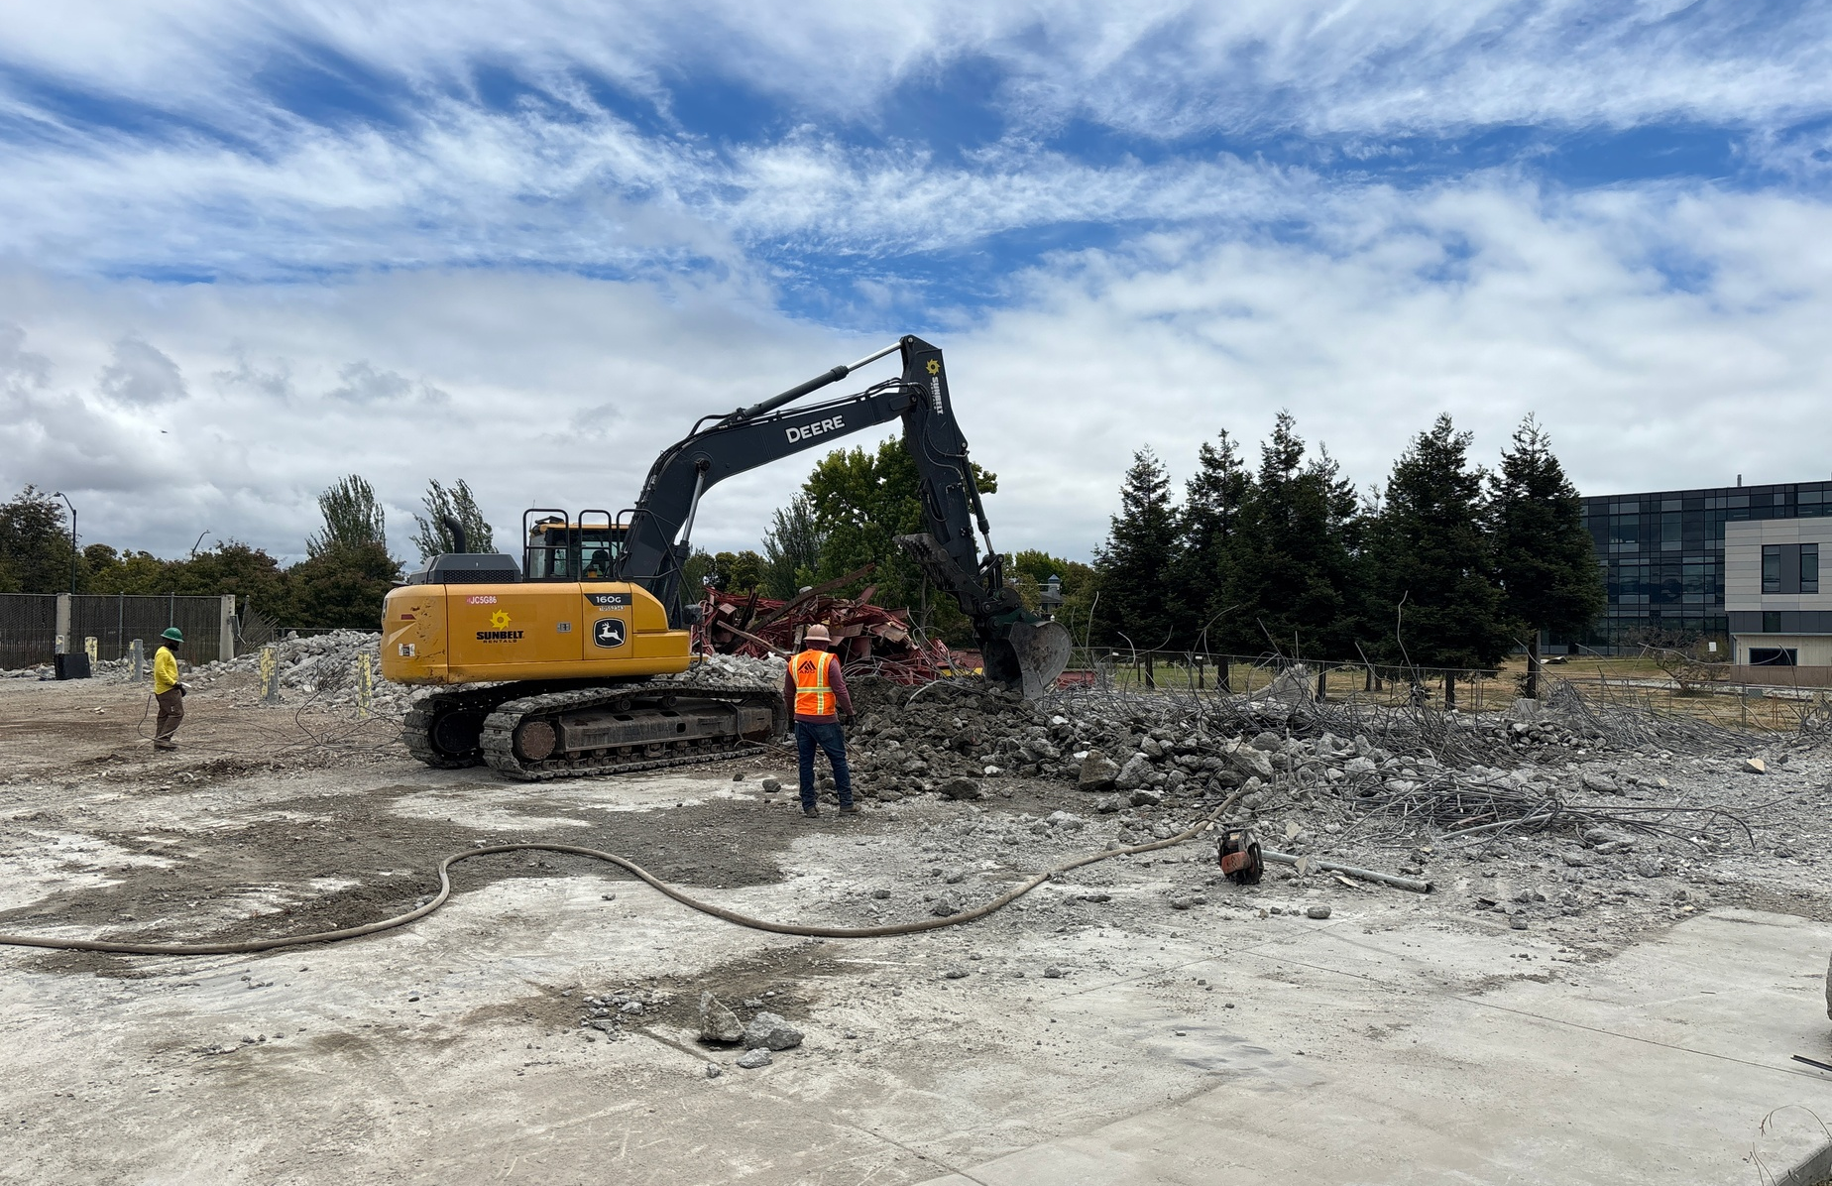
College of Alameda - New Transportation and Technology Center
A new $17.95M facility for automotive, diesel, and auto body/paint programs, designed for hands-on learning, industry partnerships, and workforce training. The project includes demolition of Buildings B and E. The center opened for students in Fall 2025, with a ribbon cutting scheduled for September 30 and final completion targeted for November 2025
Summer Progress: Equipment relocation and installation, interior finishes, HVAC startup and testing, user group move-in, IT and AV system installation, and demolition of Buildings B and E.
New Facility – Aerial view
Automotive Lab
Demolition Building E

Slide 7
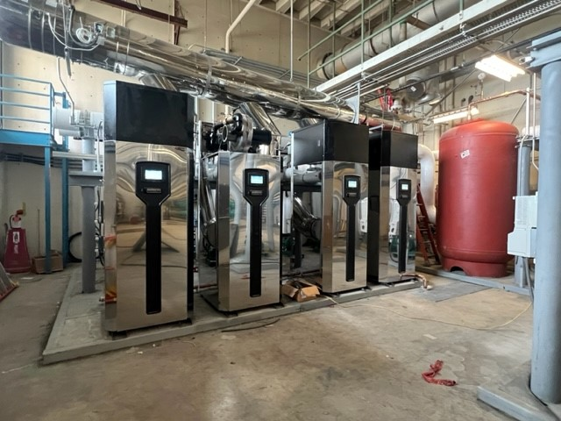
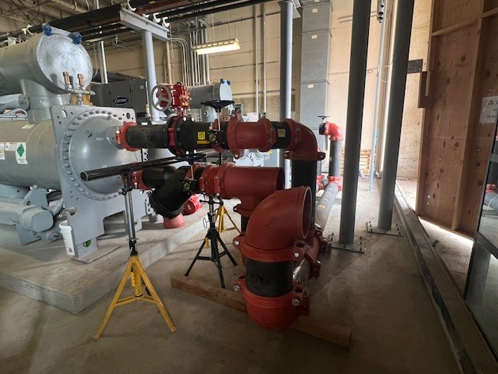
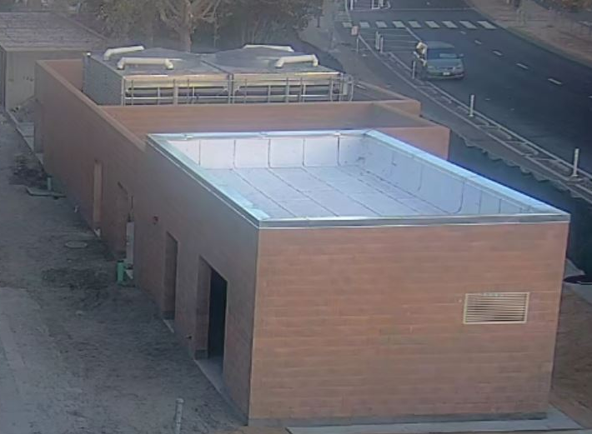
Laney College Central Utility Plant
A $21.36M project delivering a new Central Utility Plant, ADA/path of travel upgrades across campus, and a new Building AA with mechanical and electrical infrastructure to support the Library/LRC. Completion is scheduled for October 2025
Summer Progress: Work included site paving prep, fire alarm and electrical connections, controls wiring, inspections, and commissioning prep. Building AA structure is complete with electrical work underway.
New Boilers
Piping in Chiller Room
Building AA

Slide 8
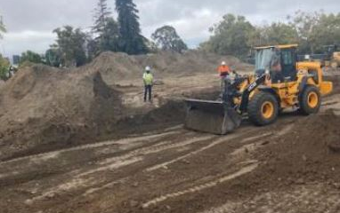
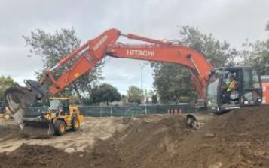
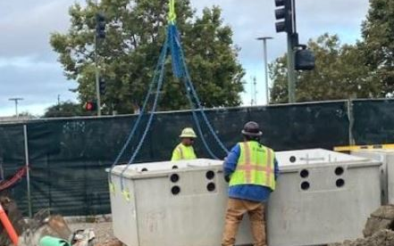
Laney College - Library and Learning Resource Center
A $93M project constructing a new Library and Learning Resource Center, providing modern spaces for study, collaboration, and student support.
Summer Progress: Initial site work and mobilization advanced, with early construction activities and procurement underway.
Site Work
Excavation and Soil Work
Electric Vault Installation

Slide 9
Coming Soon - Bond Projects Across the District
Upcoming bond-funded projects will continue modernizing facilities, improving infrastructure, and expanding student spaces:
Merritt College – Substations B & D upgrades; Allied Health shell space build-out (including the Center for Social Justice and Civic Engagement); ADA improvements; and Gym Modernization.
Laney College – Theater Modernization, Locker Room Modernization, Campuswide Fire Alarm Modernization, and Student Center Modernization.
Berkeley City College – Center Street Building Modernization.
College of Alameda – Aviation Hangars A & B Modernization, and campuswide ADA upgrades.

Slide 10
Fall 2025
Bond Project Update
Thank You!
September 2025

