Slide 1

Peralta Community College District
Berkeley City College
College of Alameda
Laney College
Merritt College
Student Health Insurance Plan Overview
2025-2026
Alliant Student Health
560 Mission Street
San Francisco, CA 94105
Alliant CA License No. 0C36861

Slide 2

  Health insurance enhances access to health services and protects you from unexpected, high medical costs.
    The U.S. does not typically offer free medical care, and medical services and treatment are expensive:
      Average cost of medical care in 2025: $7,500 per person
      Average cost of an Emergency Room visit: $2,500
      Average cost of an Ambulance ride: $900
      Average cost of an MRI: $750
      Average cost of a doctor’s visit: $200
      Labs, hospital/doctor’s fees, x-rays, surgery, prescriptions, etc. all cost extra
  The Peralta Community College District requires all international students to have health insurance.
  Together with Cigna, Peralta is pleased to offer this International Student Health Insurance Plan (ISHIP) to their F-1 international students.
The Importance of Health Insurance

Slide 3
  All international students in F-1 status are automatically enrolled in Peralta’s International Student Health Insurance plan, through your specific school; no action is needed to enroll yourself in the plan.
  Once enrolled, you will receive a Welcome Email with plan details and instructions on how to create a Cigna Envoy account and download your Insurance ID card.
How to Enroll in ISHIP

Slide 4
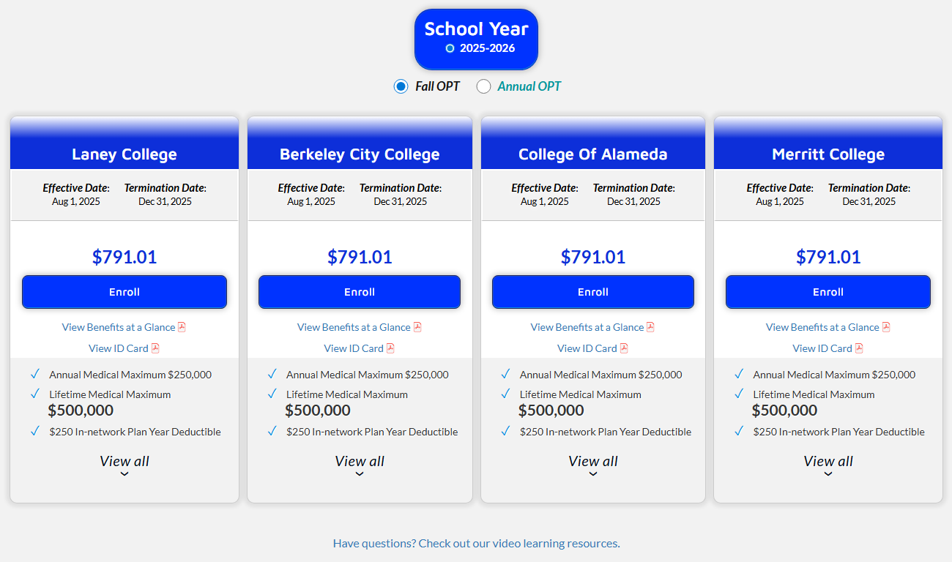
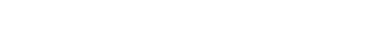
  To enroll as an OPT student online, follow these steps:
    Visit www.cghb-ogse.com/students and search for your Peralta Community College
    Select the I am an OPT Student link, then the term and College in which you are enrolling
How to Enroll in ISHIP

Slide 5
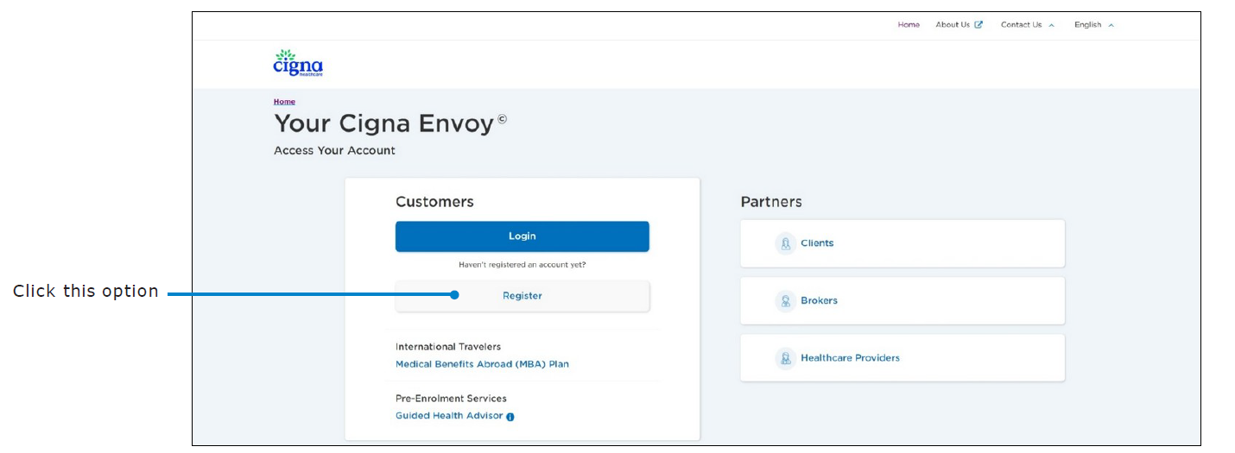
To set up your Cigna student account:
  Register for the Cigna Envoy website by navigating to www.CignaEnvoy.com and, within the Customers section, select Register.
  When creating your account, please use the email address where you received the welcome email
Cigna Student Account & Your Health Insurance ID Card

Slide 6
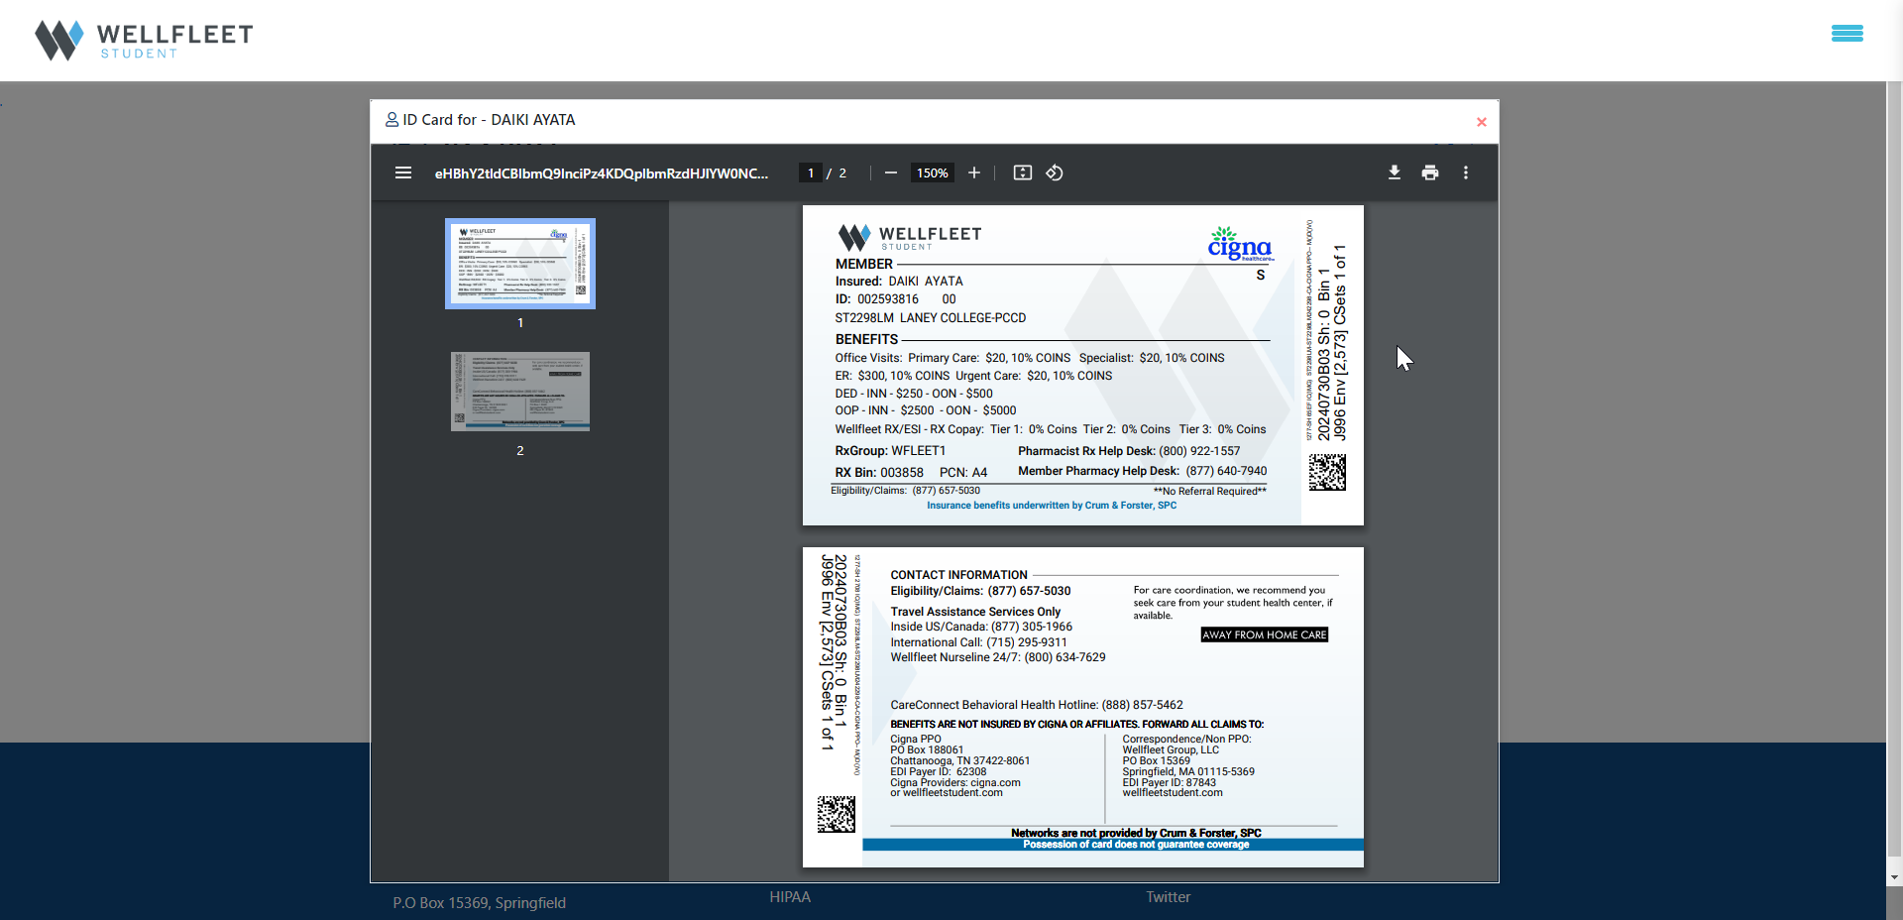
Once your account is set up, the student dashboard contains everything you need, including:
  Coverage Documents
  Links to ID cards
  Receipts
  Confirmation of coverage
  Links to find doctors
If you need medical treatment before you receive notice that your ID card is active, please contact Alliant at StudentHealthSupport@alliant.com for assistance.
Always carry your insurance ID card with you.
Cigna Student Account & Your Health Insurance ID Card

Slide 7
  ISHIP is an Accident/Illness plan that will cover you if you get injured or sick while you are away from home.
  Benefits for medically necessary services include:
    $250,000 maximum annual benefit
    $250 maximum routine preventive care and immunization benefit (combined)
    $250 deductible for in-network and $500 deductible for out-of-network services; $20 copay for in-network services; other copays may apply
    Most services paid at 90% (after applicable copay & deductible) for Cigna PPO services; or 70% of URC (after applicable copay & deductible) for out-of-network services
      Most physician visits and hospital charges
      Tests, surgery procedures, and lab services, such as X-rays
      Mental health
      Maternity and prenatal care
    P rescription drug benefits
      $5 copay generic / $10 copay preferred brand name / $20 copay non-preferred brand for in network
      50% coinsurance after plan deductible for out-of-network
ISHIP Coverage Overview

Slide 8
  Plan Maximum - The maximum amount your plan will pay per person, per plan year.
  Deductible - The amount you owe for healthcare services, before the health insurance begins to pay.
  Coinsurance - Your share of the costs of a covered health care service(s), calculated as a percentage.
  Copay - A fixed amount you pay for a covered health service, at the time of your visit.
  Out-of-Pocket Maximum - The most you pay during a policy period, before your insurance pays 100% of the allowed amount (this cost includes copays, deductibles, and coinsurance amounts).
Common Insurance Definitions

Slide 9
Your Insurance plan utilizes a PPO Network.
  “PPO” or “in-network” means that the doctor or medical facility is part of the Preferred Provider Organization, a network of doctors and hospitals that have contractually agreed to provide services at a lower rate
  Your designated PPO network is Cigna PPO
  If you use a Cigna PPO provider, covered medical services are paid by the insurance company at 90% of the Negotiated Charges (NC)
Non-PPO (aka out-of-network)
  “Non-PPO” or “out-of-network” means that the doctor or facility has not agreed to a lower rate, resulting in more expensive care
  Since these providers charge more, the insurance company will only pay a fraction of the cost, which results in you paying more money out of your pocket
  If you use an out-of-network provider, covered medical expenses are paid at 70% of Usual, Reasonable, and Customary (URC) charges
You are responsible for any charges not covered by the insurance.
PPO v Non-PPO

Slide 10
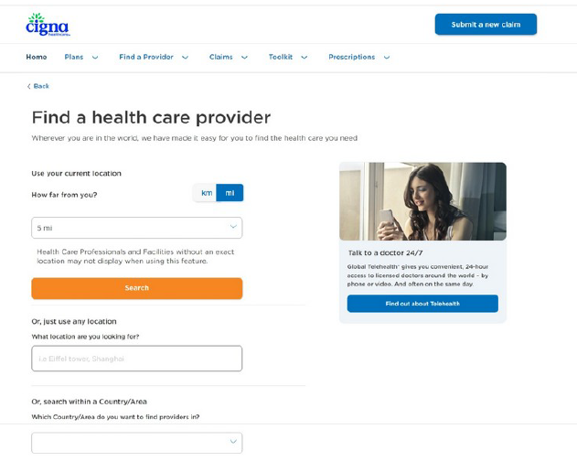
To find a Cigna PPO provider, you can search by current location, specific address, and/or country search.
It is best to locate a Cigna PPO doctor, urgent care center, and emergency room near you before you get sick.
Always verify the provider is part of the Cigna PPO network before you receive treatment.
Finding a PPO Medical Provider

Slide 11
You are responsible for the costs of any services not covered by the insurance (see exclusions and limitations in your plan policy). You are also responsible for all deductibles, copays and coinsurance for covered services.
When you go to a Cigna PPO provider, you will pay a $250 deductible before insurance starts paying benefits, plus the following:
    A $20 copay for physician’s office visits and urgent care visits
    A $50 copay for inpatient hospital room & board visits
    A $300 copay for emergency room (ER) visits, then 100%, not subject to deductible
    10% coinsurance of the Negotiated Charge (NC)
    Other copays may apply
When you go to a non-PPO provider, you will pay a $500 deductible before insurance starts paying benefits, plus the following:
    A $300 copay for emergency room (ER) visits, then 100%, not subject to deductible
    30% coinsurance of Usual, Reasonable, and Customary (URC) charges
    Expenses in excess of URC charges if you do not use a Cigna PPO provider
    Other copays may apply
ISHIP Out-of-Pocket Costs

Slide 12
Protect yourself and your family members with affordable supplemental coverage.
  Access a range of coverage options, including dental and vision at www.peralta.edu/international/health-insurance under the Accident Illness Only section
  Individual Dental and Vision insurance plan options include Delta Dental, SmileSaver, and VSP
  These plans are designed to encourage preventive treatment while minimizing costs
  HMO and PPO plans available
To add dental or vision, you will enroll and pay for the coverage directly with a credit card.
  Please note that neither Cigna nor OIE can help you add dental or vision coverage on your behalf
  Each plan is sold on an individual basis and plan may not be available in every location
Supplemental Dental and Vision Options

Slide 13
Laney College Wellness Center provides basic medical care for all enrolled Peralta students.
  It is best to visit the campus health center before receiving treatment off campus
  Provides the following services:
    COVID-19 testing
    First Aid & Supplies (bandages, Tylenol, face masks)
    HIV & Sexually Transmitted Infection (STI) Testing
    Tuberculosis (TB) Testing
    Sexual Health, Family Planning & Birth Control
    Reproductive Health, Pregnancy Testing, & Pap Smears
    Flu Shots (seasonal)
    Physicals
Located at 900 Fallon St, Oakland, CA 94607 (SC-410 Student Center, 4th floor)
Walk-ins or Appointments, 8:30AM - 5:00PM Monday – Friday
Visit www.laney.edu/health_center or call 1-510-464-3134
Accessing Medical Care

Slide 14
Physician Office Visit / Standard Medical Services - For in-person visits for non-urgent medical concerns
  When calling to schedule an appointment, ask the doctor or medical facility to confirm that they are a participating Cigna PPO network provider
    Note: this is different from asking if they accept Cigna insurance as they may accept Cigna insurance for payment but not actually be part of the Cigna PPO network
Urgent Care Center - When you need treatment for a severe but non-life-threatening condition, and you cannot wait for a scheduled appointment
  Urgent care centers are much more affordable than ERs and usually have much shorter wait times
  Typically open late and on the weekends
  Some examples of conditions urgent care centers can assist with are:
    Sprains
    Fever/chills
    Nausea
Accessing Medical Care

Slide 15
Emergency Room (ER) - When there is an immediate threat to your life or health
  Call 911 for an ambulance or go to the nearest hospital emergency room (ER)
  If you access an ER for a non-emergency be prepared for the following:
    Copay that is not waived if you are not admitted
    Long wait times
    Higher costs: ERs charge much more than doctor’s offices and urgent care centers
  Some examples of an emergency are:
    Loss of consciousness
    Broken bones or excessive bleeding
    Sudden and severe pain
Hospital – Typically sent here after an emergency or if there is a scheduled procedure, such as surgery or an MRI.
  When calling to schedule a procedure, ask the facility to confirm that they are a participating Cigna PPO network provider
    Note: this is different from asking if they accept Cigna insurance as they may accept Cigna insurance for payment but not actually be part of the Cigna PPO network
Accessing Medical Care

Slide 16
After you receive treatment at a PPO provider, your provider will usually submit a claim to the insurance company.
You will receive an Explanation of Benefits (EOB) from Cigna, detailing what the insurance paid and what is your responsibility to pay; this is not a bill
  If you have questions about your EOB or what is your responsibility to pay, please contact Alliant at StudentHealthSupport@alliant.com.
The doctor will receive payment from the insurance company and then bill you for any amount not covered by the insurance company.
  Do not ignore any medical bills you receive
  You are ultimately responsible for any services that are not paid for by the insurance
How Claims Are Paid

Slide 17
Please note that treatment, services, or supplies incurred or received in your Home Country are not covered by the insurance.
Coverage is available anywhere within the U.S., paid at the plan’s coinsurance levels, after applicable copays or deductibles.
  Cigna PPO is available nationwide so make sure to find in-network providers whenever possible
  Certain exclusions and limitations may apply
Outside of your home country and the U.S., coverage is available worldwide, paid at the plan’s out-of-network coinsurance level, after applicable copays or deductibles.
Submit all medical bills, receipts, and other information to the claims department address.
Insurance Coverage Outside of Your Home Country

Slide 18
In an emergency call 911 or head to the closest ER. In all other instances, visit your Campus Health Center whenever possible, schedule an appointment with a doctor, or go to an Urgent Care Center.
You don’t have to go to Cigna PPO network provider, but you will save money if you do. Once you find a provider, we recommend that you confirm that they are in-network before you schedule an appointment.
For prescription services, go to a Cigna Rx pharmacy when possible.
If you have questions regarding eligibility, enrollment, plan materials, or claims contact Alliant at StudentHealthSupport@alliant.com.
Overview Recap

Slide 19
Thank you
General Questions: StudentHealthSupport@alliant.com
Personal CA License No. 0F67831
Alliant CA License No. 0C36861

