Slide 1

Spring 2019 Curriculum Regional Meetings
Curriculum Regional Meetings 2019
March 15 – Mission College | March 16 – Irvine Valley College

Slide 2
The Team
ASCCC 2018-19 Curriculum Committee:
Ginni May, Chair, ASCCC Treasure
Carrie Roberson, ASCCC North Representative
Stephanie Curry, Reedley College
Karen Daar, CIO LA Valley College
Nili Kirschner, Woodland Community College
Jamar London, Santa Monica College
Donna Necke, Mt. San Antonio College
Aimee Tran, Saddleback College
Eric Wada, Folsom Lake College
CCCCIO:
Karen Daar, CIO LA Valley College
Leandra Martin, CIO Mission College
California Community Colleges Chancellor’s Office – Curriculum and Instruction:
Raul Arambula, Dean Intersegmental Support
David Garcia, Associate Governmental Program Analyst
Njeri Griffin, Program Assistant II
Chantee Guiney, Specialist
Kevin Lovelace, Program Assistant II
Kevin Olson, Specialist

Slide 3
Overview
Hot Topics – CO and 5C updates, Title 5 Changes, Credit for Prior Learning, COCI, and more…
The State of Curriculum – Equity, Guided Pathways, a Big Picture View
AB 705 Data Revision Project/MIS Recoding
Noncredit Curriculum – What’s New?

Slide 4
Hot Topics
Notes:
Craig

Slide 5

Chancellor’s Office Update
Spring 2019

Slide 6
Chancellor’s Office
Staff
New Region Assignments
CCAP Model – Vision Resource Center

Slide 7
5C Updates
What is 5C anyway?
Co-chaired by ASCCC and CIO representatives
The California Community Colleges Curriculum Committee (CCCCC = 5C) recommendations and guidance to the Chancellor’s Office on local and regional implementation of curriculum policy and regulations throughout the California Community College system
5C is responsible for the development and revision of all title 5 regulations related to curriculum and instruction, the PCAH, the Baccalaureate Degrees Handbook, and all other recommendations that require approval by the Board of Governors.
In formulating its recommendations to the Board of Governors, the 5C shall consult with all appropriate constituencies, and shall rely primarily on the advice and judgment of the Academic Senate.

Slide 8
5C Updates – Title 5 Regulations
Overall process
  5C drafts changes based on request from stakeholders (1st and 2nd Reading)
  Forward to legal counsel and Consultation Council
  Board of Governors (1st Reading, public comment period, 2nd Reading)
  Department of Finance…

Slide 9
5C Updates – Title 5 Regulations
2nd Reading at Board of Governors meeting on March 18
AB 705 Implementation
  §55002 – Standards and Criteria for Courses
  §55003 – Policies for Prerequisites, Corequisites and Advisories on Recommended Preparation
  §55063 – Minimum Requirements for Associate Degree
  §55500 – Scope and Intent
  §55522 – English and Mathematics Placement and Assessment
2nd Reading at 5C on March 14
Noncredit Curriculum Approval Processes (later in presentation)
AB 1786 and SB 1071 – Credit for Prior Learning
  §55050 – Credit for Prior Learning Credit by Examination

Slide 10
5C Updates – Current Discussions
PCAH 7th Edition
Collaborative Programs
Catalog Rights – online catalog
Definition of sequence in degrees and certificates – Ed Code §84760.5, Title 5 §55000(m)
Prerequisite Language on CORs
DE Guidelines and the COR
Certificate of Achievement – unit thresholds

Slide 11
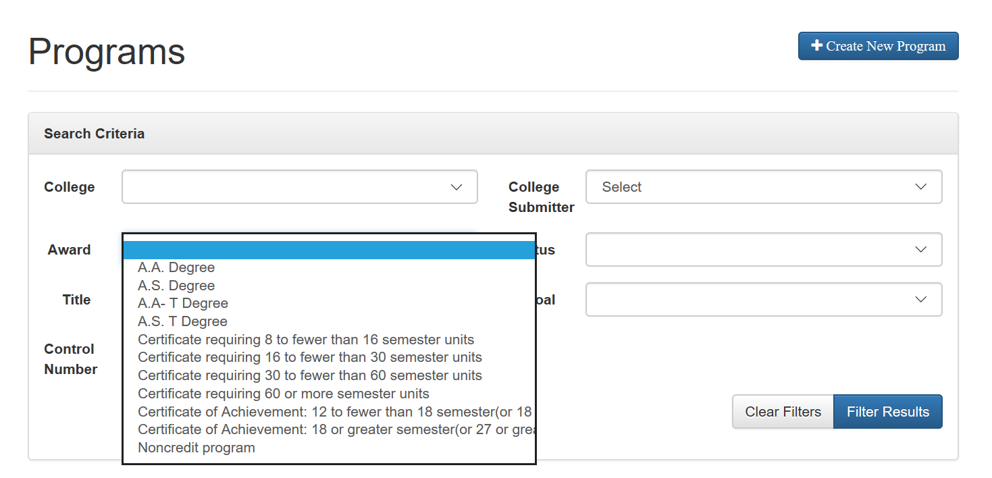
Certificate of Achievement

Slide 12
Certificate of Achievement
What it should say…
M - Certificate of Achievement: 8 to fewer than 16 semester (12 to fewer than 24 quarter) units
N - Certificate of Achievement: 16 or greater semester (24 or greater quarter) units
What it did say…
B - Certificate of Achievement: 12 to fewer than 18 semester (18 to fewer than 27 quarter) units
C - Certificate of Achievement: 18 or greater semester (27 or greater quarter) units

Slide 13
Certificate of Achievement
Certificates that are 16 to fewer than 18 semester (24 to fewer than 27 quarter) units that have not been previously approved and chaptered by the Chancellor’s Office:
Must be submitted for approval and chaptering
Then…
They will be called Certificates of Achievement
They will be recorded on student transcript

Slide 14
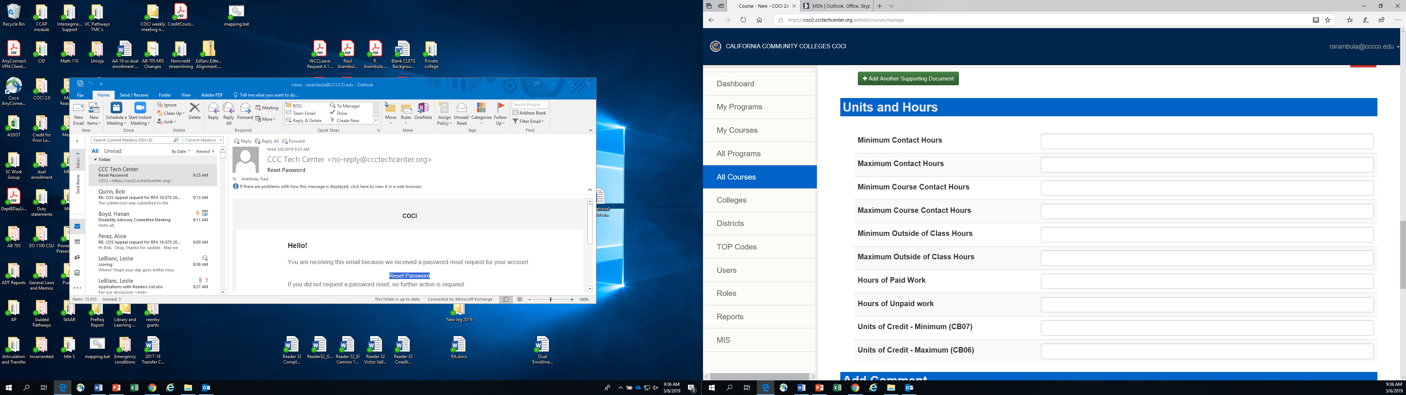
Work Experience

Slide 15
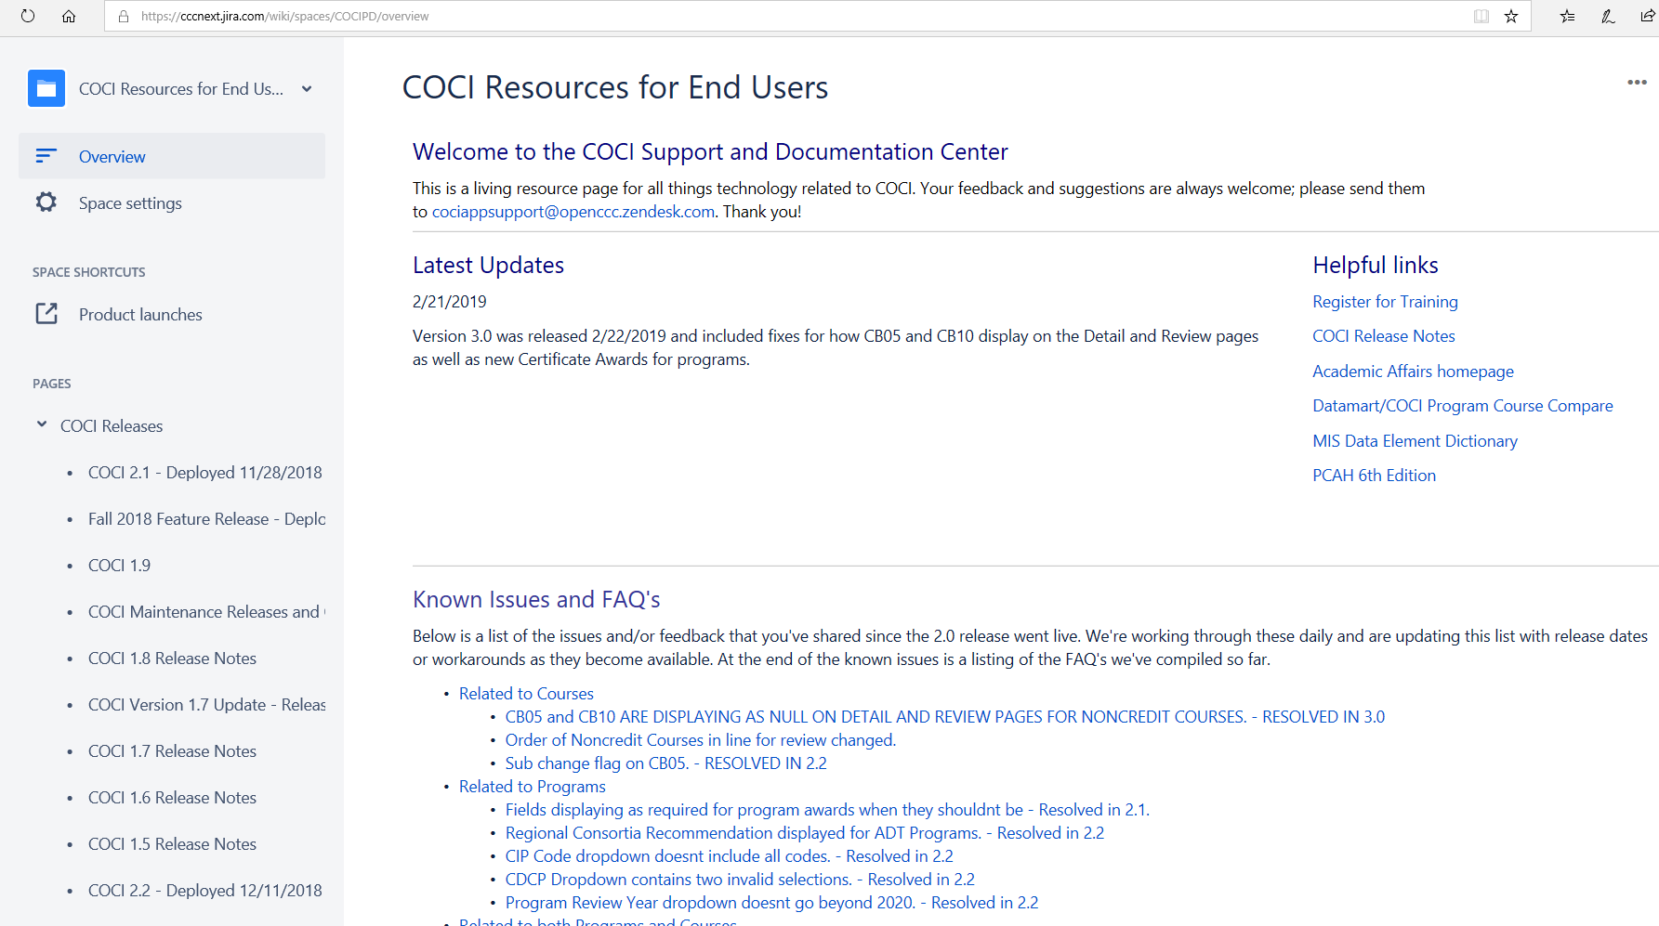
COCI User Guide

Slide 16
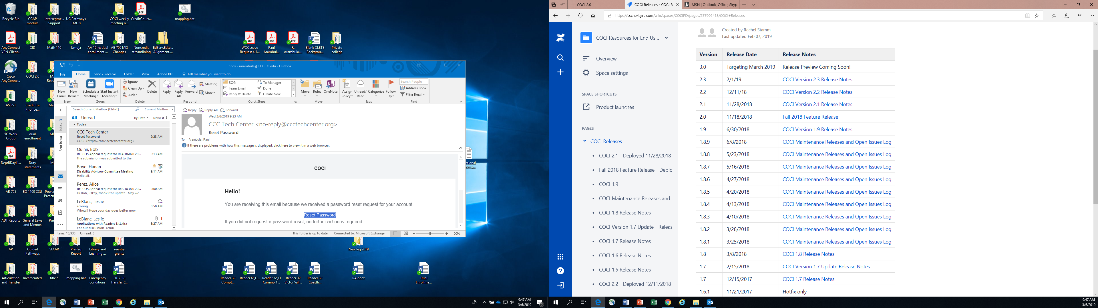
COCI Release Notes

Slide 17
CIO Perspective
Collaboration with ASCCC
Working with Curriculum Committees
Current Issues

Slide 18
The State of Curriculum:
Equity, Guided Pathways, a Big Picture View

Slide 19
Equity and Curriculum
Equity includes access and success for all students. Recent initiatives that focus on equity:
Guided Pathways
AB705
Student Centered Funding Formula (SCFF)
The first step to assessing equity involves knowing who your students are.
Has your curriculum committee ever had this discussion?
How are these initiatives changing your curriculum discussions/processes?

Slide 20
Guiding Question
How have Equity and a guided pathways framework impacted curriculum roles, processes, and procedures?
A few focus areas:
Curriculum Processes
Access and Enrollment Management
Program Mapping
Student Support

Slide 21
Guided Pathways and Curriculum
Guided Pathways asks us to re-examine our curriculum “the student experience with the end in mind.” Implementing guided pathways may involve re-examining current policies and processes.
What role does your Curriculum Committee play in implementing a guided pathways framework at your campus?
How has your Curriculum Committee changed due to guided pathways efforts at your college?
How can you ensure that the Curriculum Committee is involved in discussions around guided pathways?

Slide 22
Curriculum Processes:
Are we doing the same old thing?
Guided Pathways implementation requires silo-busting - this includes the curriculum process!
Have you reviewed your curriculum processes and/or structure in light of implementing guided pathways?
Does your committee include a discussion of equity in your curriculum processes and committee training?
What equity-focused questions should the Curriculum Committee ask when reviewing curriculum?

Slide 23
Program Development and the SCFF
The Student-Centered Funding Formula (SCFF) may result in an increased number of program proposals. With a focus on equity and guided pathways, colleges need to ensure that programs are meaningful and valuable to students – leaving Curriculum Committees to ask the tough questions.
Who can propose a new program?
How are new programs assessed for viability?
As new interdisciplinary programs are developed, how do you ensure that all interested/impacted faculty are involved in their development and maintenance?

Slide 24
Access/Enrollment Management:
Designing with the Student in Mind
An equity framework considers disproportionate impact on student populations in course design, modality, and scheduling.
Do your faculty, staff, and administration know your disproportionately impacted populations?
How have student equity data been used to measure the impact of course modality and scheduling on access?
What curricular innovations have been adopted in response to AB 705?

Slide 25
Program and Pathway Mapping:
Time for Cross-functional Discussions
Mapping programs and designing/evaluating pathways require cross-functional perspective, including discipline experts, counseling and student services, academic supports, and student voices.
How are programs being mapped at your college? Who is involved?
Are the backgrounds, needs, and course-taking capacity of your students being considered when developing program maps?
How can you ensure that program maps are useful to your student population?

Slide 26
Student Support:
It’s not Only for Student Services
Silo-busting means no more division between student services and instruction.
Are student support faculty involved in the curriculum process and do they serve on the committee?
What are good examples of student services inclusion in your Guided Pathways discussions?
What effective curricular practices have been developed and/or deployed at local colleges that support student success?

Slide 27
Other Considerations?

Slide 28
Lunch

Slide 29
AB 705 Data Revision Project – Why?

Slide 30
Why?
The Student Success Metrics for AB 705 and SCFF: all (no unit minimum) transfer-level courses with TOP Codes:
  1501.00 (English),
  1520.00 (Reading), and
  1701.00 (Mathematics)
TOP codes are taxonomy of program – but the metric is a course within various programs with other TOP codes
TOP codes not being counted such as:
  Quantitative Reasoning – 0401.00 (Biostats), 0502.00 (accounting), 0506.00 (Business), 0701.00 (Computer Science), 2001.00 (Psychology), 2204.00 (Economics), 2208.00 (Sociology)
  English Composition – 0514.00 (Office Technology), 4930.84 (ESL)
  ESL – Writing 4930.84, 4930.87 Integrated
Success for students meeting local math competency requirements is not being counted.

Slide 31
AB 705 Data Revision Project
With AB 705, AB 1805, the Student Centered Funding Formula – accurate and meaningful data collection is imperative.
The CCCCO contracted West Ed to spearhead the AB 705 Data Revision Project to update coding.
Five Workgroups with stakeholder representation: Coordination, MIS, Math, English/Reading, ESL

Slide 32
Project Overview
Review existing MIS codes to determine changes needed to support AB705 evaluation:
  Flag (code) for competencies in quantitative reasoning, English/reading, and ESL (integrated into CB21)
  Flag (code) for courses fulfilling general education composition and quantitative reasoning requirements (no existing elements)
  Flag (code) for the specific transfer status of courses (no existing elements)
  Flag for support courses associated with college-level courses (no existing elements)

Slide 33
Project Overview
Five working groups:
  Faculty, CIOs, researchers, and Chancellor’s Office staff: Coordination
  Credit, noncredit, and K12 adult school discipline faculty: ESL
  Credit, noncredit, and K12 adult school discipline faculty: English & Reading
  Credit, noncredit, and K12 adult school discipline faculty: Math
  Faculty, researchers, and Chancellor’s Office staff: MIS
Each group held 2 meetings between September 2018-January 2019

Slide 34
Recommendation One:
Revise the CB21 Rubrics
Integrate outcomes related to quantitative reasoning, English/reading courses, and ESL from the federal Educational Functioning Levels (EFL) already in use by noncredit programs and K12 adult schools.
Integrate outcomes from C-ID approved courses.
ASCCC will hold regional meetings to gather feedback about the revised rubrics for math and English this March, and bring the rubric to the spring plenary.
ESL will continue to work on its rubric through the spring, for review at the Curriculum Institute and over the summer.

Slide 35
Recommendation One:
Revise the CB21 Rubrics
The new rubric will enable faculty to document the levels of skills that students will have attained by the end of a broader range of pre-collegiate courses, such as pre-statistics.
Having one consolidated rubric will facilitate alignment between credit, noncredit, and adult schools and allow for mirrored courses and transition from adult education and noncredit to credit.
The element will continue to be used to determine skills gains in contexts like AB 705, the Student Success Metrics, and the Adult Education Program.

Slide 36
Recommendation Two: Edit Flag for Student Educational Functioning Level (SA07)
The existing code related to student scores on federal EFL pre- and post-tests should be amended to differentiate between progress in quantitative reasoning and English/reading, rather than displaying an integrated Adult Basic Education and Adult Secondary Education scores
Breaking out skill levels in quantitative reasoning and English/reading can be used to provide more refined information on adult education progress for AB 705 and the Adult Education Program and will allow for an additional means of tracking skills gains for the Student Success Metrics

Slide 37
Recommendation Three: Create a New MIS Flag for Courses that Fulfill General Education Requirements
Currently, the concept of passing transfer-level math and English is measured by looking at courses with math, English, and reading Taxonomy of Program (TOP) codes that also are flagged as transferrable to a four-year institution.
To more accurately capture the intent of AB705 and the SCFF, data should be collected on whether:
  Transfer-directed students pass courses that fulfill baccalaureate degree general education quantitative reasoning and composition requirements
  Local associate degree or certificate-directed students pass required college-level math courses and courses that fulfill general education requirements for English composition
  ESL students pass courses that fulfill general education requirements for English composition
The Chancellor’s Office will create a new MIS data element (CB25) and begin collecting data at the end of 2019-20

Slide 38
Courses that Fulfill Baccalaureate Degree Mathematics and Quantitative Reasoning General Education Requirements
A course should be flagged if it meets one or more of the following:
CSU (General Education Breadth): Area B4: Mathematics and Quantitative Reasoning
UC (IGETC): Area 2: Mathematical Concepts and Quantitative Reasoning
CCC Baccalaureate: IGETC or CSU General Education Breadth
Other Transfer Institutions: Courses must have general education certification or articulation agreements that ensure the course fulfills mathematics or quantitative reasoning requirements at an accredited four-year institution

Slide 39
Courses that Fulfill Local Associate Degree or Certificate Mathematics and Quantitative Reasoning Requirements
A course should be flagged if meets the Title 5 requirements for college-level quantitative reasoning:
[Title 5 §55063]
Note:
Title 5 language is under consideration by the BOG March 18, 2019

Slide 40
Courses that Fulfill English Composition General Education Requirements
A course should be flagged if it meets one or more of the following:
CSU (General Education Breadth): Area A2: Written Communication (Freshman Composition) and/or an Area A3: Critical Thinking course
UC (IGETC): Area 1A: English Composition and/or Area 1B: Critical Thinking and Composition
CCC Baccalaureate: IGETC or CSU General Education Breadth
Other Transfer Institutions: Courses must have general education certification or articulation agreements that ensure the course fulfills English Composition requirements at an accredited four-year institution

Slide 41
Recommendation Four: Create a New MIS Flag for Course Transfer Type
Transferrable courses should be flagged to identify whether the course counts for general education, electives, or a specific major.
Initially, this flag would be applied to transferrable general education composition, quantitative reasoning, and ESL courses, and then could be expanded to other transferrable courses over time.
The Chancellor’s Office will create a new MIS data element (CB26) and begin collecting data at the end of 2019-20.

Slide 42
Specific Transfer Status of Courses
A course should be flagged to identify all of the following criteria that are relevant:
Discussion included consideration of the following – still under discussion…
Elective credit at UC
General ed requirement at UC
Articulation agreement for a specific major at UC
Elective credit at CSU
General ed requirement at CSU
Articulation agreement for a specific major at CSU
Elective credit at another accredited four-year institution
General ed requirement at another accredited four-year institution
Articulation agreement for a specific major at another accredited four-year institution

Slide 43
Recommendation Five: Create a New MIS Flag for Support Courses Associated with College-Level Courses
It will be important to be able to identify support courses for analyses.
The Chancellor’s Office should create a new MIS data element (CB27) that identifies support courses associated with college-level courses and begin collecting data at the end of 2019-20.

Slide 44
The Plan – Recap
Create new data elements, in particular:
CB21 Identify content of English, math, ESL and related discipline courses using rubrics created by discipline workgroups based on EFLs, vetted by faculty statewide, approved by ASCCC delegates at 2019 spring plenary session – As of February 26, this coding be rolled into CB21 and the CB21 rubrics will be updated.
CB25 – Identify GE requirement or local competency: CSU GE Breadth/IGETC—B4/2A (math/QR) and A2, A3/1A (English Comp/Critical Thinking), local GE/competency
CB26 – transfer type: major, GE, elective, where to: CSU, UC, other college
CB27 – support course type, as of February 26, this is a binary code: support course or not a support course

Slide 45
The Plan – Recap
The Chancellor’s Office is creating/updating the MIS elements during March.
Training and vetting of CB21 Rubrics – not word-smithing taking place in March—AB 705 Data Revision Project Recoding Regional Meetings: March 5, 7, 13, 18, 21
Webinar on March 27 on the AB 705 Data Revision Project – more info to follow…
During the Curriculum Institute in July 2019, sessions will be offered where faculty can code their courses with support from curriculum experts.

Slide 46
Noncredit Curriculum – What’s New?

Slide 47
OVERVIEW
Noncredit Updates
  Policy Recap – Bird’s Eye View
  Using Noncredit for AB 705 Implementation
  Title 5 Draft Regulations
  Mirrored Courses
  ASCCC Noncredit Draft Paper

Slide 48
Noncredit policy recap…
BIRD’S EYE VIEW

Slide 49

Statutes Governing Curriculum
EDUCATION CODE
TITLE 3. POSTSECONDARY EDUCATION
  DIVISION 7. COMMUNITY COLLEGES
PART 43. THE CALIFORNIA COMMUNITY COLLEGES……….70900 - 70902
  PART 50. FINANCE……….84000 - 85304

Slide 50

Title 5 Regulations Governing Curriculum
California Code OF REGULATIONS (CCR)
Title 5. Education
Division 6. California Community Colleges
Chapter 1. Board of Governors
Chapter 2. Community College Standards
Chapter 3. General Provisions
Chapter 4. Employees
Chapter 5. Students
Chapter 6. Curriculum and Instruction
Chapter 7. Special Programs
Chapter 8. Construction
Chapter 9. Fiscal Support
Chapter 10. Community College Administration

Slide 51
NONCREDIT POLICY RECAP: COURSES

Slide 52
Noncredit Categories Eligible for Apportionment
EC § 84757; CCR title 5 § 58160
Noncredit Course Categories
ESL
Immigrant Education
Elementary and Secondary Basic Skills
Health and Safety
Substantial Disabilities
Parenting
Home Economics
Older Adults
Short-term Vocational
Workforce Preparation
The underlined instructional categories are eligible for (CDCP) enhanced funding, in accordance with Education Code 84760.5 and CCR title 5 section 55151 (i.e., ESL, Elementary and Secondary Basic Skills, Short-term Vocational With High Employment Potential, and Workforce Preparation).
Notes:
Noncredit course categories that are eligible for State apportionment, per EDC section 84757 (9 categories defined in EDC; 10th category (workforce preparation) defined in Title 5 section 55151)
Underlined categories are CDCP enhanced funding (EDC 84760.5(b); Title 5 section 55151 – CDCP)

Slide 53

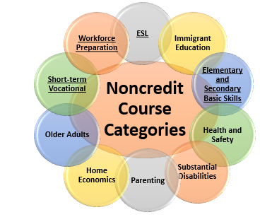
Limitations on State Aid
Title 5 § 58160. Noncredit Course Funding
Must be approved pursuant to Title 5 sections:
  55002 - Standards and Criteria for Courses, and
  55150 - Approval of Noncredit Courses and Programs
Must fall into one of the noncredit
instructional categories eligible for
state apportionment
§ 58160. Noncredit Course Funding.
(b) The provisions of sections 58050, 58051, 58051.5, 58130 and related provisions of this chapter also apply in determining whether a noncredit course is eligible for funding.
Notes:
(a) In order to be eligible to be claimed for state apportionment, a noncredit course must be approved pursuant to sections 55002 and 55150 and fall into one of the following statutory categories:
(1) elementary and secondary basic skills courses and other courses such as remedial academic courses in reading, mathematics, and language arts;
(2) courses in English as a second language, including vocational English as a second Language;
(3) short-term vocational courses and programs with high employment potential;
(4) workforce preparation courses in the basic skills of speaking, listening, reading, writing, mathematics, decisionmaking, problem solving skills, and other courses required for preparation to participate in job-specific technical training;
(5) courses in citizenship for immigrants;
(6) parenting, including parent cooperative preschools, courses in child growth and development and parent-child relationships;
(7) courses and programs for persons with substantial disabilities;
(8) courses and programs for older adults;
(9) courses and programs in home economics; and
(10) courses in health and safety education.
(b) The provisions of sections 58050, 58051, 58051.5, 58130 and related provisions of this chapter also apply in determining whether a noncredit course is eligible for funding.
(c) In order to be eligible for enhanced funding pursuant to Education Code sections 84750.5 and 84760.5, a career development or college preparation noncredit course must be part of a program or sequence of courses approved by the Chancellor pursuant to section 55151.
(d) Courses of the type described in section 55151 may not be claimed for enhanced funding if they are not part of a program or sequence of courses which is approved by the Chancellor pursuant to that section, but such courses may continue to be offered and be claimed for basic noncredit funding, provided that each individual course has been approved by the Chancellor pursuant to section 55150 and falls into one of the categories described in subdivision (a).
Note: Authority cited: Sections 66700, 70901, 78401 and 84760.5, Education Code. Reference: Sections 70901, 84500, 84750.5, 84757 and 84760.5, Education Code.

Slide 54

  Standards and Criteria for Noncredit Courses
Title 5 § 55002 (c)
A noncredit course is a course which, at a minimum is…
Recommended by the college and/or district curriculum committee
Approved by the district governing board as a course meeting the needs of enrolled students
Notes:
5 CCR § 55002
§ 55002. Standards and Criteria for Courses.
(c) Noncredit Course. A noncredit course is a course which, at a minimum, is recommended by the college and/or district curriculum committee (the committee described and established under subdivision (a)(1) of this section) and approved by the district governing board as a course meeting the needs of enrolled students.
(1) Standards for Approval. The college and/or district curriculum committee shall recommend approval of the course if the course treats subject matter and uses resource materials, teaching methods, and standards of attendance and achievement that the committee deems appropriate for the enrolled students. In order to be eligible for state apportionment, such courses must be approved by the Chancellor pursuant to article 2 (commencing with section 55150) of subchapter 2 of this chapter and satisfy the requirements of section 58160 and other applicable provisions of chapter 9 (commencing with section 58000) of this division.
(2) Course Outline of Record. The course is described in a course outline of record that shall be maintained in the official college files and made available to each instructor. The course outline of record shall specify the number of contact hours normally required for a student to complete the course, the catalog description, the objectives, contents in terms of a specific body of knowledge, instructional methodology, examples of assignments and/or activities, and methods of evaluation for determining whether the stated objectives have been met.
(3) Conduct of Course. All sections of the course are to be taught by a qualified instructor in accordance with the set of objectives and other specifications defined in the course outline of record.
(4) Repetition. Repeated enrollment is allowed only in accordance with provisions of section 58161.
Note: Authority cited: Sections 66700 and 70901, Education Code. Reference: Section 70901, Education Code.
HISTORY
1. Amendment of subsection (a) filed 12-28-83; effective upon filing pursuant to Government Code section 11346.2(d) (Register 83, No. 53).
2. Amendment filed 5-18-84; effective thirtieth day thereafter (Register 84, No. 20).
3. Repealer and new section filed 10-7-88; operative 11-6-88 (Register 88, No. 42).
4. Amendment filed 3-4-91 by Board of Governors of California Community Colleges with the Secretary of State; operative 4-5-91 (Register 91, No. 23). Submitted to OAL for printing only pursuant to Education Code Section 70901.5(b).
5. Amendment filed 10-25-91; operative 11-24-91 (Register 92, No. 7).
6. Amendment filed 10-5-93; operative 11-4-93. Submitted to OAL for printing only pursuant to Education Code section 70901.5(b) (Register 93, No. 42).
7. Editorial correction of History 4 (Register 95, No. 20).
8. Amendment filed 3-15-2006; operative 4-14-2006. Submitted to OAL for printing only pursuant to Education Code section 70901.5 (Register 2006, No. 17).
9. Amendment of subsection (c)(1) filed 1-17-2007; operative 1-17-2007. Submitted to OAL for printing only pursuant to Education Code section 70901.5 (Register 2007, No. 8).
10. Amendment of section heading and section filed 7-17-2007; operative 8-16-2007. Submitted to OAL for printing only pursuant to Education Code section 70901.5 (Register 2007, No. 35).
11. Amendment of subsections (a)(5) and (b)(5) filed 5-16-2008; operative 6-15-2008. Submitted to OAL for printing only pursuant to Education Code section 70901.5 (Register 2008, No. 21).
This database is current through 4/7/17 Register 2017, No. 14
5 CCR § 55002, Previous Term5 CA ADC § 55002Next Term
End of Document

Slide 55
NONCREDIT POLICY RECAP: CERTIFICATE PROGRAMS

Slide 56

  Approval of Noncredit Courses and Programs
Title 5 §55150
Who Approves?
Course Outline of Record (COR)
College Recordkeeping
Programs Approved by the Chancellor’s Office
Program Approval Forms
Notes:
5 CCR § 55150
§ 55150. Approval of Noncredit Courses and Programs.
(a) All noncredit courses shall be approved by the Chancellor in accordance with this article on forms provided by the Chancellor. Failure to comply with the provisions of this article may result in termination of approval.
(b) Course outlines of record for all noncredit courses prepared in accordance with subdivision (c) of section 55002 shall be on file in the community college offering the course.
(c) Authorities of each community college maintaining noncredit courses shall keep such current records and reports as may be required by the Chancellor.
(d) The following noncredit educational programs shall be approved by the Chancellor:
(1) Noncredit educational programs that qualify for enhanced funding;
(2) Adult high school diploma programs as specified in section 55154; and
(3) Those noncredit educational programs that are otherwise required by law to be approved by the Chancellor.
(e) Noncredit educational programs requiring approval of the Chancellor shall be approved by the Chancellor in accordance with this article and on forms provided by the Chancellor.
Approval of a noncredit educational program is effective until either:
(1) The noncredit educational program or implementation of the noncredit educational program is discontinued or modified in any substantial way; or
(2) The Chancellor evaluates the noncredit educational program after its approval on the basis of factors listed in sections 55151 or 55154, as applicable. If the Chancellor determines that the noncredit educational program should no longer be offered based on the evaluation, the Chancellor may terminate the approval and determine the effective date of termination.

Slide 57
  Noncredit Programs
Noncredit
Certificate of Competency
(T5, §55155)
Certificate of Completion
(T5, §55155)
Adult High School Diploma
(T5, §55154)
The underlined programs are eligible for CDCP enhanced funding, EDC 84760.5 (b)
Notes:
- Noncredit Programs, Title 5 section 55155
- Underlined programs are CDCP (EDC 84760.5; Title 5 section 55151)
- AHSD, see Title 5 section 55154

Slide 58
  Noncredit Certificates
Title 5 §55155
(b) All noncredit educational programs leading to a
Noncredit Certificate of Completion or
Noncredit Certificate of Competency
must be approved by the Chancellor pursuant to section 55151 – Career Development and College Preparation.
Notes:
§ 55155. Noncredit Certificates.
(a) Any noncredit educational program leading to a certificate must be approved by the college curriculum committee and the district governing board.
(b) All noncredit educational programs leading to a noncredit certificate of completion or certificate of competency must be approved by the Chancellor pursuant to section 55151.
(c) If a district does not seek enhanced funding for a noncredit educational program, or it does not qualify for enhanced funding pursuant to section 55151, a noncredit educational program leading to a certificate may be established by the district without approval by the Chancellor except as required in section 55154. A district may award a certificate to a student completing a noncredit educational program, but may not designate or refer to it as a certificate of completion or a certificate of competency in a recognized career field pursuant to section 55151.
(d) A certificate awarded to a student completing a noncredit educational program may not be referred to as a certificate of achievement regardless of its length or whether it has been approved by the Chancellor.
(e) A description of each approved noncredit educational program shall be included in the college catalog.
(f) Provisions of this section regarding the naming or designation of certificates shall become effective for the Fall 2008 term.
Note: Authority cited: Sections 66700 and 70901, Education Code. Reference: Sections 70901 and 70902, Education Code.

Slide 59

Career Development and College Preparation (CDCP) Certificates
CDCP – Career Development and College Preparation
Community College Funding Legislation (SB 361)
Education Code Statutes
  CDCP Funding (84750.5)
  Instructional Requirements (84760.5)
Title 5 Regulations
  Curriculum and Instruction (Ch 6, § 55151)
  Fiscal Support (Ch 9)
Note: CDCP is also referred to as noncredit “Enhanced Funding”
Notes:
CDCP is also referred to as “Enhanced Funding”

Slide 60
CDCP Certificate Requirements
Ed Code § 84760.5 (b)
Limits CDCP eligibility to courses in the following instructional categories*:
Workforce Preparation
Short-term Vocational w/
High Employment Potential
Elementary and Secondary Basic Skills
English as a second language (ESL) and
vocational English as a second language
*Course Data Element CB22 = A, C, I, or J
*CDCP courses and certificates cannot be limited to exclusive “special/target” populations such as Older Adults, Disabled Students, Parents, and Immigrants
Career Development
Certificate of Completion
Title 5,
§ 55151(h)
Certificate of Competency
Title 5,
§ 55151(i)
College Preparation
Notes:
Education Code section 84760.5 provides the fundamental framework for defining CDCP noncredit courses and classes that are eligible for enhanced funding.
Only courses subject to subdivision (b) of 84760.5 are eligible for enhanced funding, which limits eligibility to the following:
- Classes and courses in elementary and secondary basic skills;
- Classes and courses for students eligible for educational services in workforce preparation classes in the basic skills of speaking, listening, reading, writing, mathematics, decision-making and problem-solving skills that are necessary to participate in job-specific technical training;
- Short-term vocational programs with high employment potential, as determined by the California Community Colleges chancellor in consultation with the Employment Development Department utilizing job demand data provided by that department; and
- Classes and courses in English as a second language and vocational English as a second language.

Slide 61
Corequisite Noncredit Course
AB 705 Implementation
A corequisite course in noncredit is allowable and may be required (per AB 705 FAQ released August 2018) if the college can demonstrate that the corequisite increases the likelihood of success.
The corequisite course could have variable hours to allow different amounts of corequisite support to be scheduled with only one course outline.
Courses are required to have an approved course outline that meets the requirements outlined in Title 5 §55002 (this includes specifying possible topics that will be covered in the course content)

Slide 62
Corequisite Noncredit Course
AB 705 Implementation
Possible Advantages
Students enroll in the class for free
Students don’t accumulate excess units
Courses could be scheduled as open entry/open exit or regularly scheduled times
Student can reenroll in the support course until they pass the transfer course
Possible Disadvantages
Course would not count towards financial aid eligibility
Restricted to basic skills
Student may have different instructor for lecture and support course
Student may be in lecture course with students that are more prepared
Colleges would currently be paid at the noncredit rate (not enhanced funded)
Courses are not covered by streamlined approval at the CO

Slide 63
Noncredit Short Term Review Courses
AB 705 Implementation
Target Audience:
Pre-enrollment and those who withdraw/fail
Noncredit and credit faculty come together to create curriculum
Free
Math review to include a STAT and STEM pathway
Open entry/exit
Flexible scheduling
Customized to student need based on diagnostic testing, competency-based
Embedded tutors and counselors

Slide 64
Placement of Students from Noncredit/Adult Education
AB 705 Implementation
Students with an Adult High School Diploma
  Would be placed like traditional high school students
  Transcript data is good for a minimum of 10 years
Students with High School Equivalency (GED/HiSET/TASC)
  No statewide placement rules have been determined yet
  Students would be placed based on a college’s local evaluation
  The Chancellor’s Office is assembling a group to determine whether additional guidance should be developed.

Slide 65
Title 5 Regulations – Changes…?
ASCCC Resolution 9.02 F18 calls for noncredit curriculum approval processes to be equalized to credit curriculum approval processes.
Title 5 Sections under consideration:
§55150 – Approval of Noncredit Courses and Programs
§55151 – Career Development and College Preparation
§55154 – Adult High School Diploma Programs
§55155 – Noncredit Certificates
§58160 – Noncredit Course Funding

Slide 66
Credit Curriculum Approval
Automated Curriculum Approval
Recommended by Curriculum Committee/Academic Senate
Approved by Local Board of Trustees
Chaptered by the Chancellor’s Office
Certified by the Curriculum Chair, CIO, Academic Senate President, CEO:
  All credit courses
  Modified credit programs with the exception of ADTs
  New credit programs with a goal of local program with the exception of new CTE credit programs and Apprenticeship
The Chancellor may at any time limit or terminate the college district’s ability to self-certify such curriculum.

Slide 67
Noncredit Curriculum Approval – Concept
Has not been approved
Automated Curriculum Approval
Recommended by Curriculum Committee/Academic Senate
Approved by Local Board of Trustees
Chaptered by the Chancellor’s Office
Certified by the Curriculum Chair, CIO, Academic Senate President, CEO:
  All noncredit courses
  Modified noncredit programs
  New noncredit programs with the exception of CDCP short-term vocational noncredit programs
The Chancellor may at any time limit or terminate the college district’s ability to self-certify such curriculum.

Slide 68
Mirrored Courses – Credit/Noncredit
Colleges can have equivalent versions of credit and noncredit courses (usually seen in ESL or short term vocational).
These courses can be scheduled at the same time, with the same instructor (instructor must meet credit minimum qualifications) and have credit and noncredit students enrolled.
Colleges can choose whether they allow noncredit students to petition for course credit through credit by exam.
These types of courses can be helpful for students that are transitioning from noncredit into credit.
5C has recommended that automated approval of noncredit course that mirrors an approved credit course – February 2018

Slide 69
Draft Noncredit Paper from ASCCC
Noncredit Instruction: Opportunity and Challenge by ASCCC Noncredit Committee
1st Reading at ASCCC Executive Committee February 2019
2nd Reading at ASCCC Executive Committee March 2019
Draft for ASCCC Spring 2019 Plenary Session Consideration
Final Edits and Formatting during summer 2019 (provided it is approved at the plenary session)

Slide 70

Questions?
Thank You!

Slide 71
Resources
Student Success Metrics Dash Board, Second Build 1-18-2019: https://digitalfutures.cccco.edu/Portals/0/Documents/data-element-dictionary.pdf
CCCCO Data Element Dictionary: http://extranet.cccco.edu/Divisions/TechResearchInfoSys/MIS/DED.aspx
CCCCO MIS Data Mart: https://datamart.cccco.edu/DataMart.aspx
Academic Senate for California Community Colleges: https://asccc.org

Slide 72
Some Acronyms and Definitions
MIS – Chancellor’s Office Management Information System: http://extranet.cccco.edu/Divisions/TechResearchInfoSys/MIS.aspx
CB – Course Basic: signifies the domain of the data element. These codes are assigned to courses for tracking and analyses. The CB data elements can be found here: http://extranet.cccco.edu/Divisions/TechResearchInfoSys/MIS/DED/Course.aspx
ESL – English as a Second Language
SCFF – Student Centered Funding Formula
EFL – Educational Functioning Level: used in noncredit and adult education to define competency levels
SSM – Student Success Metrics: https://digitalfutures.cccco.edu/Projects/Student-Success-Metrics

Slide 73
Acronyms
ASCCC – Academic Senate for California Community Colleges
CCCCO or CO – California Community Colleges Chancellor’s Office or Chancellor’s Office
CSU GE – California State University General Education
IGETC – Intersegmental General Education Transfer Curriculum
SCFF – Student Centered Funding Formula
ADT – Associate Degree for Transfer
CTE – Career and Technical Education
LMI – Labor Market Information
PCAH – Program and Course Approval Handbook
AAM – Articulation Agreement for Major
SOC – Standard Occupational Classification
TOP – Taxonomy of Program
EDD – Employment Development Department
CDCP – Career Development and College Preparation
COR – Course Outline of Record
COCO – Chancellor’s Office Curriculum Inventory
CWE – Cooperative Work Experience

